Slide 1
Key Requirements of the Construction General Permit
Scott Taylor, P.E., CISEC

Slide 2
Permit Fast Facts
285 page permit
All reporting is publicly available through SMARTS
Requires self-reporting, which may lead to enforcement
Substantial fines for noncompliance
~7,000 active projects in CA
Requires runoff sampling for some projects (RL 2, 3, non-visible)

Slide 3
Project Fast Facts
All projects greater than one acre (DSA) must:
Conduct risk level determination
Register for permit coverage
Pay the first annual fee
Develop a SWPPP
Implement the SWPPP during construction
Stabilize all disturbed areas after construction
Construct post-construction BMPs/maintenance plan
Submit annual reports
Terminate permit coverage

Slide 4
Past Enforcement Actions (Or, Why Should You Care?)
Walmart, $3.1 million
EPA, 2004, for failure to obtain stormwater permits and implement BMPs
Richmond American + other companies, $928,500
EPA, 2003, for failure to obtain stormwater permits, develop/implement SWPPPs, implement BMPs to minimize sediment discharge, and conduct site inspections
City of San Diego, $532,000
RWQCB, 2000, for failure to curb erosion from City roadway
Caltrans, $1,600,000
RWQCB, 2011, for failure to implement effective BMPs

Slide 5
Responsibilities
Property owners – have full responsibility:
Ensure permit compliance
Certify all documents as required by the CGP
PRDs, COI, NOT, monitoring data, exceedance/violation reports
Inspect, monitor, sample, repair, report
Submit a Notice of Termination to State when project is complete
QSD:
Conduct risk assessment
Write SWPPP
Develop SWPPP amendments for major changes
QSP
Implement and maintain SWPPP
Conduct inspections, monitoring, sampling, BMP repair, reporting
Communicate with project owner and QSD
Provide information for NOT

Slide 6
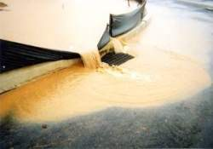
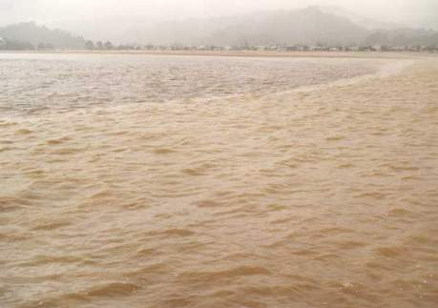
Pollutant Effects - Sediment
Increased water temperature, decreased light penetration in waterbody, pollutants…

Slide 7
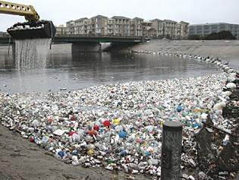
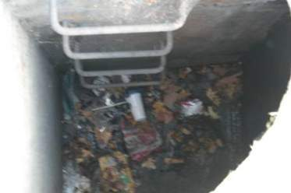
Pollutant Effects - Trash
Aesthetics and impacts to wildlife
Notes:
Ballona creek

Slide 8
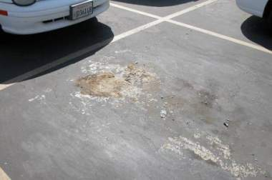
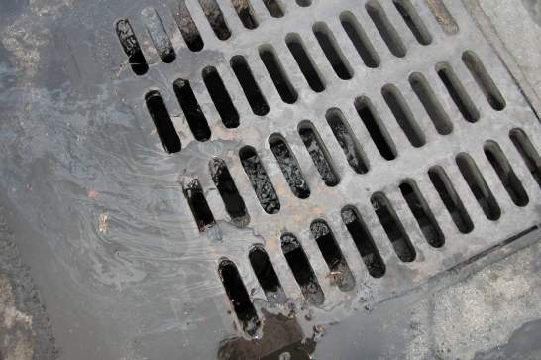
Pollutant Effects – Oil and Grease
Toxicity to aquatic organisms, aesthetics

Slide 9
Permit Requirements
Based on project Risk Level or LUP Type
Risk Level refers to traditional, box projects
LUP Type refers to linear utility projects
A project may be Risk Level 1, 2, 3 or LUP Type 1, 2, or 3
Risk Level 1 and LUP Type 1 are the simplest

Slide 10
Compliance Activities: Risk Level 1
Task | Submittal Requirement
Weekly Inspection Report | Hold in SWPPP, submit with Annual Report
Storm Event Inspection Report (pre/during/post storm) | Hold in SWPPP, submit with Annual Report
SWPPP Modifications | Upload major modifications
Quarterly Non-Stormwater Inspection | Hold in SWPPP, submit with Annual Report
Non-visible Pollutant Monitoring | Hold in SWPPP, submit with Annual Report
Annual Report | Covers July 1 – June 30, Due September 1
Notice of Termination | Submit within 90 days of project completion

Slide 11
Compliance Activities: Risk Level 2
Task | Submittal Requirement
Weekly Inspection Report | Hold in SWPPP, submit with Annual Report
Storm Event Inspection Report | Hold in SWPPP, submit with Annual Report
Rain Event Action Plan (REAP) | Hold in SWPPP, submit with Annual Report
Weather forecast | Hold in SWPPP, submit with Annual Report
NAL compliance monitoring data | Hold in SWPPP, submit with Annual Report If NAL exceedance, submit to SMARTS within 10 days
NAL Exceedance Report | Submit to SMARTS if requested by RB
SWPPP Modifications | Upload major modifications
Quarterly Non-Stormwater Report | Hold in SWPPP, submit with Annual Report
Non-visible pollutant Monitoring | Hold in SWPPP, submit with Annual Report
Annual Report | Covers July 1 – June 30; due on September 1
Notice of Termination | Within 90 Days of project completion

Slide 12
Compliance Activities: Risk Level 3
Task | Submittal Requirement
Weekly Inspection Report | Hold in SWPPP, submit with Annual Report
Storm Event Inspection Report | Hold in SWPPP, submit with Annual Report
Rain Event Action Plan (REAP) | Hold in SWPPP, submit with Annual Report
Weather forecast | Print daily, hold in SWPPP, submit with Annual Report
NAL compliance monitoring data | Hold in SWPPP, submit with Annual Report If NAL exceedance, submit to SMARTS within 10 days
NAL Exceedance Report | Submit to SMARTS if requested by RB
Receiving Water Monitoring | If violation of old NELs….
ATS System | Receiving water monitoring (maybe)
SWPPP Modifications | Upload major modifications
Quarterly Non-Stormwater Report | Hold in SWPPP, submit with Annual Report
Non-visible pollutant Monitoring | Hold in SWPPP, submit with Annual Report
Annual Report | Covers July 1 – June 30; due on September 1
Notice of Termination | Within 90 days of project completion

Slide 13
Compliance Activities: LUP Type 1
Task | Submittal Requirement
Daily BMP Inspections | Hold in SWPPP, submit with Annual Report
SWPPP Modifications | Upload major modifications
Photographs | Upload pre, during and post storm photos for every third storm event
Annual Report | Covers July 1 – June 30
Notice of Termination | Submit within 90 days of project completion
Note that weekly inspection report and Quarterly Non-Stormwater Report are not required for LUP Type 1 projects

Slide 14
Compliance Activities: LUP Type 2
Task | Submittal Requirement
Storm Event Inspection Report (pre/during/post) | Hold in SWPPP, submit with Annual Report
Daily BMP and Trackout Inspections | Log in SWPPP, submit with Annual Report
Weather forecast | Hold in SWPPP, submit with Annual Report
NAL compliance monitoring data | Hold in SWPPP, submit with Annual Report If NAL exceedance, submit to SMARTS within 10 days
NAL Exceedance Report | Submit to SMARTS if requested by RB
Photographs | Upload pre, during and post storm photos for every third storm
SWPPP Modifications | Upload major modifications
Annual Report | Covers July 1 – June 30; due on September 1
Notice of Termination | Submit within 90 days of project completion

Slide 15
Compliance Activities: LUP Type 3
Task | Submittal Requirement
Storm Event Inspection Report (pre/during/post) | Hold in SWPPP, submit with Annual Report
Daily BMP and Trackout Inspections | Log in SWPPP, submit with Annual Report
Weather forecast | Print daily, hold in SWPPP, submit with Annual Report
Photographs | Upload pre, during and post storm photos for every third storm
NAL compliance monitoring data | Hold in SWPPP, submit with Annual Report If NAL exceedance, submit to SMARTS within 10 days
NAL Exceedance Report | Submit to SMARTS if requested by RB
No NELs!
Non-Stormwater Monitoring | Hold in SWPPP, submit with Annual Report
SWPPP Modifications | Upload major modifications
Annual Report | Covers July 1 – June 30; due on September 1
Notice of Termination | Submit within 90 days of project completion

Slide 16
Storm Water Pollution Prevention Plan (SWPPP)
Document that summarizes construction site compliance activities
Reflects the Risk Level
Identifies Qualified SWPPP Practitioner/ Qualified SWPPP Developer
Includes:
Monitoring Requirements (CSMP)
Inspection Requirements/Logs/forms
Sampling Locations
Erosion and Sediment Control Drawing
BMPs to be used
Non-stormwater management
ID of ESA’s, TMDLs, other site conditions

Slide 17
Numeric Action Levels (NALs)
Risk Level 2 and 3 Sites
pH NAL = 6.5 – 8.5
Turbidity NAL = 250 NTU
Verify compliance with NAL by sampling stormwater runoff during storm events
Upon NAL exceedance, the Regional Board may require the submittal of an NAL Exceedance Report
NAL exceedance triggers BMP review and improvement cycle
NAL exceedance is not a violation, but is an immediate call to action
Notes:
a couple of things happen when an nal exceedance occurs. First, you have to submit your monitoring results to the RB, via SMARTS. Then, if the RB elects, an nal exceedance report must be submitted.

Slide 18
Numeric Effluent Limitations (NELs)
Risk Level 3 Sites:
pH NEL = 6.0 – 9.0
Turbidity NEL = 500 NTU
GONE! More about this later…..
Notes:
Submit nel violation report to rb via smarts; must be certified by an lrp or approved signatory – very fast turnaround

Slide 19
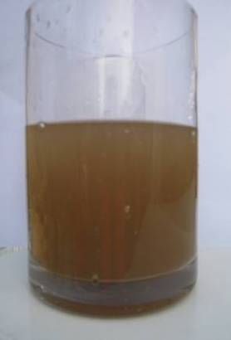
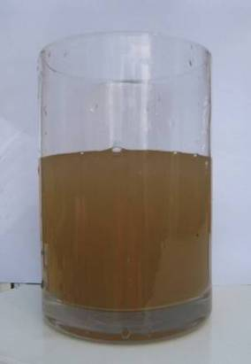
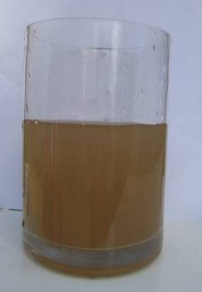
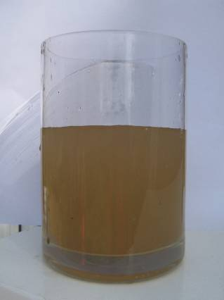
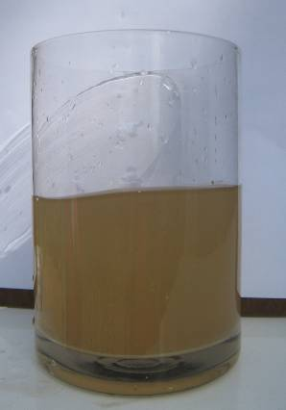
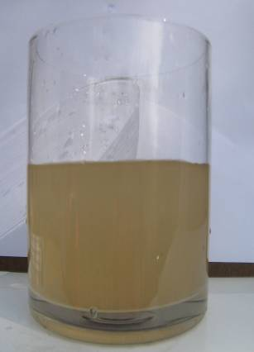
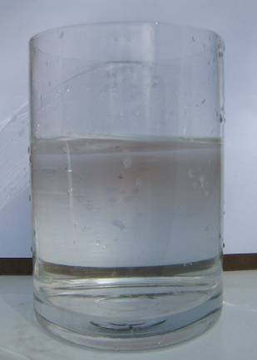
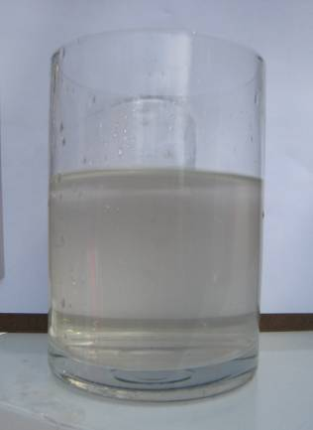
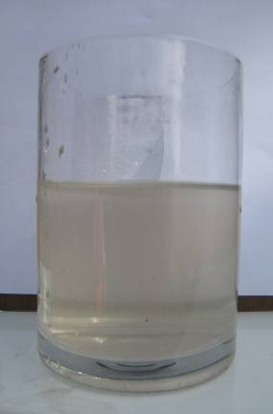
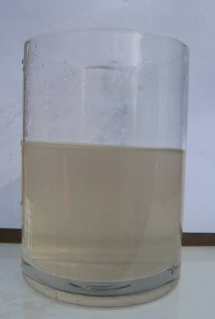
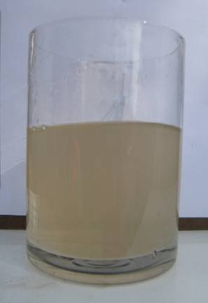
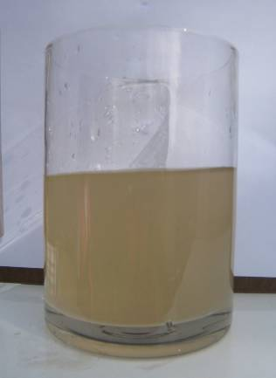
Turbidity Readings - Visual Comparisons
933 NTU
745 NTU
584 NTU
477 NTU
404 NTU
283 NTU
4 NTU
44 NTU
64 NTU
107 NTU
140 NTU
216 NTU
Readings Above Old Turbidity NEL (Monitoring)
Readings Above Turbidity NAL (call to action)
Readings Below Turbidity NAL

Slide 20
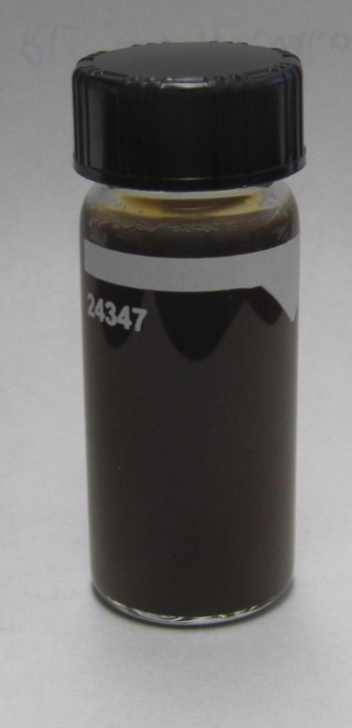
Guess the Turbidity?
Sample #1
Sample #2
Notes:
Sample 1: 37.2 NTU
Sample 2: >1000 NTU
Sample 2: after 10:1 dilution, measured 372 NTU
Goes to show that you can’t judge turbidity without a turbidity meter.

Slide 21
Certification and Training
Qualified SWPPP Developer (QSD)
Writes and prepares SWPPP
Must obtain registrations/certifications by 7/1/2010
Must attend three-day training by 9/2/2011
Must pass QSD exam by 9/2/2011
Qualified SWPPP Practitioner (QSP)
Responsible for the implementation of the SWPPP and REAP
Must obtain registrations/certifications by 9/2/2011
Must attend two-day training by 9/2/2011
Must pass QSP exam by 9/2/2011
All Grandfathering Dates have Past!

Slide 22
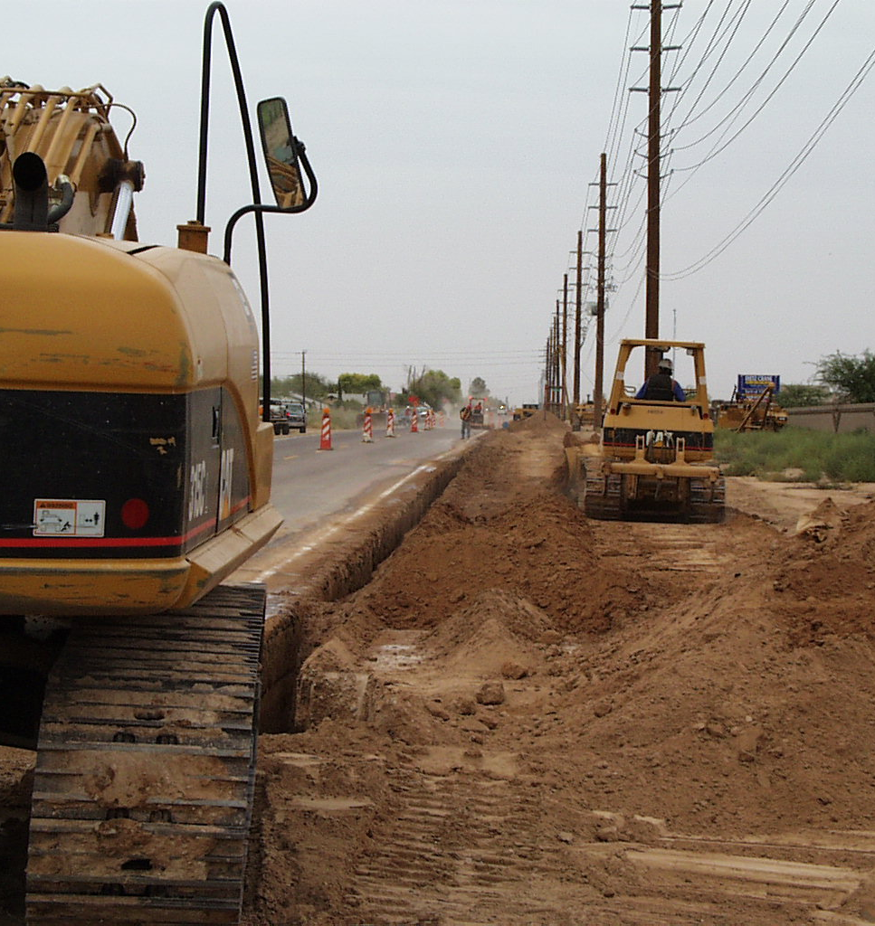
Example Project – Start to Finish
Risk Level 2 project
Risk Level 2 field requirements:
SWPPP implementation
Weekly BMP inspection (documented)
Daily visual inspection
Storm event inspections (pre/during/post storm)
Quarterly non-stormwater inspection
Rain Event Action Plan (REAP)
Storm event monitoring for pH and turbidity
BMP installation and maintenance
22

Slide 23
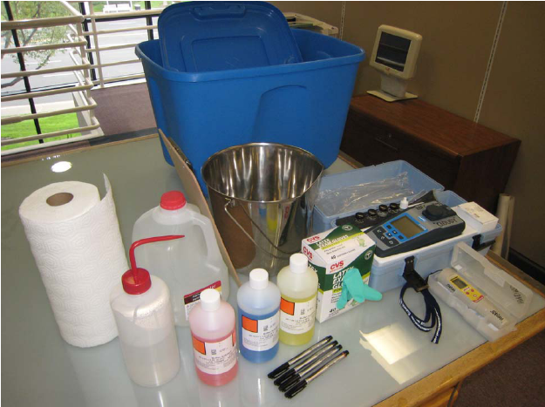
2 Weeks Prior to Construction
Permit coverage acquired (WDID)
SWPPP developed
Field inspector/QSP receives the SWPPP
Prepare for stormwater monitoring
Train the contractor
Prepare project schedule

Slide 24
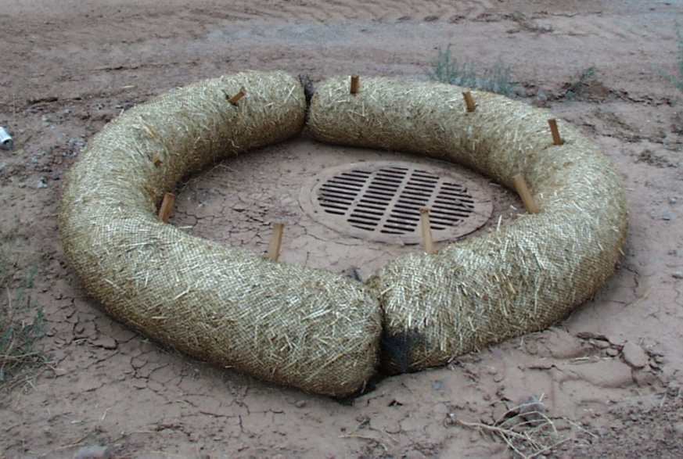
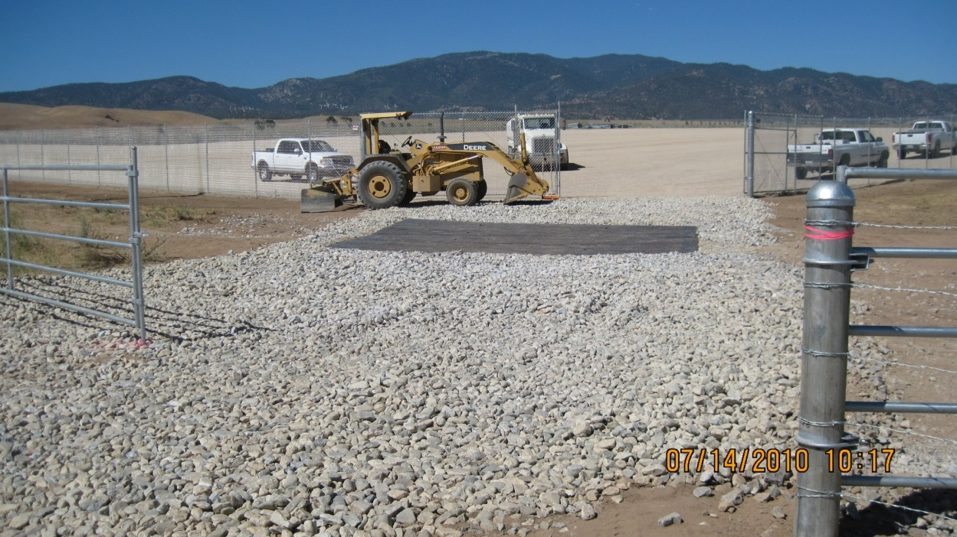
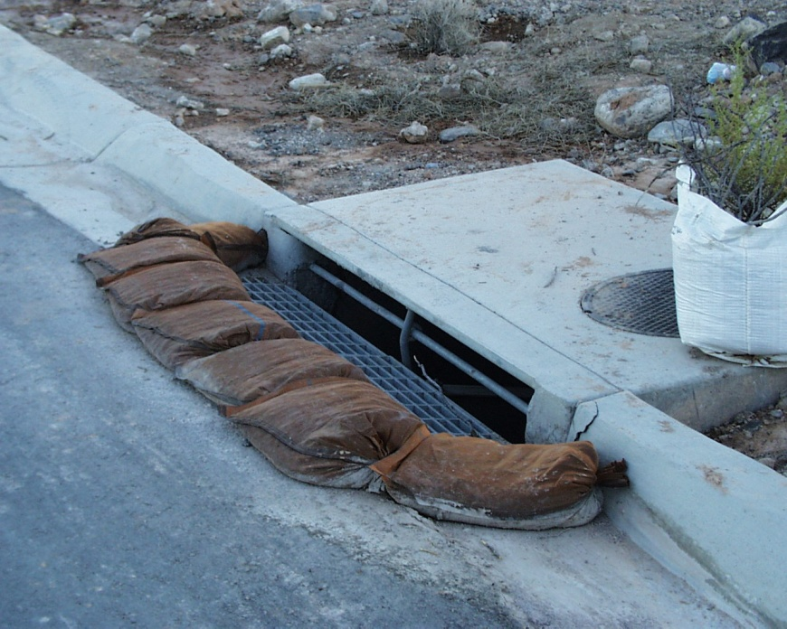
Start of Construction
Prior to grading or clearing:
Install tracking control BMPs
Install laydown area BMPs
Install inlet protection BMPs
Install perimeter controls
Note: The SWPPP map must always reflect the BMPs on the site!
24

Slide 25
Start of Construction
Begin weekly and quarterly inspections
Begin daily visual track-out inspections
Maintain log sheet of visual inspections in SWPPP
Check NOAA website (weather.gov) daily for rain forecasts
Perform pre, during, and post storm inspections as needed
Develop Rain Event Action Plan as needed
Begin monitoring
Non-visible pollutants (upon spill)
pH and turbidity (during rain events)
25

Slide 26
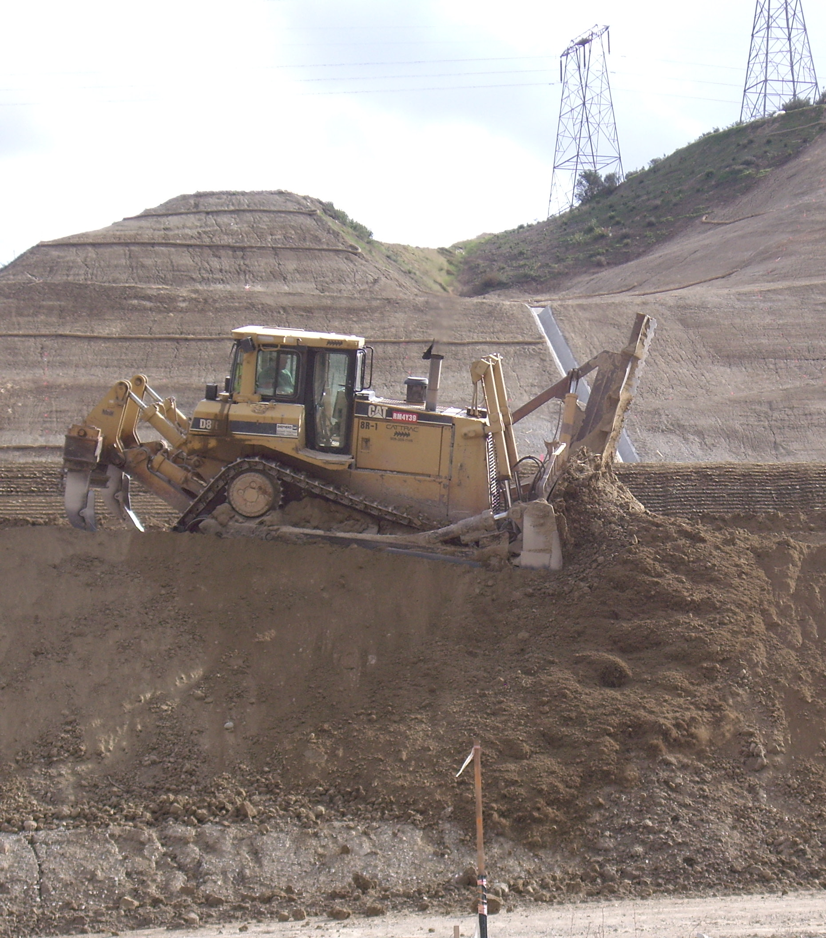
55% Chance of Rain Forecasted
50% is the trigger for a storm event
Develop a REAP
Conduct pre-storm site inspection
Fill out inspection checklist
Take photos of the site
Install BMPs to protect active areas from rain event
Prepare to sample runoff from all cleared construction areas for pH and turbidity
QSP or person trained by the QSP must perform inspections/sampling
26

Slide 27
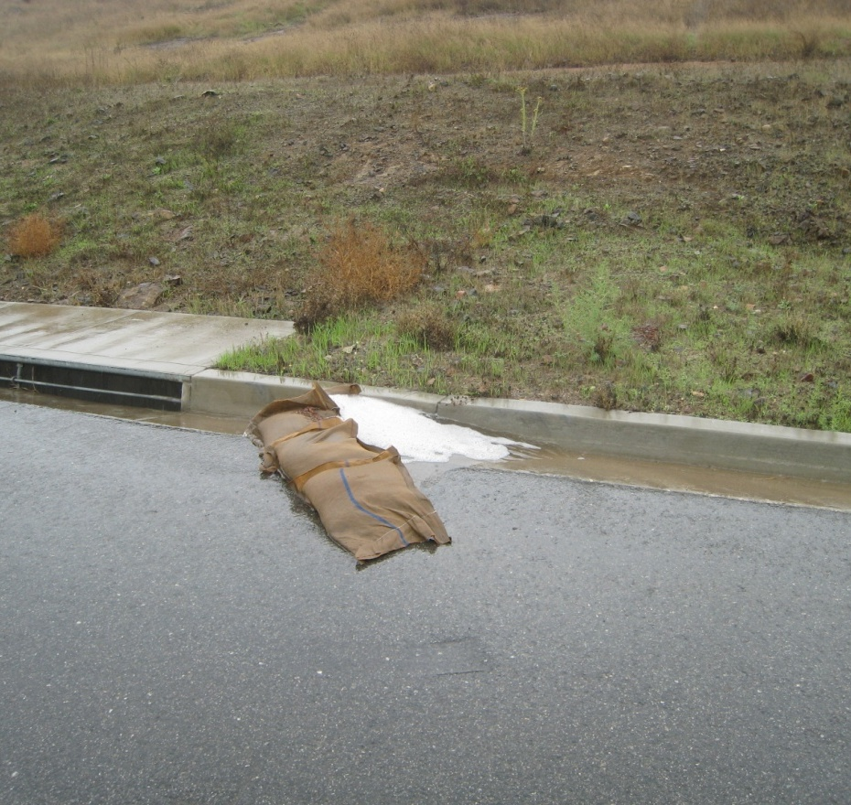
Rain Event Occurs
Conduct storm-event inspection
Fill out site inspection checklist
Take photos of site
Use SWPPP map to identify BMPs that should be on site
Sample runoff for pH and turbidity minimum of 3 times per day
Sample where discharge leaves the project site
Sampled runoff must be representative of all site runoff
All pH and turbidity measurements must be made in the field (use portable instruments)
27

Slide 28
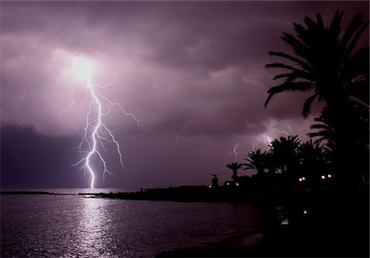
Rain Event Occurs
Follow Monitoring & Reporting Plan in SWPPP
If site is deemed “unsafe”, sampling is not required or outside normal business hours
28

Slide 29
Post-Storm
Conduct post-storm inspection within 48 hours
Fill out inspection checklist
Take photos of site
Repair BMPs as needed (w/in 72 hrs)
Coordinate with QSP to deliver monitoring results
pH and turbidity data must be uploaded to SMARTS if there are exceedances of the Numeric Action Levels
Store all completed inspection records in the SWPPP
Records must be maintained for 3 years from date of origination
29

Slide 30
Construction Operations
Stop inspecting and monitoring at completed/stabilized areas of the project (with proper documentation) with COI
Continue BMP maintenance
Continue to check NOAA website (noaa.gov) for rain event forecasts
If a Regional Board inspector visits your project, you MUST allow them access, and show them your SWPPP
If you have questions on the SWPPP or the permit, call your City stormwater coordinator
30

Slide 31
If NAL Exceedance Occurs
Contact QSP to initiate reporting
Determine where BMPs failed
Repair BMPs or install additional BMPs, confer with owner/QSD
Be prepared for an inspection
31

Slide 32
Tips for Achieving Compliance
Ensure that the QSP completes all administrative requirements
Inspections, SWPPP maintenance
The SWPPP map should always show exactly which BMPs are installed. It’s the first thing an inspector will ask to see during an inspection!
Never allow trackout
Prevent trash from blowing off the site
Concrete washouts must be water tight
Always be forthright with Regional Board inspectors.
If a BMP breaks, somebody has to fix it! (within 72 hrs)

Slide 33
Recent Permit Changes
Dec 27, 2011, Superior Court issued ruling in BIA vs. SWRCB: NELs for Risk Level 3 and LUP Type 3 invalidated.
What this means on a construction site:
NALs for RL 2 and 3 sites remain in effect
NELs are not applicable
Receiving water monitoring is suspended, but not for long…
SWPPP should be amended to reflect these changes
SWRCB prepared a Permit Amendment for adoption in July, 2012

