Slide 1
Analyzing a Development Site
for Low Impact Development design

Slide 2
LID Design Guide
Page 35
Analyze your project
Select LID options
Design site and document drainage
Show how criteria are met
Specify preliminary design details
Integrate LID with paving and landscaping
Iterate

Slide 3
LID Design Guide
Analyze your project
Select LID options
Design site and document drainage
Show how criteria are met
Specify preliminary design details
Integrate LID with paving and landscaping
Iterate

Slide 4
Strategies, Applicability, Design
Optimize the site layout
Use pervious surfaces
Disperse runoff
Store runoff and use it later
Use bioretention (or other facilities)
Page 36

Slide 5
Optimize the Site Layout
Protect Watercourses and Drainage
Preserve Open Space
Cluster Buildings
Minimize Pavement Widths
Minimize Parking
APPLICABILITY

Slide 6
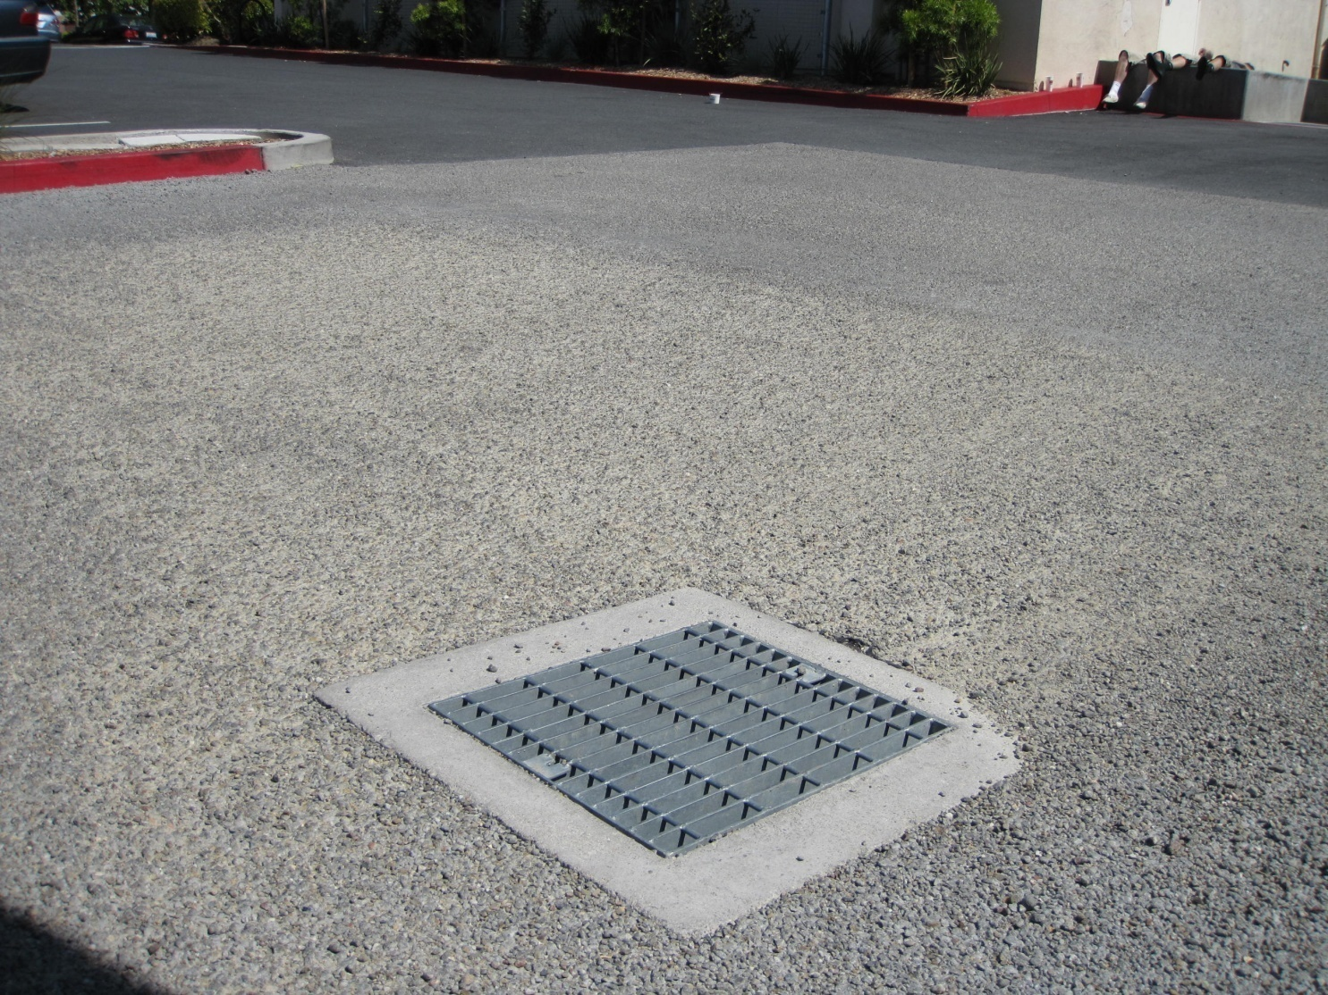
Pervious Pavement
Expensive to build
Durability and maintenance issues
Best for:
Flat sites with limited access to drainage
No need for drainage pipes or structures
On well-drained, competent soils
Where traffic is limited
For aesthetic reasons
To avoid thresholds
APPLICABILITY

Slide 7
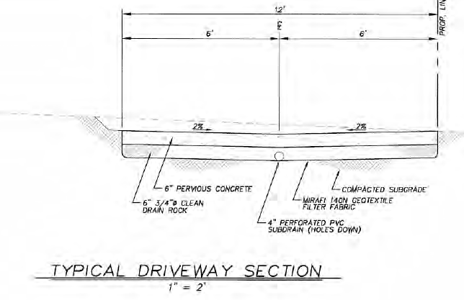
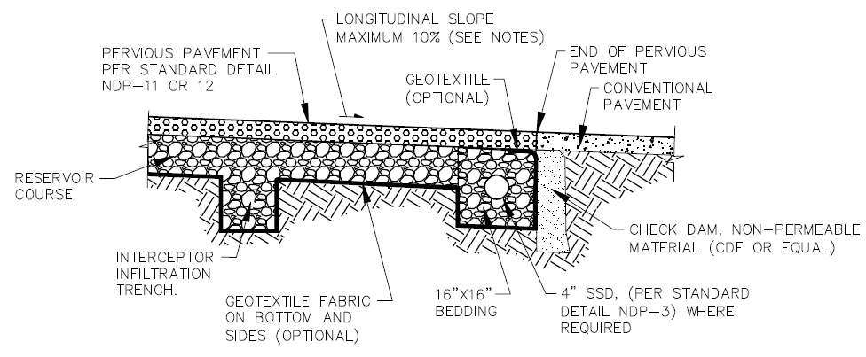
Pervious Pavement Design Issues
Subgrade
No compaction or minimal compaction
Captures and holds runoff at interface
Avoid surfacing of runoff
No subdrain
Or minimum 3 inches above soil
APPLICABILITY

Slide 8
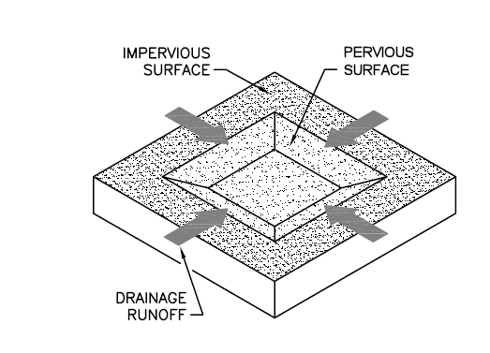
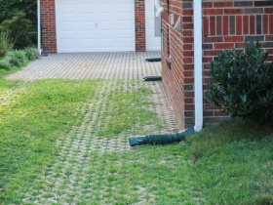
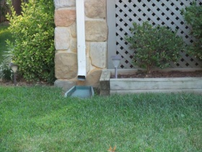
Disperse Runoff
Extensive flat, landscaped areas
Next to buildings
Downgradient from paved areas
Impervious:Pervious ratios
2:1 if treatment only criteria apply
1:1 if flow-control (hydromodification management) criteria apply
APPLICABILITY

Slide 9
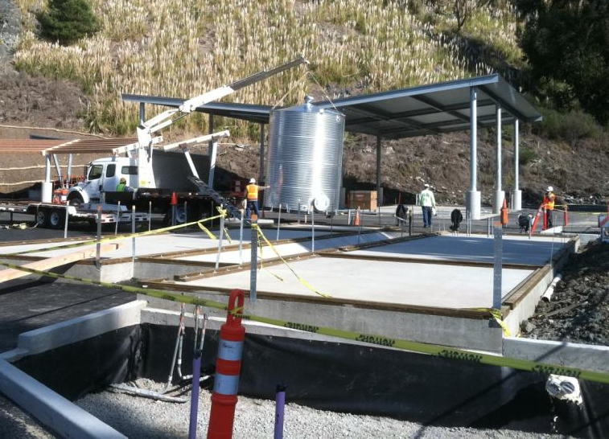
Harvesting and Reuse
Where there is an industrial demand for non-potable water
Concrete plants
Washing
Projects emphasizing water conservation and sustainability
LEED certification
Where there is intense occupancy and good facility management
High rises
Public facilities
APPLICABILITY

Slide 10
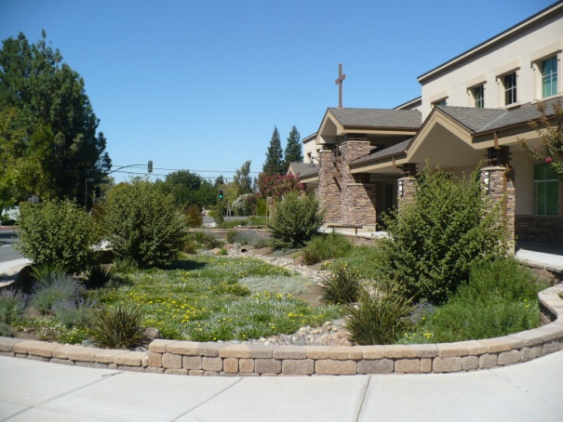
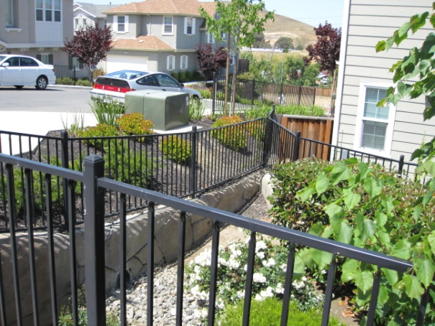
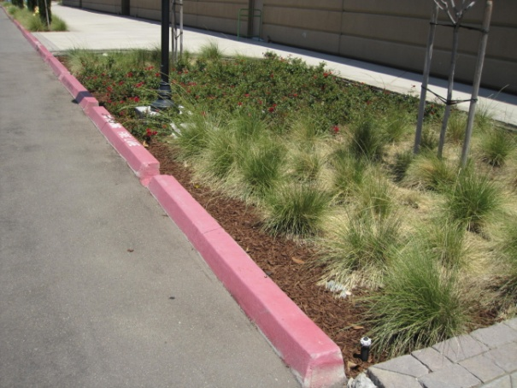
Bioretention
Applicable to nearly any development site
Can reliably treat and manage runoff in small footprint
Achieves some infiltration and evapotranspiration
Flow-through planter can be used if infiltration is infeasible
APPLICABILITY

Slide 11
Example Development Site
Thanks to:
Signature Properties dk Consulting City of Lafayette

Slide 12
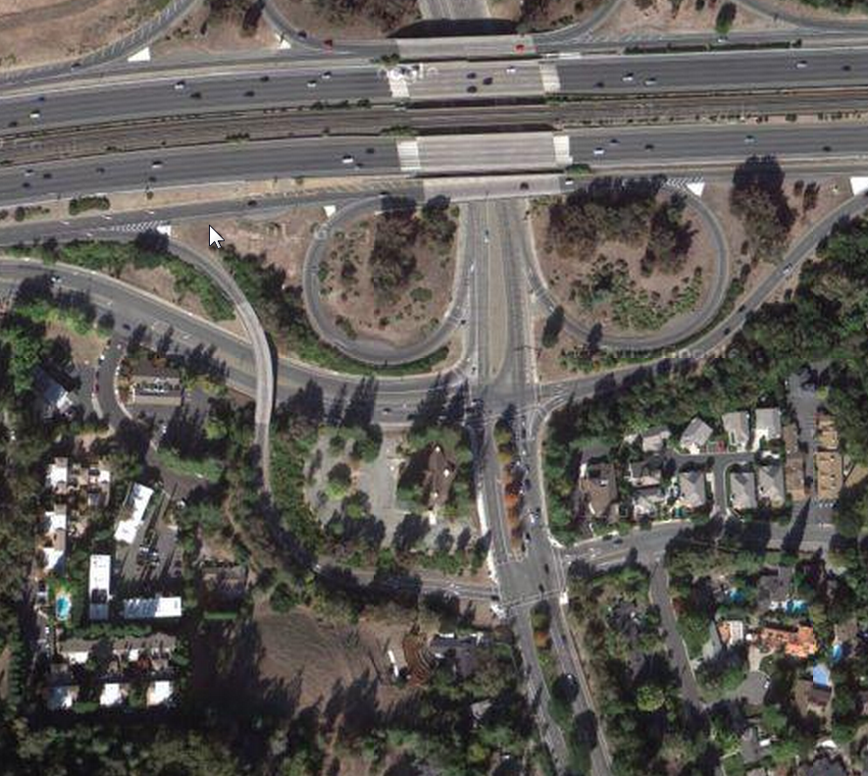
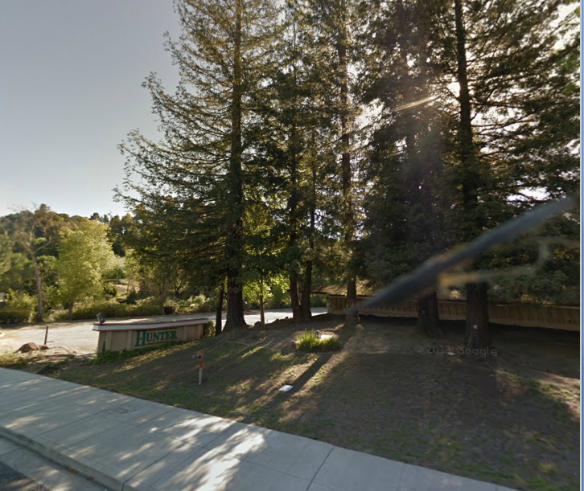
Opportunities and Constraints
DESIGN

Slide 13
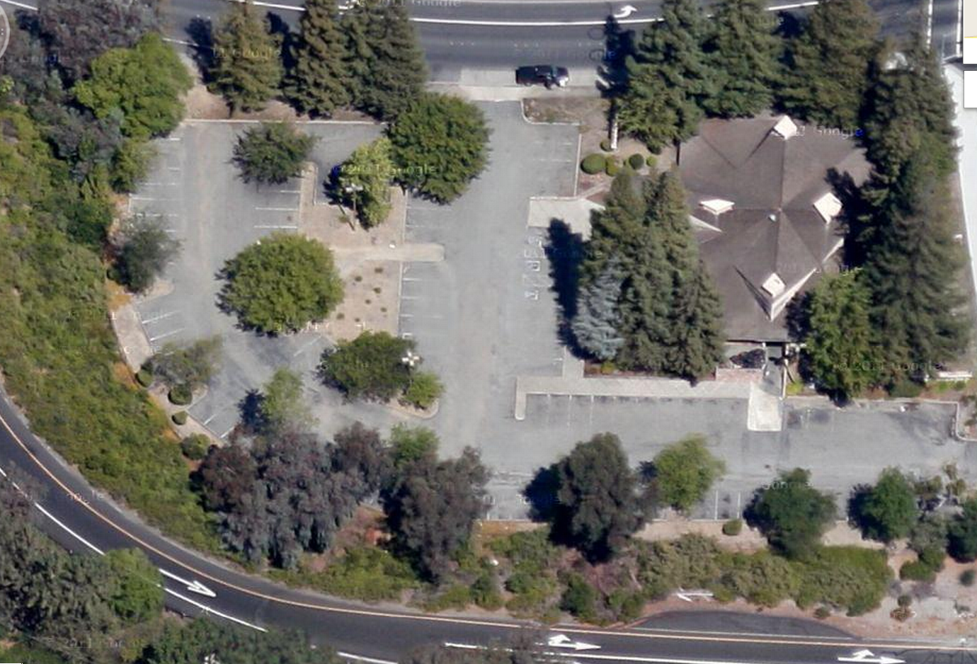
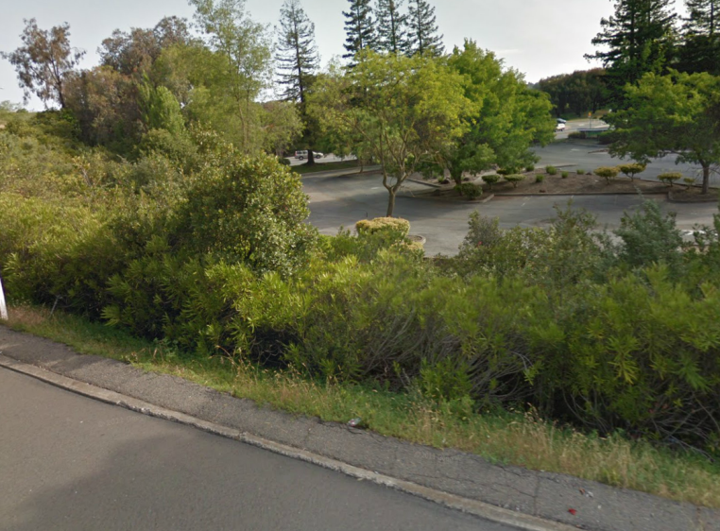
Opportunities and Constraints
1%
DESIGN

Slide 14
Opportunities and Constraints
Fill 8.5 to 15 feet deep
Silty clay to clayey sand (Group “D”)
DESIGN

Slide 15
Opportunities and Constraints
Densely developed townhome project
DESIGN

Slide 16
Opportunities and Constraints
Landscaped areas around buildings and central plaza/green space
DESIGN

Slide 17
Applying the Strategies
Optimize the site layout
Use pervious surfaces
Disperse runoff
Store runoff and use it later
Use bioretention (or other facilities)
DESIGN

