Slide 1
Preparing a Stormwater Control Plan
Stormwater C.3 Guidebook 6th Edition

Slide 2
Better and More Complete Plans
Regulatory Climate
Intense focus on LID
Confusion and debate about LID
Objectives
LID Stormwater Treatment Methods
Continuous Simulation Hydrology
Requirements for studies and proposals
More reporting requirements and data requests
Need to learn from real-world experience
Better and more consistent documentation

Slide 3
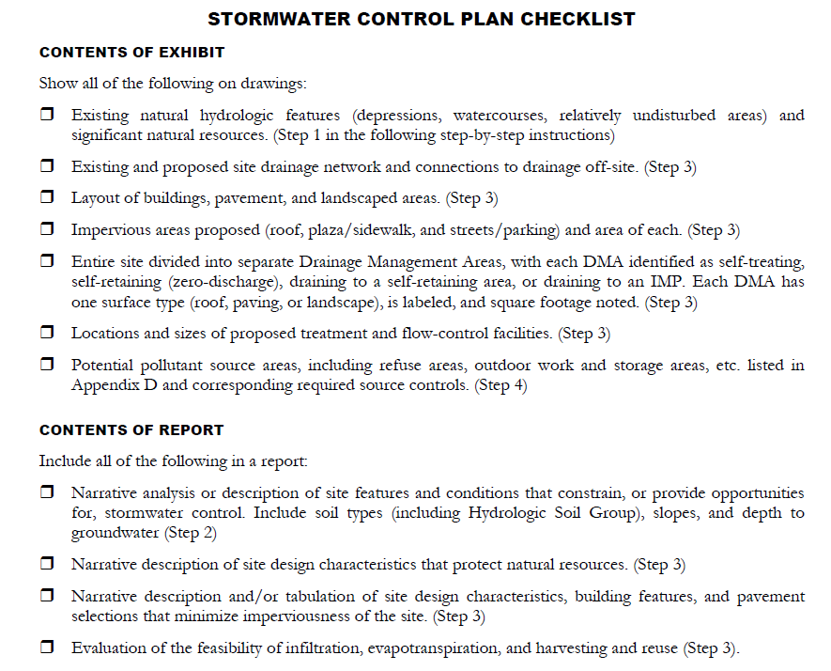
Guidance
Guidebook Chapter 3
Checklist
Step-by-step instructions
Outline
Template
Example

Slide 4
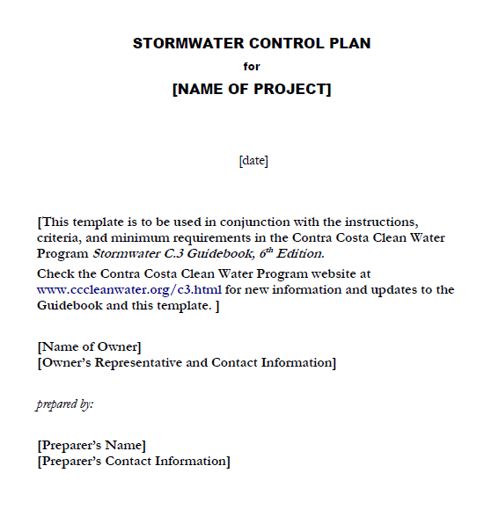
OVERVIEW

Slide 5
Table of Contents
Project Data (table)
Setting
LID Design Strategies
Documentation of Drainage Design
Source Control Measures
Stormwater Facility Maintenance
Construction Plan C.3 Checklist
Certifications
Attachment: Exhibit
OVERVIEW

Slide 6
Project Data
Name/Number
Application Submittal Date
To be verified by municipal staff
Location
Name of Developer
Phase No.
Project Type and Description
Watershed
Obtain from municipal staff
Site Area (sum of parcel areas)
Total Area of Land Disturbed
DATA TABLE

Slide 7
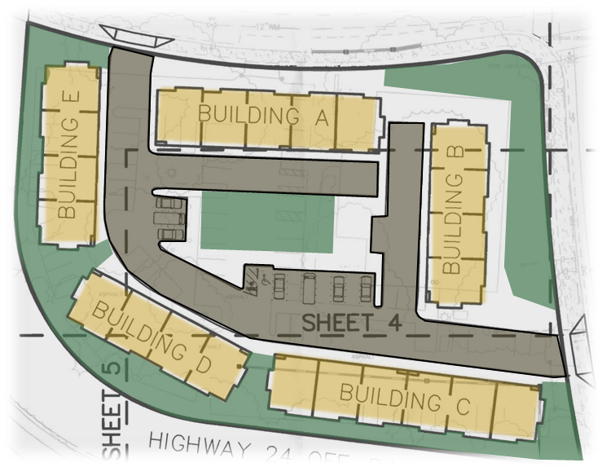
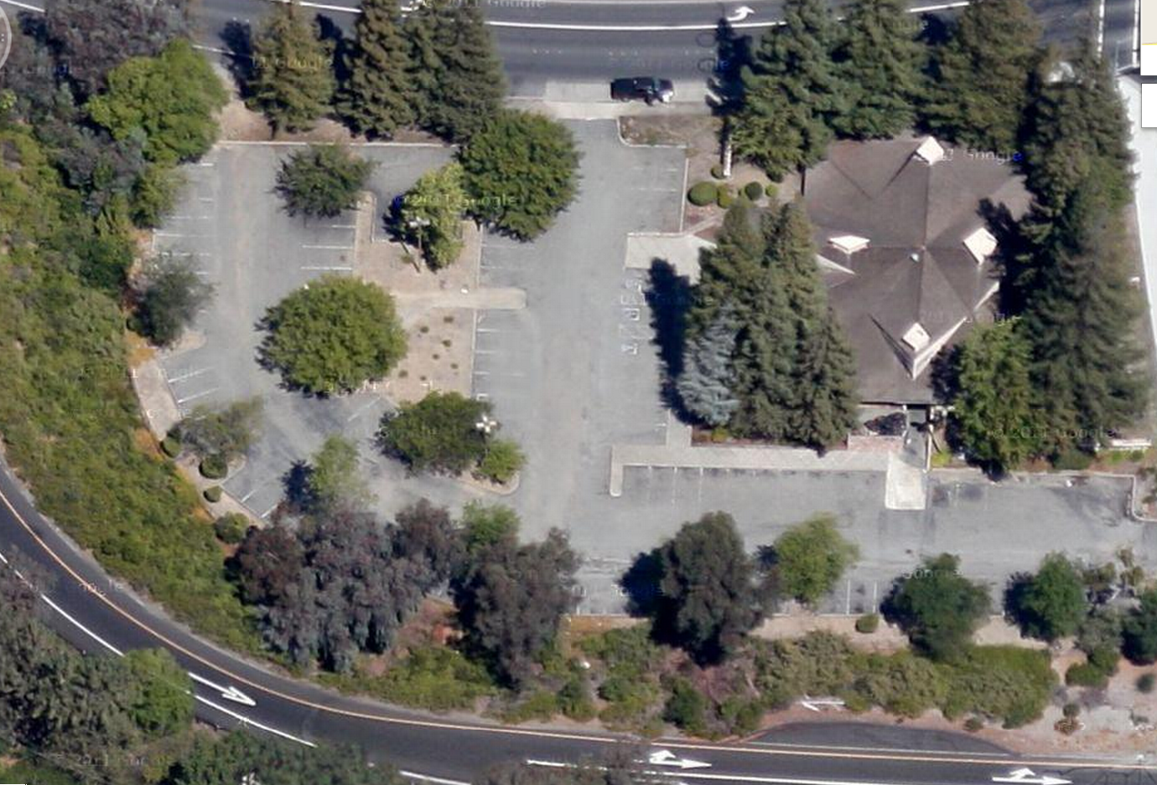
Impervious Surface
- Thresholds
- 50% rule
New Impervious Surface Area
Replaced Impervious Surface Area
Pre-Project Impervious Surface Area
Post-Project Impervious Surface Area
DATA TABLE

Slide 8
Project Data
Page 60
Project Density
DU/Acre or FAR
Applicable Special Project Categories
A: Lot line to lot line, <½ acre, no surface parking
B: ½ acre to 2 acres, no surface parking FAR > 2:1 or > 50 DUs/acre
C: Transit-oriented, no limit on size FAR > 2:1 or > 25 DUs/acre
Percent LID/non-LID Treatment
HMP Compliance Option
DATA TABLE
Page 9

Slide 9
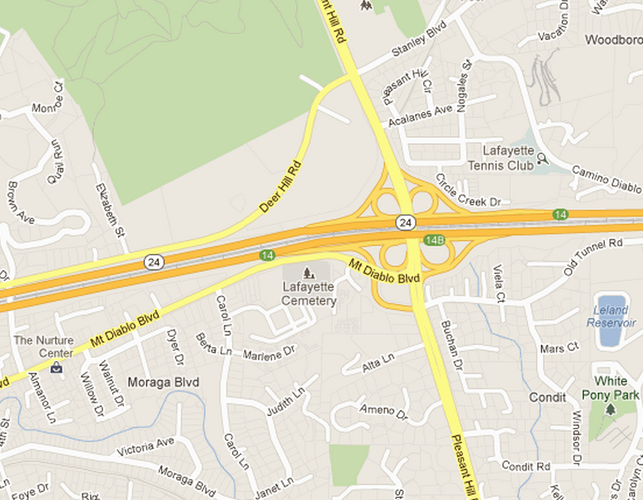
Project Setting
Location and Description
Existing Site Features and Conditions
Opportunities and Constraints

Slide 10
Optimization of Site Layout
Limitation of development envelope
Preservation of natural drainage
Riparian setbacks
Minimization of imperviousness
Use of drainage as a design element
LID DESIGN

Slide 11
Use of Permeable Pavements
Not used in this project
LID DESIGN

Slide 12
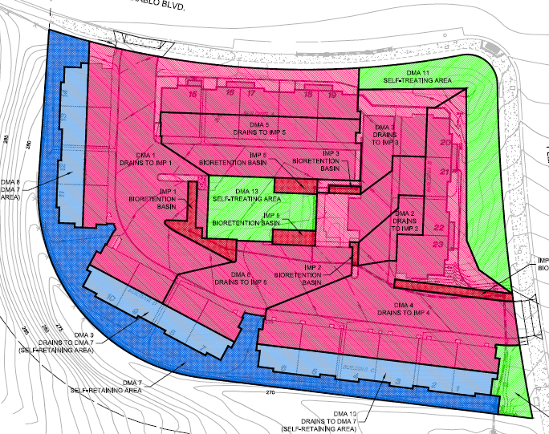
Dispersal of Runoff
LID DESIGN

Slide 13
Harvesting and Use Assessment
Discuss potential opportunities
Explain and justify selection of impervious areas for analysis.
LID DESIGN
A | B | C | D | E | F | G | H | I | J
Area | SF | Acres | Uses and User Units | Toilet and Urinal Usage (gal/day) | Water Use per Acre | Req’d Demand per Acre | F>G? | Adjacentpervious area ≥ 2.5 × “B”? | Other Use ≥ “G”?
All | 41102 | 0.94 | 23 DUs | 554 | 589 | 5900 | No | No | No
Bldgs | 18975 | 0.44 | 23 DUs | 554 | 1271 | 5900 | No | No | No
Bldg A | 4125 | 0.09 | 23 DUs | 554 | 5850 | 5900 | No | No | No

Slide 14
Integrated Management Practices
Describe the facilities
Bioretention
Flow-through planter
Bioretention + Vault
Cistern + Bioretention
Page 69
LID DESIGN

Slide 15
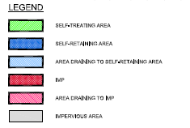
Drainage Management Areas
Step 1: Delineate the DMAs
Step 2: Classify the DMAs
DRAINAGE
Page 45

Slide 16
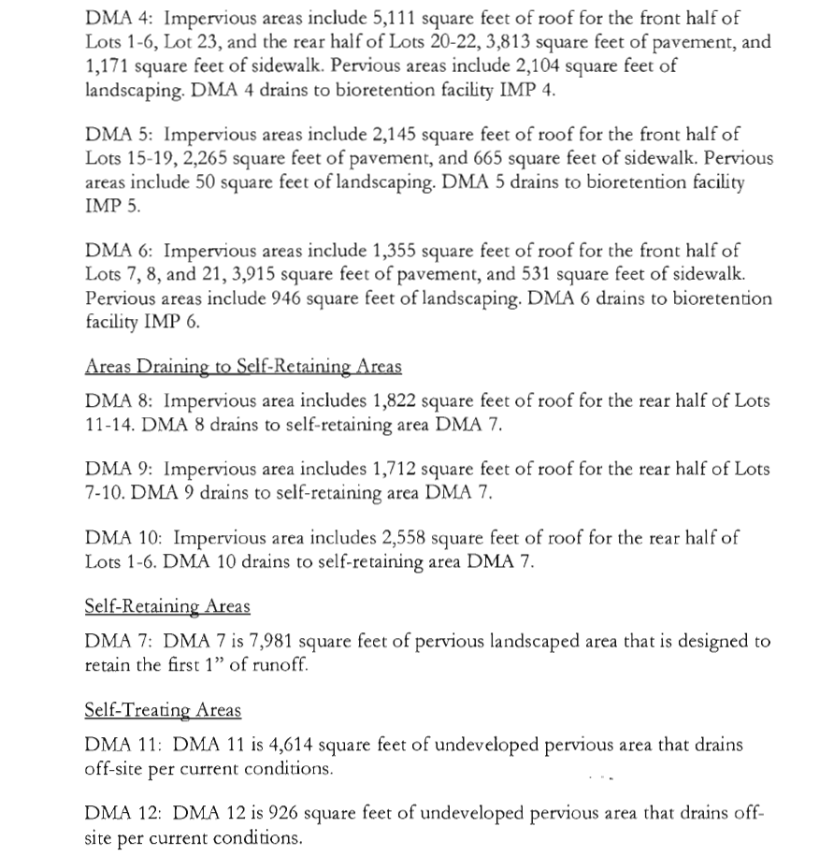
Drainage Management Areas
DRAINAGE

Slide 17
Tabulation and Calculations
Page 49
Self-treating areas
Self-retaining areas*
DMA Name | Square Feet
DMA 13 | 2570
DMA 11 | 4614
DMA 12 | 926
DRAINAGE
DMA Name | Square Feet
DMA 7 | 7918
*Include green roofs and areas draining to harvest and reuse facilities

Slide 18
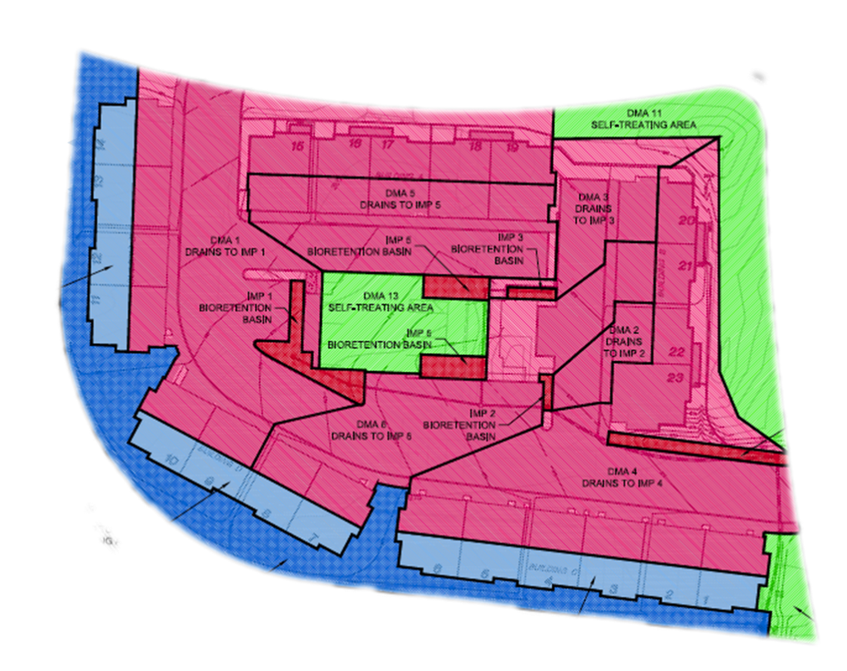
Tabulation and Calculations
Areas draining to self-retaining areas
DRAINAGE
DMA | Square Feet | Surface | Runoff Factor | Product | Receiving DMA | Receiving DMA Area | Ratio
8 | 1822 | Roof | 1.0 | 1822 | DMA-7 | 7981
9 | 1712 | Roof | 1.0 | 1712 | DMA-7 | 7981
10 | 2558 | Roof | 1.0 | 2588 | DMA-7 | 7981
∑ |  |  |  | 6092 |  | 7981 | 0.76

Slide 19
Tabulation and Calculations
Example: IMP 5 Calculation with Hydromodification Management
DMA | Area | Surface | Runoff Factor | Area × Runoff Factor | Soil Type
5 | 2145 | Roof | 1.0 | 2145 | D
5 | 2265 | Pave | 1.0 | 2265
5 | 946 | LS | 0.7 | 662
 |  |  |  |  | IMP Sizing Factor | Rain Adjust Factor | Min Area or Volume | Proposed Area or Volume
 |  |  |  | A | 0.05 | 1.0 | 254 | 283
 |  |  |  | V1 | 0.042 | 1.0 | 213
 |  |  |  | V2 | 0.055 | 1.0 | 279
 |  |  |  | Orifice Size:
Page 51
DRAINAGE

Slide 20
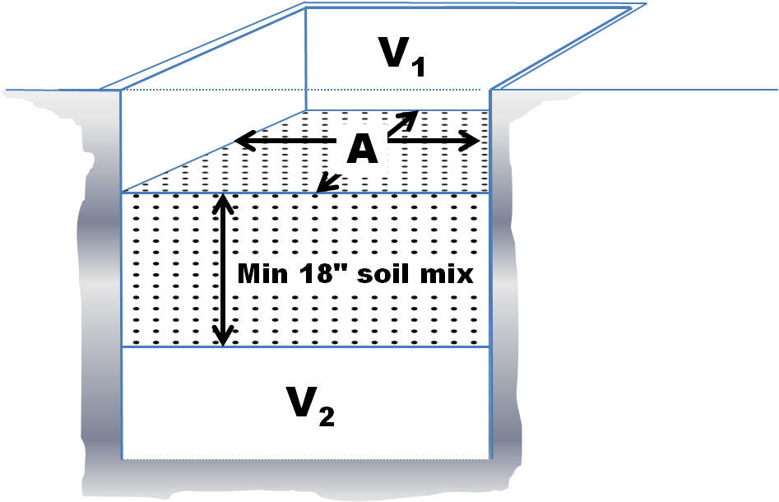
Sizing Bioretention Layer Depths
DRAINAGE
V₁ = 213 CF
9 in
A = 283 SF
V₂ = 279 CF
2.5 ft
279/0.4 = 698 CF Gravel

Slide 21
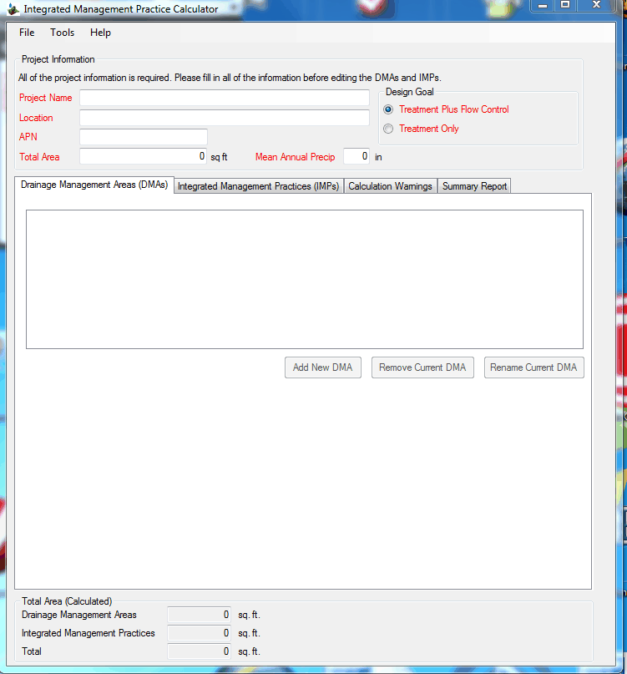
Using the IMP Calculator
DRAINAGE

Slide 22
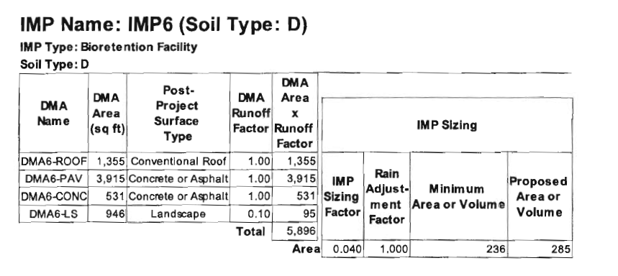
DRAINAGE

Slide 23
Special Projects Reporting
Narrative: Onsite LID feasibility
Infiltration, evapotranspiration,harvesting/reuse
Description of site and DMAs
Need for pavement where proposed
Why any landscaped areas can’t be bioretention
Narrative: Offsite LID feasibility
Owner owns land in same watershed?
In-lieu program exists?
Technical Criteria for Non-LID Facilities

Slide 24
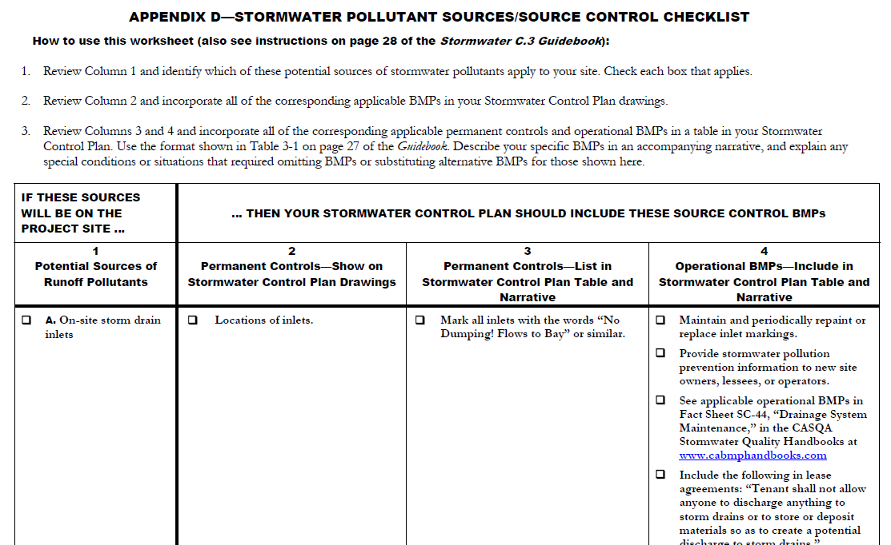
Source Control Measures
Page 28

Slide 25
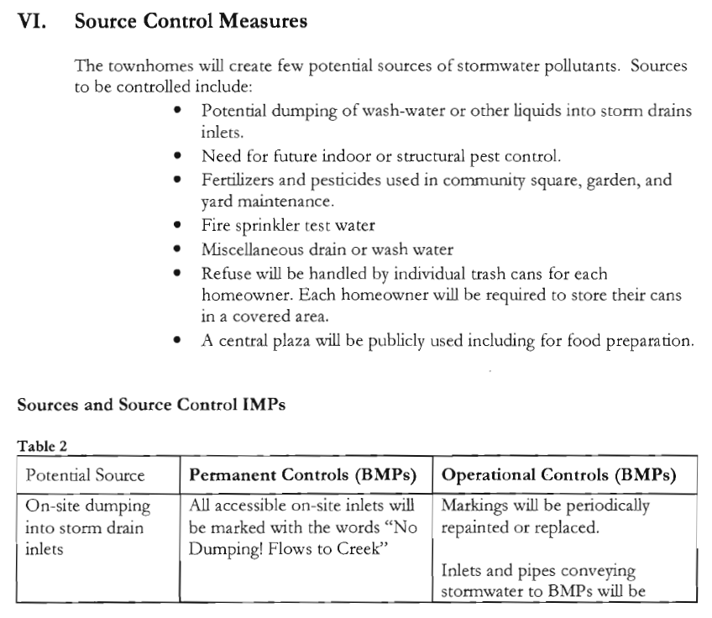

Slide 26
Stormwater Facility Maintenance
Page 29
Ownership and responsibility
Commitment to execute agreements
Accept O&M until formally transferred
Maintenance requirements
Fact sheets on website

Slide 27
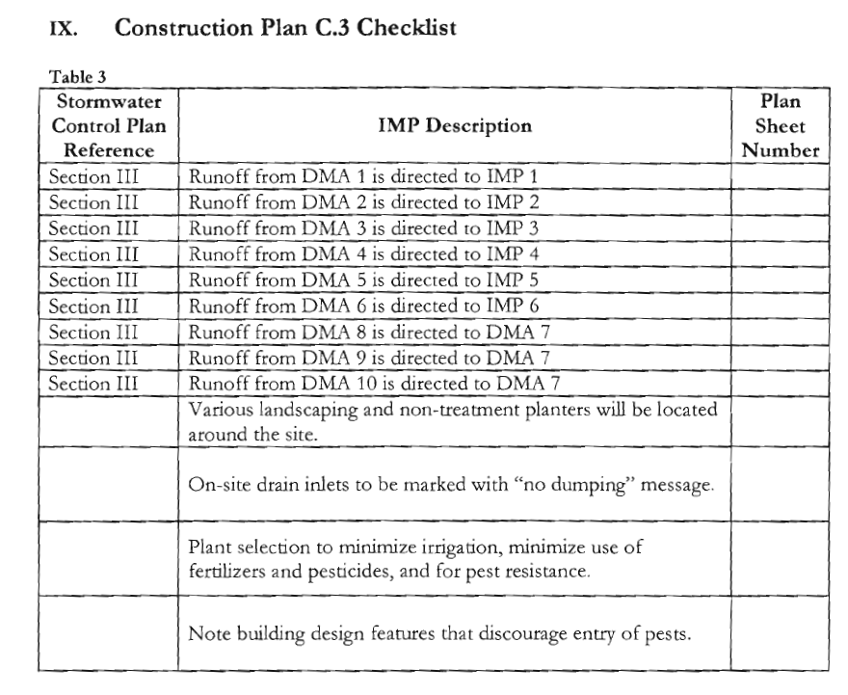
Construction C.3 Checklist

Slide 28
Certification
“The selection, size, and preliminary design of treatment BMPs and other control measures in this plan meet the requirements of Regional Water Quality Board Order R2-2009-0074.”

