Slide 1
Municipal Regional Permit Provision C.6
Dan Cloak, P.E. Principal Dan Cloak Environmental Consulting

Slide 2
Provision C.6 Overview
Which projects are required to implement BMPs?
What BMPs are required?
What projects must municipalities inspect?
What must be inspected?
What happens if a violation is found?
What must be tracked and documented?
What must be reported?

Slide 3
What Projects Require BMPs?
Municipalities must require all construction sites to have site-specific, and seasonally and phase-appropriate BMPs.

Slide 4
What BMPs are Required?
Site-Specific BMPs in Six Categories
Erosion Control
Run-on and Run-off Control
Sediment Control
Active Treatment Systems (if needed)
Good Site Management
Non-Stormwater Management
Same as Construction General Permit

Slide 5
What BMPs are Required?
References for BMPs
California BMP Handbooks (CASQA)
Caltrans Stormwater Quality Handbooks
RWQCB Erosion and Sediment Control Field Manual (2002)
New BMPs

Slide 6
What BMPs are Required?
Municipalities must:
Review contractors’ SWPPP or erosion/pollution control plan to confirm appropriate BMPs are planned
Provide outreach materials
For sites disturbing an acre or more:
Verify filing for Construction General Permit
By September 1, remind owners/ developers to prepare for wet season

Slide 7
Inspections—When and Where
Monthly inspections
All sites disturbing an acre or more
“High Priority” sites, based on:
Soil erosion potential
Slope
Project size and type
Proximity/sensitivity of waters
If Municipality or Water Board say so

Slide 8
Inspections — What
Inspections are for:
Compliance with SWPPPs, etc.
Adequacy of BMPs
Evidence of discharge
Actual or potential illicit connections
Education
All inspections are recorded
Electronic database or tabular format

Slide 9
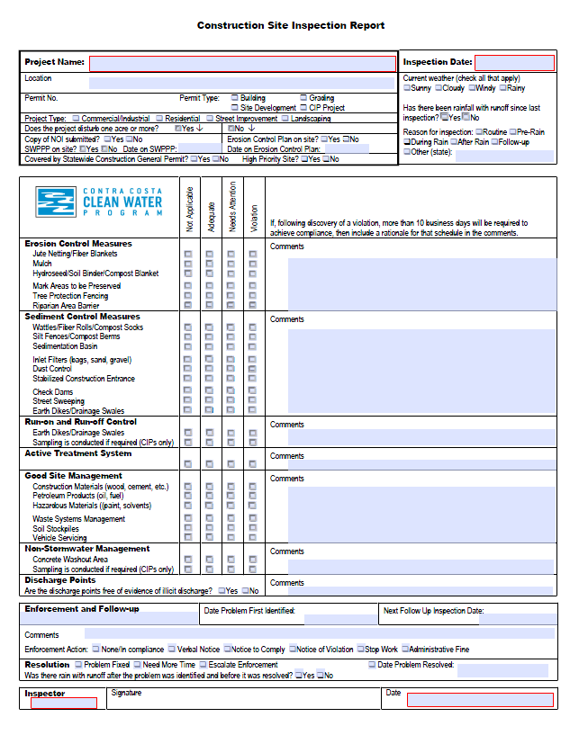
Inspection Tracking
Project Info
Inspection Info
BMP Info
6 categories
4 columns
Comments
Enforcement

Slide 10
Enforcement
Required by Permit
Progressive (Levels 1- 4)
Specified in local Enforcement Response Plan

Slide 11
Enforcement Level One
Verbal Warning or Warning Notice for:
Exposed pollutant sources
Evidence of past discharge
Inadequate BMPs
Follow-up
Log the incident
Example: Check “Needs Attention” on Construction Site Inspection Report
Re-inspect if needed

Slide 12
Enforcement Level Two
Notice of Violation for:
Active pollutant discharge, or
Failure to comply with warning
Remediation plan and schedule
May also use Clean/Abate, Cease/Desist, or Stop Work order
Timely correction (before next rain)
Correct within 10 days or provide rationale
Document resolution

Slide 13
Enforcement Level Three
Major Violation
Discharge of hazardous materials
Pattern of noncompliance
Failure to respond to notice of violation
Remediation plan and schedule
Citation
Cost recovery
Negotiated settlement

Slide 14
Enforcement Level Four
Legal Action
Failure to respond to Level Three actions
Referral may be to:
City Attorney and/or
Contra Costa County District Attorney
Emergency responders
Regional Water Board
California Dept. Fish and Game

Slide 15
Staff Training
Training every other year
Correct uses of BMPs
BMP installation and maintenance
Permit requirements
Local requirements
Enforcement Response Plans
Include in Annual Report
Topics covered
Percentage of inspectors attending

