Slide 1
Welcome
Tom Dalziel, Manager
Contra Costa Clean Water Program

Slide 2
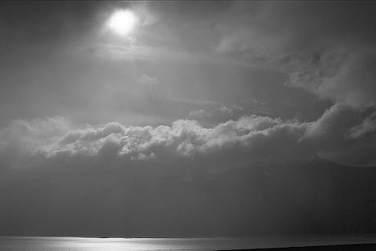
Objectives for this Morning
Understand C.3 Requirements
Know how to analyze a site and formulate a strategy for LID
Be able to develop a workable preliminary LID design
Be able to use calculations to demonstrate C.3 compliance
Know how to prepare a Stormwater Control Plan

Slide 3
Today’s Schedule
9:00 | Background and Update on C.3 Compliance
9:45 | Conceptual LID Design for Development Sites
10:15 | Evaluating Feasibility of Harvesting and Reuse
10:45 | Break
11:00 | Preparing a Stormwater Control Plan
12:00 | Bioretention: Getting the Details Right
12:30 | Adjourn

Slide 4
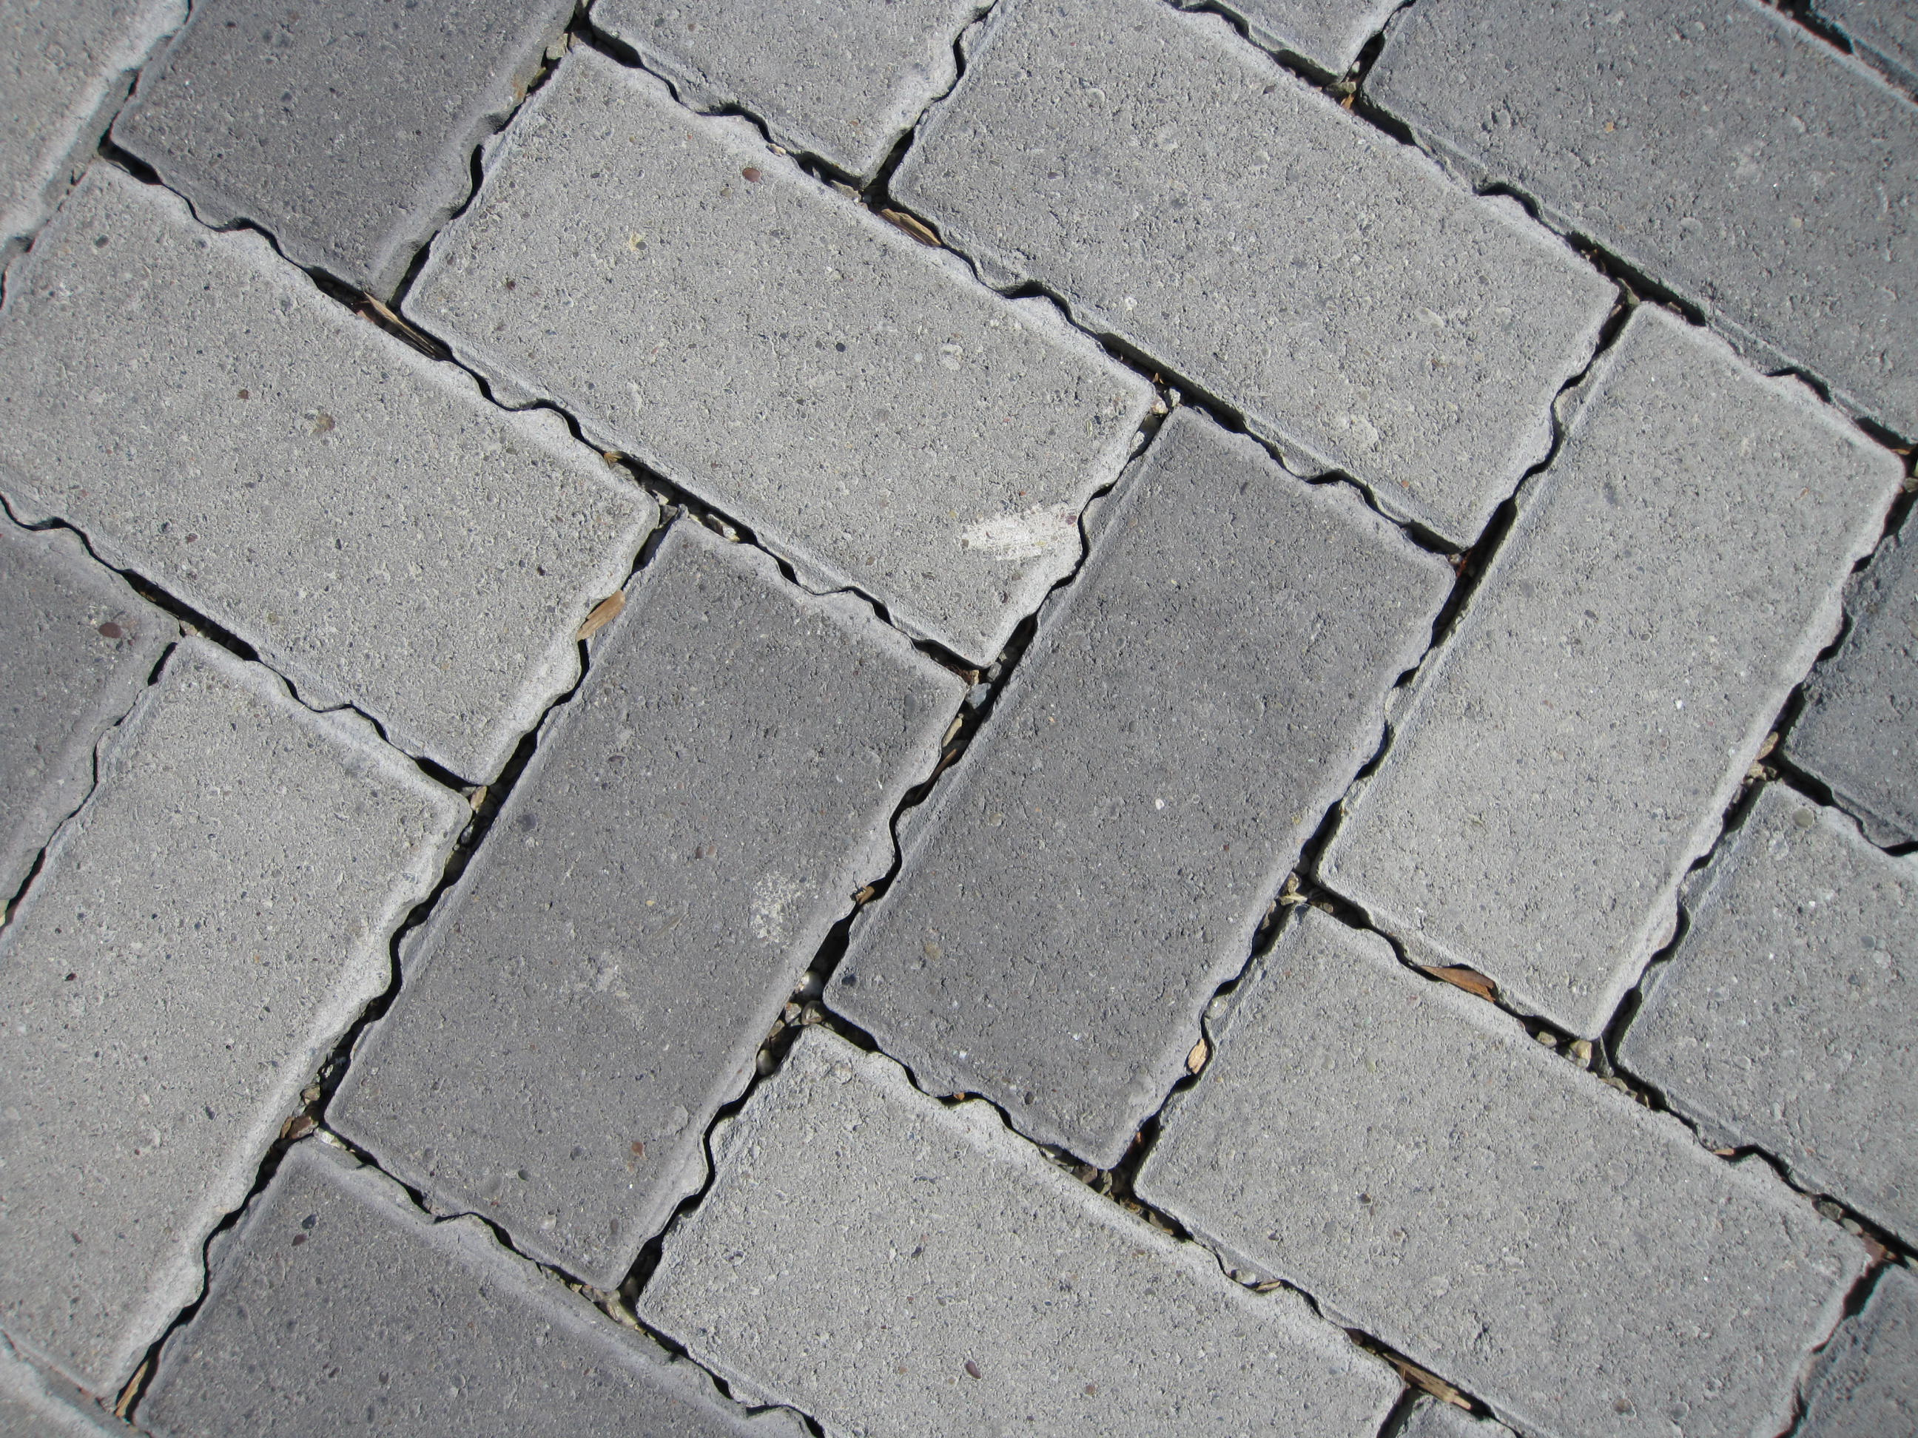
Logistics

