Slide 1
Preparation for maintenance
Get Ready before you go
Megan W. Stromberg Consulting

Slide 2
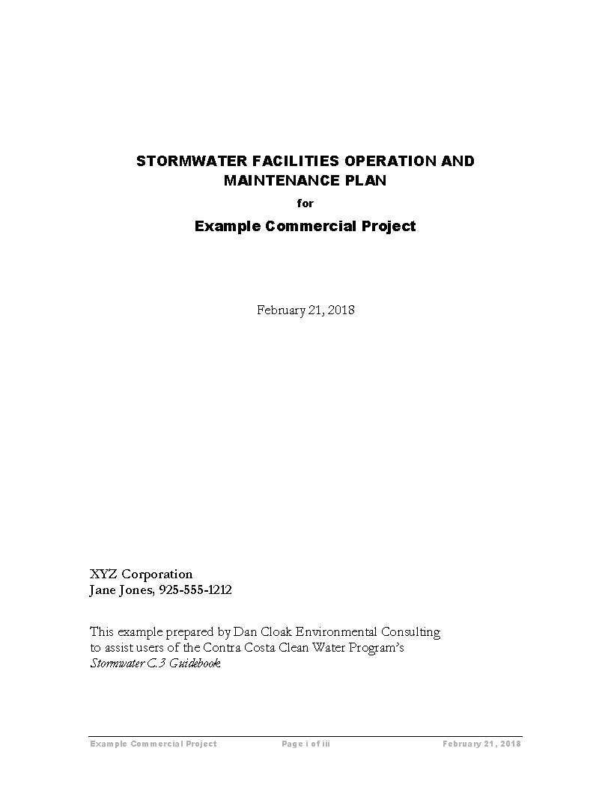
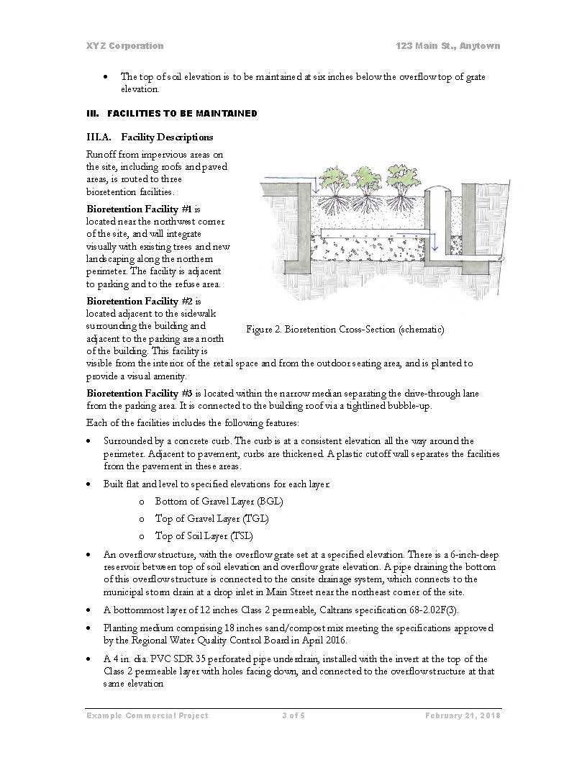
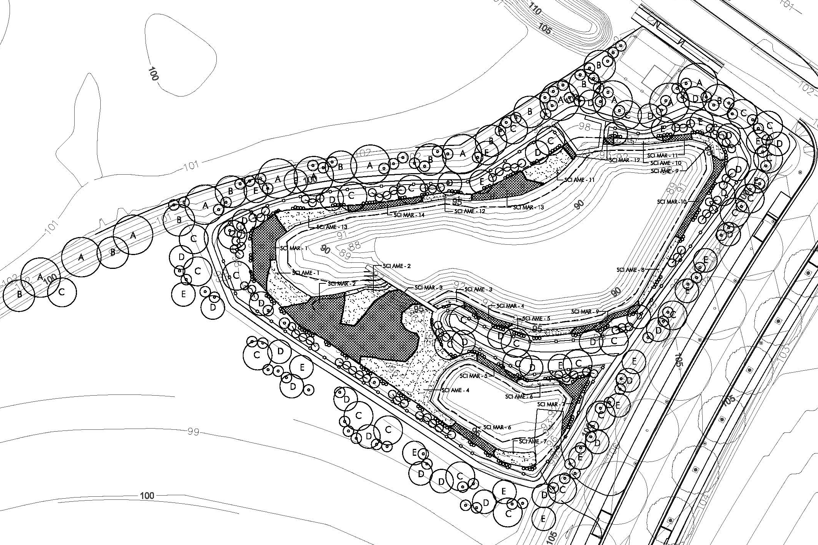
Background Info
Operations and Maintenance Plan
As-built or design report (locations of inlets/outlets, plantings, irrigation system, etc.)
Sections out of date and updates needed
Contact info for site personnel
Past Inspection and Maintenance Reports

Slide 3
equipment
Boots, reflective vest
Cut resistant gloves
Eye & Hearing protection
Hard hat for cutting overhead branches
Use a grabber for trash whenever possible
Shovel for sediment
Pruning tools, rakes

Slide 4
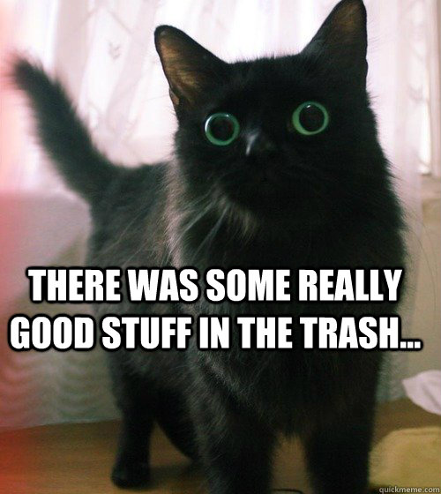
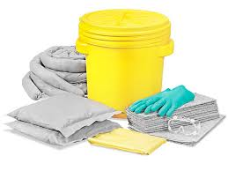
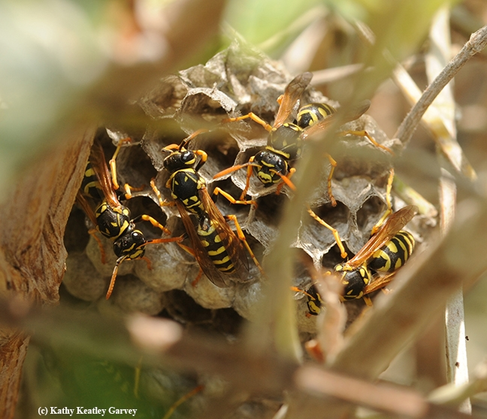
hazards
Trash - needles, animal carcasses, feeces
Spill Kit on Hand (Gloves, kitty litter, absorbant pad, bag/bucket)
Spill Hotline: 925-335-3232
Animals/Wildlife – call animal or vector control
Notes:
Trash
Be sure to use gloves and grabbers to remove dangerous trash
(needles, animal carcasses, etc.) and dispose of safely.
Spills
Chemical spills could easily introduce pollutants into facilities and
the piped stormwater system. Workers should always have a spill kit
on hand in order to prevent any spills from reaching the facility, local
water bodies, or stormwater inlets.
Animals/Wildlife
• Do not handle animals or wildlife.
• Do not use poisons or other toxic baits in a stormwater facility. If you call vector control, be sure to alert them that the facility drains to a creek.

Slide 5
Prevent Spills
When re-fueling equipment in the field:
Do not fuel the tank while engine is hot or running
Conduct fueling operations over drip pans or other hard surfaces
Keep away from storm drain inlets, the stormwater system, and waterways.
Do not “top off” fuel tanks.
Keep clean absorbent materials on hand for minor spills.
Make sure portable fuel tanks are leak free and are secured during transit.
Your company name

Slide 6
Inspections & Maintenance
Consult your local jurisdiction for frequency
Once a year as minimum
Schedule inspection within 48 hours after ½” rain if possible
Document inspections (O&M form), take photos

Slide 7
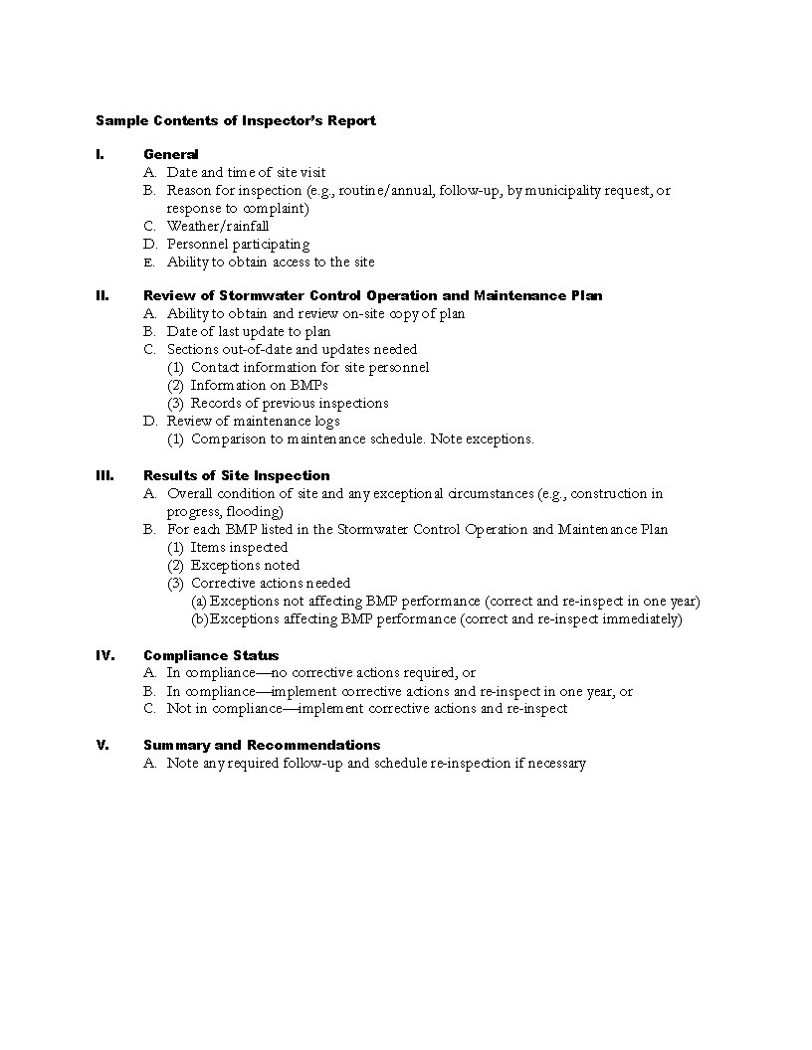
Inspection Checklist
Yes or No?
Is there sediment accumulation?
Are trash, excessive leaves, grass clippings, or other debris present?
Is anything blocking or clogging inlets or outlets?
Are there areas of bare soil or erosion?
Is there standing water 48 or more hours after rainfall?
Are weeds or invasive plants present?
Corrective actions needed?
Template Inspector’s Report: https://www.cccleanwater.org/construction-business/development/stormwater-c-3-guidebook

Slide 8
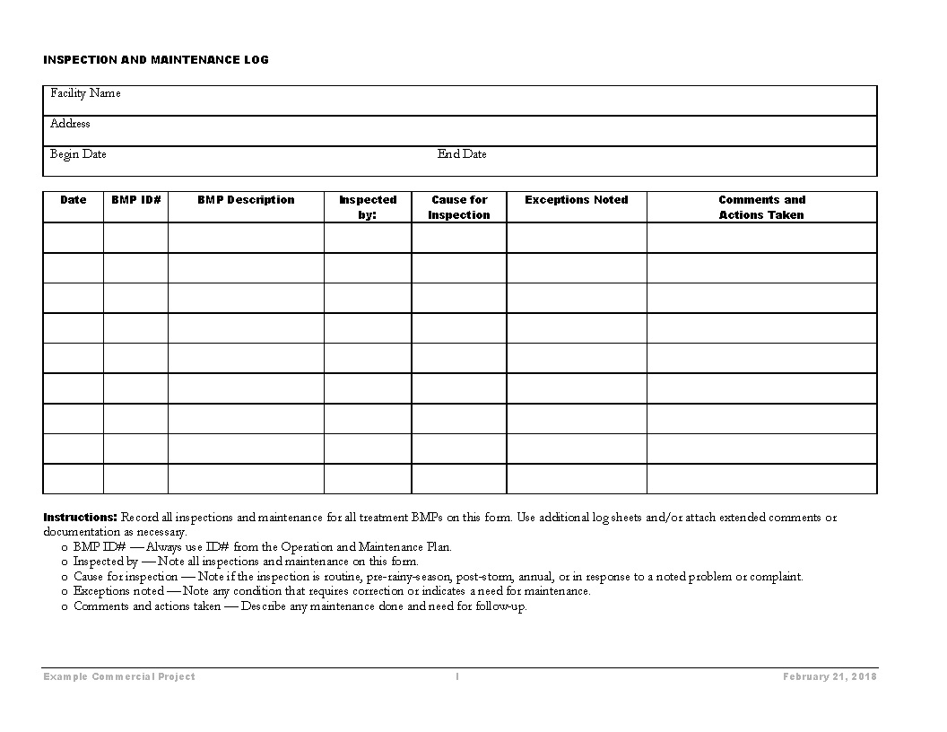

Slide 9
Maintenance calendar
Activity | How Often? | When? | Spring | Summer | Fall | Winter
General Inspection | 2/year min, after every major storm | Any season | X | X | X | X
Remove trash | Daily (weekly) | All Year | X | X | X | X
Fix erosion problems (mulch or soil) | after every major storm | Wet Season | X |  | X | X
Remove sediment from bottom of facility | As needed when reaches 2-3” | Dry Season | X | X
Remove sediment from inlets | As needed after every major storm | Any time of year | X | X | X | X
Notes:
Check O& M plan for the facility to see if it has different requirements.

Slide 10
Maintenance calendar
Activity | How Often? | When? | Spring | Summer | Fall | Winter
Check for clogging | After every major storm | Wet Season | X |  | X | X
Rake & Replenish Mulch | As needed after every major storm | Any season | X | X | X | X
Clear Outlets | As needed after every major storm | Any season | X | X | X | X
Remove weeds | As needed: if impeding function | Spring-Fall | X | X | X
Plant Replacement | As needed, inspect 1/year | Spring or Fall | X |  | X
Notes:
Suggested Frequencies from Oregon State University
Many Sites have O&M plans with required maintenance frequencies called out.

Slide 11
Maintenance calendar
Activity | How Often? | When? | Spring | Summer | Fall | Winter
Pruning trees and Shrubs | As needed, inspect 1/year | November – January |  |  |  | X
Grass pruning | As needed, inspect 1/year | Fall - early Spring (not during hot weather) | X |  | X | X
Irrigation schedule | Quarterly | All Year | X | X | X | X
Inspect irrigation for leaks/breaks | 1/year min | Spring | X
Inspect & maintain structures | 1/year | Fall, before rain |  |  | X
Notes:
Bird nesting starts February 1 so I always tell people to prune or take out trees in January.

