Slide 1

Implementing MRP Provision C.3
Stormwater NPDES Compliance
For New Developments

Slide 2
Overview
Stormwater NPDES Compliance for New Developments

Slide 3
C.3 Regulatory History
1987 | Congress adds Section 402(p) to Clean Water Act
1990 | USEPA regulations require states to issue stormwater NPDES permits to large municipalities
1990 | Regional Water Board issues first Bay Area stormwater NPDES permits
2000 | State Water Resources Control Board “Bellflower decision” confirms municipalities must require new developments to treat runoff
OVERVIEW

Slide 4
C.3 Regulatory History
2003 | Regional Water Board adds Provision C.3 to stormwater permit for Contra Costa municipalities
2005 | C.3 implementation begins for projects creating or replacing an acre or more of impervious area
2006 | Water Board adopts Contra Costa’s Hydrograph Modification Management Plan and requirements take effect. C.3 threshold for treatment requirements drops from one acre to 10,000 square feet of impervious area
OVERVIEW

Slide 5
C.3 Regulatory History
2009 | Municipal Regional Permit adopted, including LID requirements. Threshold for some land uses lowered to 5,000 SF of impervious area. Contra Costa develops current HMP sizing factors and calculator.
2011 | MRP amended, including “Special Projects” categories. LID requirements take effect, including feasibility tests for infiltration and harvesting/reuse.
2013 | C.3 includes “major issues” for MRP reissuance, scheduled for late 2014
OVERVIEW

Slide 6
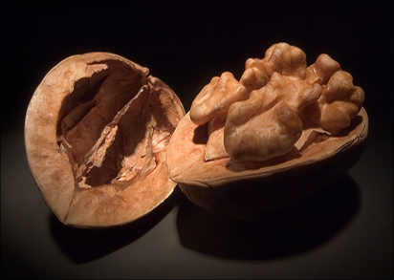
C.3 in a nutshell
Projects subject to C.3 must:
Minimize imperviousness
Control potential pollutant sources
Use LID to treat stormwater before discharge
Match runoff peaks and durations to
pre-project conditions
  Projects ≥ 1 acre impervious area, where downstream beneficial uses could be affected
Maintain treatment and flow-control facilities.
OVERVIEW

Slide 7
C.3 & Development Review
Pre-Application
Meeting
Completed
Application
“Deemed
Complete”
OVERVIEW
Section
Review
Planning
Commission
Conditions
of Approval
CEQA
Review
Detailed
Design
Plan Check
Permits
to
Build

Slide 8
Path to Compliance
Page
4
Pre-application meeting
Review Guidebook
Prepare a Stormwater Control Plan
Prepare detailed project design
C.3 checklist on project plans
Prepare Operation & Maintenance Plan
Maintain facilities during construction
Final O&M Plan, transfer responsibility
Maintain facilities in perpetuity
OVERVIEW

Slide 9
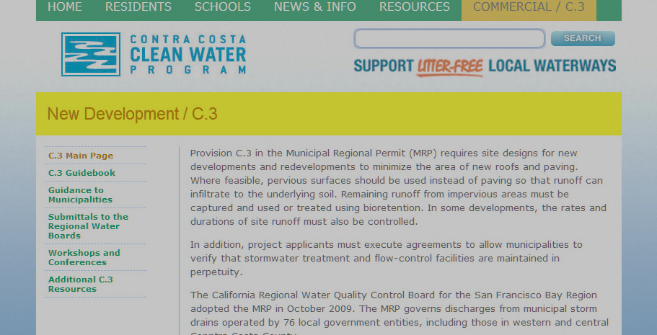
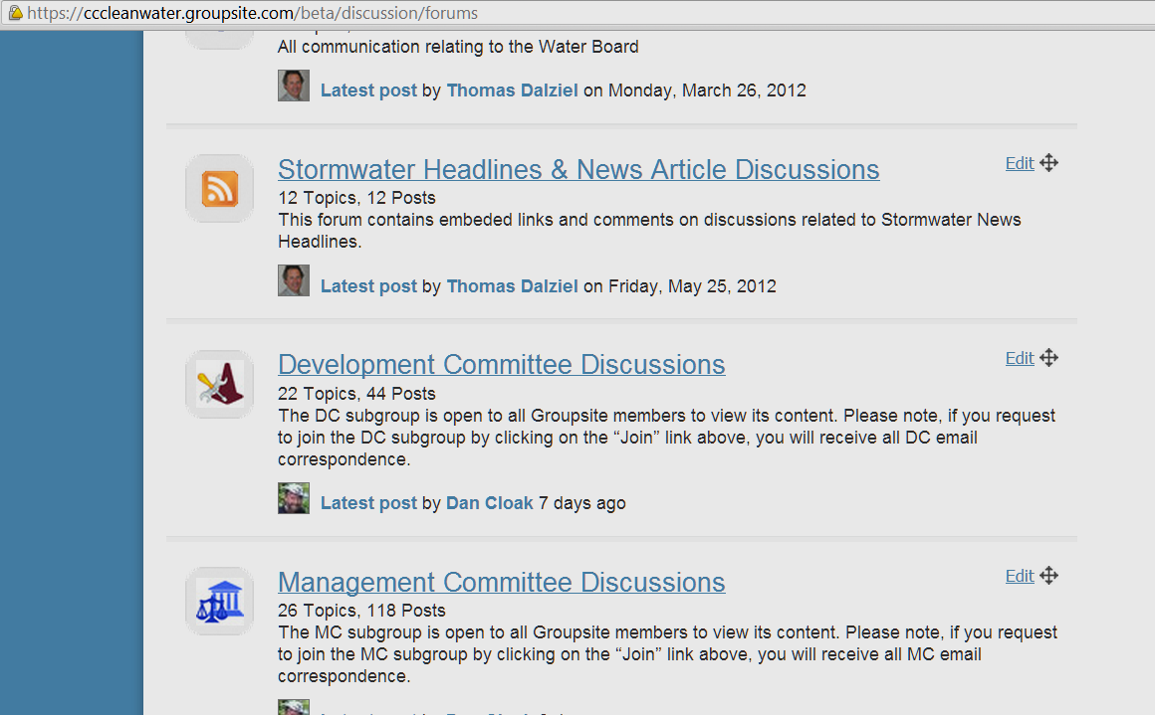
Tools and Resources
OVERVIEW

Slide 10
Applicability
Stormwater NPDES Compliance for New Developments

Slide 11
In Summary…
Page
4
All projects | Site design measures and source controls
≥2500 SF | Include at least one of six LID measures
≥(5,000 SF) ≥10,000 SF | (For parking lots, auto service, restaurants) Treat flows to numeric standard
≥1 acre | Hydromodification Management
APPLICABILITY

Slide 12
Applying the Thresholds
Page
6
Grandfathering and new approvals
Phased Projects
  Apply threshold to the whole of the action
  Guard against piecemealing
  Require the appropriate level of detail
Subdivision Map Approvals
  Estimate future impervious area
  Type, size, location, final ownership of treatment and flow-control facilities
  Mechanism to ensure future implementation
  See the Policy on C.3 for Subdivisions
APPLICABILITY

Slide 13

Threshold Arcana
What if the project reduces the
amount of impervious surface?
What about a 6,000 SF project with two parking spaces?
Does pervious pavement count?
Does pavement replacement count?
Are swimming pools impervious?
Is gravel impervious?
Are public improvements included?
APPLICABILITY

Slide 14
The 50% Rule
Criterion in previous
permit (2003-2009):
Project results in an
increase of or
replacement of 50% or
more of existing
development
OLD
NEW
APPLICABILITY
Existing Development
MRP criterion: Project
results in alteration of
more than 50% of the
previously existing
development
OLD
NEW

Slide 15
LID CONCEPTUAL DESIGN
Stormwater NPDES Compliance for New Developments

Slide 16
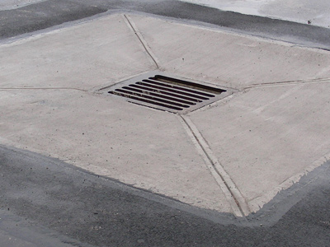
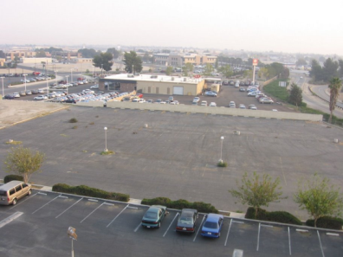
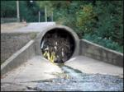
Conventional Urban Drainage
Impervious surfaces:
roofs and pavement
Catch basins and
piped drainage
“Collect and
convey” design
objective
LID CONCEPTS

Slide 17
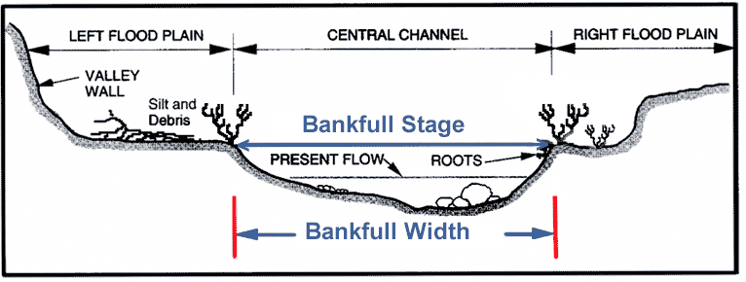
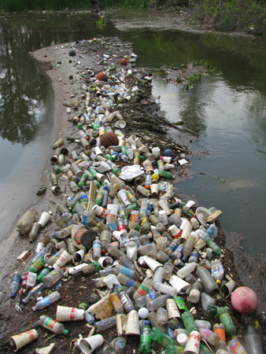
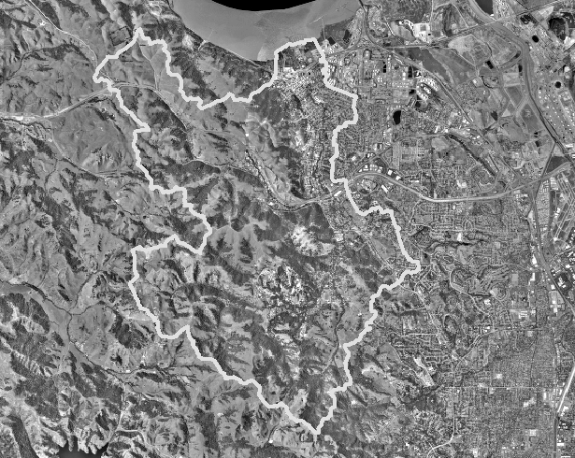
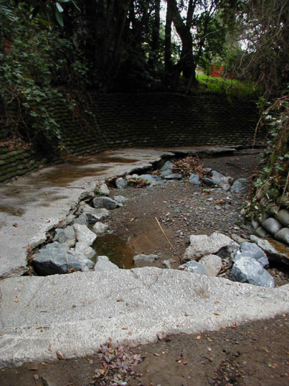
Drainage Impacts
Site Scale | Watershed and Stream Scale
Higher peak flows | Flooding and scouring of stream beds
Lower time of concentration | Flash flows
Runoff from small storms | Discharge when runoff did not previously occur
Increased runoff durations | Stream erosion at moderate stream flow rates
Greater runoff volumes | Higher pollutant loading
Greater runoff energy | Conveys trash and gross pollutants to streams
Decreased infiltration | Lower and less frequent stream base flow
Dry weather discharges | High pollutant concentrations during low flows
LID CONCEPTS
Notes:
The pictures relate to items #1, #4, and #6 in the table.

Slide 18
LID Design Objectives
LID CONCEPTS
Watershed and Stream Scale | Site scale
Reduce peak flows | Detain runoff on site
Increase time of concentration | Slow runoff from leaving site
No runoff from small storms | Infiltrate, evapotranspirate and reuse
Reduce duration of moderate flows | Let runoff seep away very slowly
Reduce runoff volume | Infiltrate and reuse where possible
Reduce runoff energy | Detain and slow flows
Increase groundwater storage and stream base flows | Facilitate infiltration
Reduce pollutants in runoff | Detain and filter runoff
Protect against spills and dumping | Disconnect drainage and filter runoff

Slide 19
LID Design Process
Page
35
Analyze Project for LID
Develop and Document LID Drainage Design
Specify LID Preliminary Design Details
LID CONCEPTS
Coordinate with Site Design and Landscape Design

Slide 20
Analyzing a Project for LID
Five LID Strategies
Optimize the site layout
Use pervious surfaces
Disperse runoff
Store runoff and use it later
Direct runoff to bioretention facilities
LID CONCEPTS

Slide 21
1. Optimize the Site Layout
Define the development envelope
Set back from creeks, wetlands, and
riparian habitats
Preserve significant trees
Minimize grading
LID CONCEPTS

Slide 22
1. Optimize the Site Layout
Preserve and use permeable soils
Limit roofs and paving
Detain and retain runoff throughout the site
Use drainage as a design element
LID CONCEPTS

Slide 23
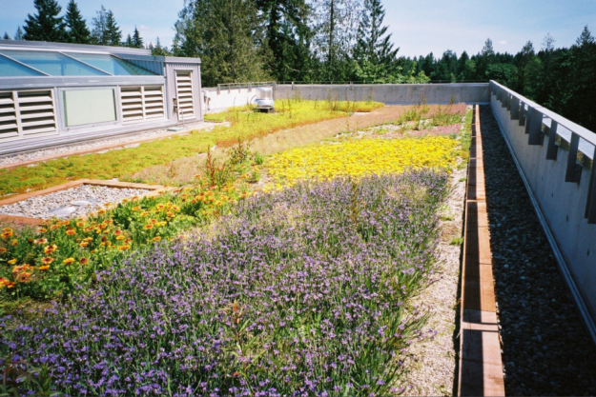
2. Use Pervious Surfaces
Permeable pavements
LID CONCEPTS
Green roofs

Slide 24
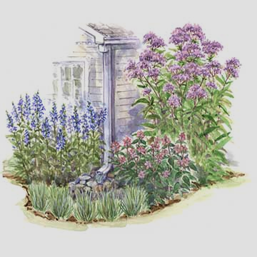
3. Disperse Runoff
LID CONCEPTS

Slide 25
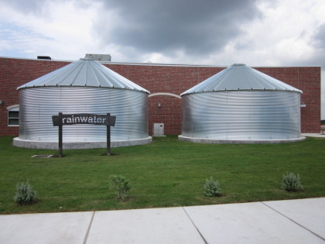
4. Harvest and Reuse Runoff
Feasibility analysis
mandated by permit
Analysis not required if
enough runoff can be
infiltrated on-site
  80% of long-term runoff
  Requires K_{sat} ≥ 1.6“/hour (Group A soils)
Simplified criteria submitted to
Water Board in Dec. 2011
Feasibility Status Report due Dec. 2014
LID CONCEPTS

Slide 26
Screening for Adequate Demand
Identify and list sub-areas of site from which runoff could feasibly be captured
Calculate on-site demand for:
  Toilet flushing
  Landscape Irrigation
  Other uses
Compare on-site demand to
drawdown required given:
  80% of runoff to be used
  50,000 gal. storage/acre impervious area
LID CONCEPTS

Slide 27
Required Demand
30+ years of
hourly runoff from one acre
Table 4-3 on page 41
Rain Gauge | Min. Demand (gal/day/acre)
Berkeley | 5900
Brentwood | 4200
Martinez | 5900
Dublin | 4100
LID CONCEPTS
Overflow
(20%
of total)
50,000
gallons
storage
(for example,
about
25' diameter
x 14' high)
Reuse (80% of total)

Slide 28
Select Roofs or other Surfaces
Page
40
“List specific impervious areas from which runoff might be feasibly captured or stored.
All contiguous
roof areas
10,000 SF and
greater must
be listed.”

Slide 29
Default Toilet Flushing Use
Land Use Type | User Unit | User Unit Factor (Optional—use project-specific data if available) | Daily Use/Unit (gal./day/ user unit)*
Residential | Resident | 2.8 residents/ dwelling unit | 8.6
Office or Retail | Employee (non-visitor) | 200 SF/ employee | 6.9
Schools | Employee (does not include students) | 50 SF/ employee | 33.9
Industrial Uses (not including process water) | Employee (non-visitor) |  | 5.4
LID CONCEPTS
*Or use project-specific data

Slide 30
Mixed Use Development
Page
41
A | B | C | D | E | F | G | H | I | J
Area | SF | Acres | Uses and User Units | Toilet and Urinal Usage (gal/day) | Water Use per Acre | Req’d Demand per Acre | F>G? | Adjacent pervious area ≥ 2.5 × “B”? | Other Use ≥ “G”?
B-1 | 21000 | 0.48 | 77 DUs + 9000 SF Retail | 1854 + 310 = 2164 | 4508 | 5900 | No | No | No
LID CONCEPTS
77 DUs × 2.8 residents/DU × 8.6 gal/day/resident = 1854 gal/day
9000 SF retail ÷ 200 SF/employee × 6.9 gal/day/employee = 310 gal/day

Slide 31
A | B | C | D | E | F | G | H | I | J
Area | SF | Acres | Uses and User Units | Toilet and Urinal Usage (gal/day) | Water Use per Acre | Req’d Demand per Acre | F>G? | Adjacentpervious area ≥ 2.5 × “B”? | Other Use ≥ “G”?
All | 41102 | 0.94 | 23 DUs | 554 | 589 | 5900 | No | No | No
Bldgs | 18975 | 0.44 | 23 DUs | 554 | 1271 | 5900 | No | No | No
Bldg A | 4125 | 0.09 | 23 DUs | 554 | 5850 | 5900 | No | No | No
23 DUs x 2.8 residents/DU
x 8.6 gal/day/resident
= 553.8 gal/day
554 gal/day ÷ .94 acres
= 589 gal/day/acre

Slide 32
Design for Water Supply
30+ years of
hourly runoff from one acre
LID CONCEPTS
Less storage
(<<50,000
gallons/acre)
More Overflow (>>20% of total)
Reuse (<<80% of total)

Slide 33
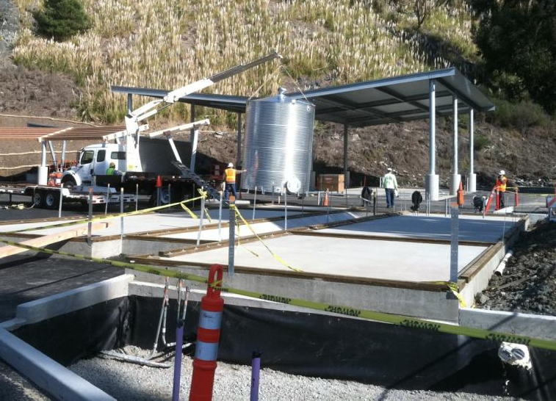
Bioretention in Series

Slide 34
LID Design Process
Page
35
Analyze Project for LID
Develop and Document LID Drainage Design
Specify LID Preliminary Design Details
LID CONCEPTS
Coordinate with Site Design and Landscape Design

Slide 35
Analyzing a Project for LID
Five LID Strategies
Optimize the site layout
Use pervious surfaces
Disperse runoff
Store runoff and use it later
Direct runoff to bioretention facilities
LID CONCEPTS

Slide 36


5. Direct Runoff to Bioretention
LID CONCEPTS

Slide 37
Drainage
Management Areas
Stormwater NPDES Compliance for New Developments

Slide 38
LID Site Design Principles
DMAs
Paved or Roof Area

Slide 39
LID Site Design Principles
DMAs

Slide 40
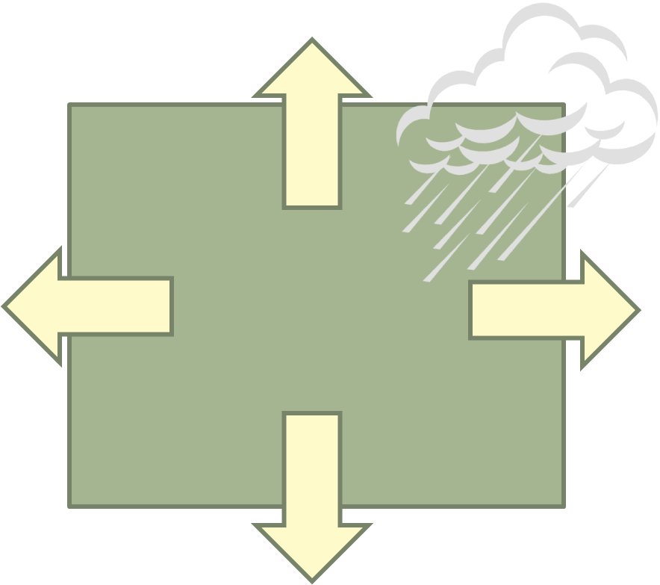
LID Site Design Principles
Mimic natural hydrology
Disperse runoff
Keep drainage areas small
Don’t concentrate runoff
Don’t allow run-on from landscaped or natural areas

Slide 41
Drainage Management Areas
DMAs

Slide 42
Drainage Management Areas
DMAs
DMA 1
DMA 4
DMA 3
DMA 2

Slide 43
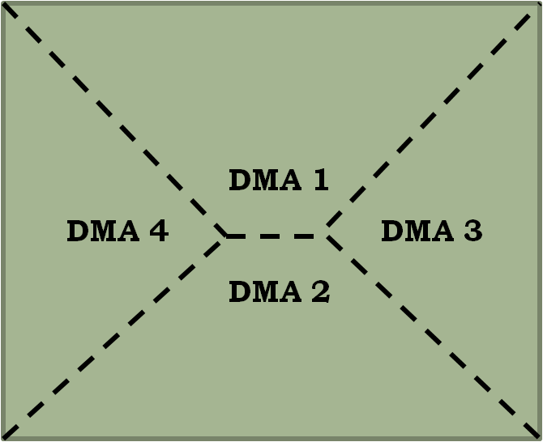
Drainage Management Areas
DMAs

Slide 44
Drainage Management Areas
Natural
DMA-8
DMAs
DMA-5
Paved
DMA-6
DMA-7
Landscaped

Slide 45
Drainage Management Areas
Natural
DMA-8
DMAs
DMA-5
Possible
Facility
Locations
Paved
DMA-6
DMA-7
Landscaped
Municipal Storm Drain

Slide 46
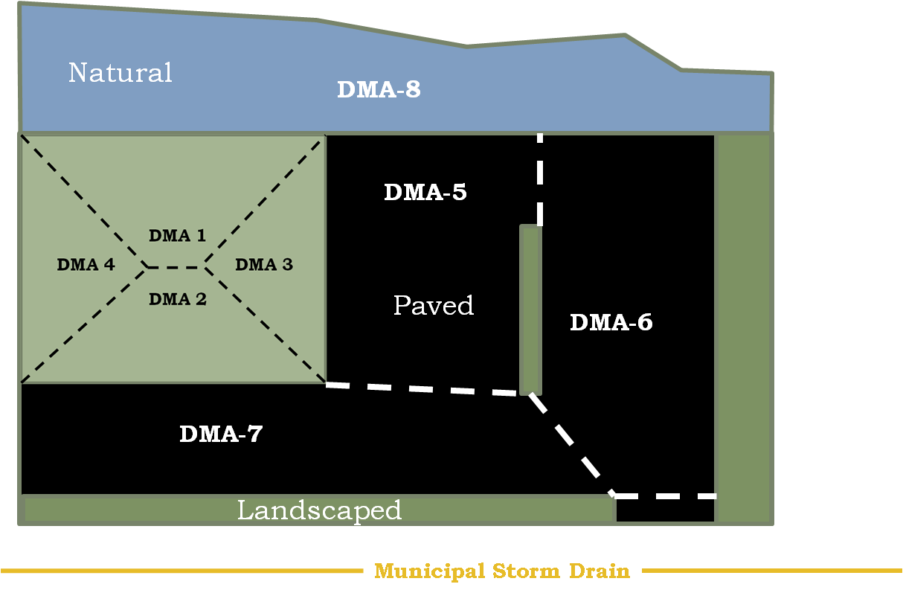
Options – Pervious DMAs
DMAs
DMA-8
  Self-treating?
  Self-retaining?
  Drain to IMP?

Slide 47
DMA 8
Self-Treating
  Drain directly to storm drain system
Self-Retaining
  Retain first inch of rainfall without producing runoff
Drain to IMP
  Use runoff factor to account for contribution
DMAs
Best choice may depend on slope and relative elevation

Slide 48
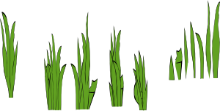


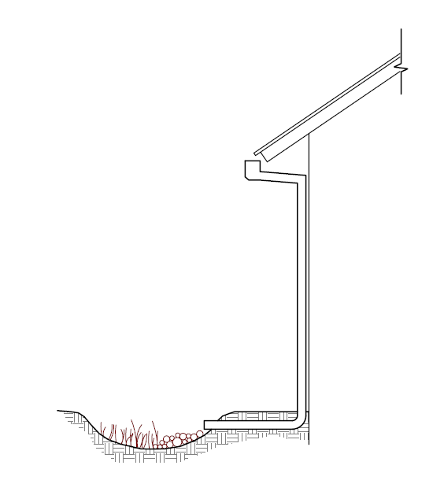
Details
Use a curb to avoid run-on
from self-treating areas
To storm drain
DMAs
Grade self-retaining areas
to drain inward. Set any area drains to pond 3"-4"
Consider that adjacent roofs or paved areas could drain to self-retaining areas (not to exceed 1:1)

Slide 49
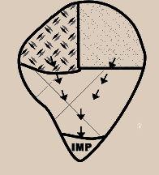
Options – Combining DMAs
Option to combine DMAs if they have identical runoff factors (for example, roofs and paving) and drainage is routed to the same location.
DMAs
Carefully follow grade breaks and roof ridges to delineate DMAs

Slide 50
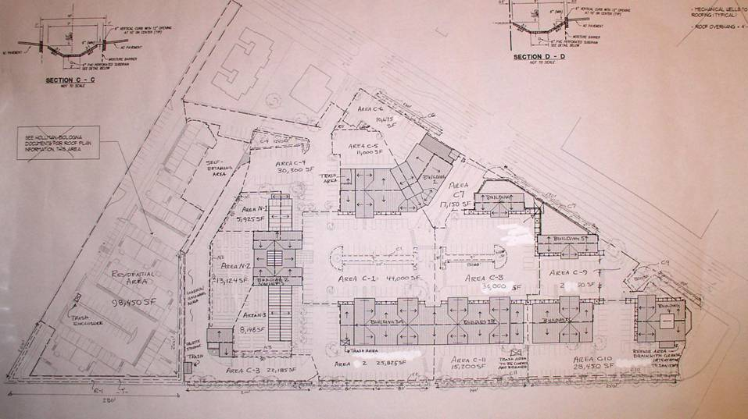
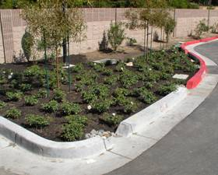
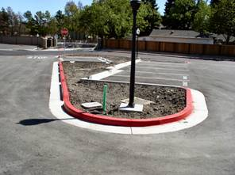
Roof ridges and grade breaks
DMAs

Slide 51
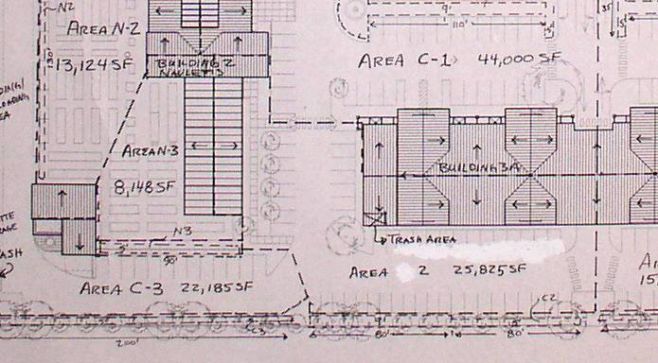
Roof and Grading Plans
DMAs

Slide 52
Reviewing Stormwater
Control Plans
Stormwater NPDES Compliance for New Developments

Slide 53
Contents
Project Data
Setting
Low Impact Design Strategies
  Optimization of Site Layout
  Use of Permeable Pavements
  Dispersal of Runoff to Pervious Areas
  Feasibility of Harvesting and Use
Documentation of Drainage Design
Source Control Measures
Stormwater Facility Maintenance
Construction Plan C.3 Checklist
Certifications
REVIEW PLANS

Slide 54
Impervious Areas Pre/Post
SITE
New Building
REVIEW PLANS
Reduced Re-Graded Lot

Slide 55
Special Projects
Page
60
Project Categories
  A
  B
  C
Percent LID and non-LID treatment
Other Reporting Requirements
  Narrative on LID Feasibility
  Criteria used for non-LID facilities
Contact Program Staff for assistance
REVIEW PLANS

Slide 56
Setting and Strategies
Setting
  Project Location and Description
  Existing Site Features and Conditions
  Opportunities and Constraints
LID Strategies
  Optimization of Site Layout
  Use of Permeable Pavements
  Dispersal of Runoff to Pervious Areas
  Feasibility Assessment of Harvesting/Use
  Integrated Management Practices (bioretention)
REVIEW PLANS

Slide 57
Drainage Design Calculations
Drainage Management Areas
DMA Name | Surface Type | Area in SF
REVIEW PLANS
Σ(DMAs + Bioretention Facilities) = Total Site

Slide 58
Example Site
Natural
DMA-8
REVIEW PLANS
DMA-5
Possible
IMP
Locations
Paved
DMA-6
DMA-7
Landscaped
Municipal Storm Drain

Slide 59
Example Site
Natural
DMA-8
9350 SF
1300 SF
DMA-4
5570 SF
Possible
IMP
Locations
4000 SF
1050 SF
1050 SF
Paved
DMA-6
1300 SF
DMA-5
7025 SF
Landscaped
Municipal Storm Drain

Slide 60
Example Site
Natural
DMA-8
9350 SF
REVIEW PLANS
1300 SF
DMA-5
5570 SF
Possible
IMP
Locations
4000 SF
1050 SF
1050 SF
Paved
DMA-6
1300 SF
DMA-7
7025 SF
Landscaped
Municipal Storm Drain

Slide 61
Setting Up Calculations
Self-retaining Area
Area Draining to Self-retaining Area
DMA Name | Square Feet
DMA-8 | 9350
REVIEW PLANS
DMA | Square Feet | Surface | Runoff Factor | Product | Receiving DMA | Receiving Area | Ratio
DMA-1 | 1300 | Roof | 1.0 | 1300 | DMA-8 | 9350 | 0.139

Slide 62
Setting Up Calculations
Areas Draining to IMPs
DMA | Area | Surface | Runoff Factor | Area × Runoff Factor | Soil Type
DMA-2 | 1050 | Roof | 1.0 | 1050 | D
DMA-4 | 1300 | Roof | 1.0 | 1300
DMA-7 | 7025 | Paved | 1.0 | 7025
 |  |  |  |  | IMP Sizing Factor | Rain Adjust Factor | Min Area or Volume | Proposed Area or Volume
 |  |  |  | A
 |  |  |  | V1
 |  |  |  | V2
 |  |  |  | Orifice Size:
REVIEW PLANS

Slide 63
Setting Up Calculations
Areas Draining to IMPs
DMA | Area | Surface | Runoff Factor | Area x Runoff Factor | Soil Type
DMA-2 | 1050 | Roof | 1.0 | 1050 | D
DMA-4 | 1300 | Roof | 1.0 | 1300
DMA-7 | 7025 | Paved | 1.0 | 7025
 |  |  |  | 9375 | IMP Sizing Factor | Rain Adjust Factor | Min Area or Volume | Proposed Area or Volume
 |  |  |  | A | 0.06 | 1.0 | 562.5
 |  |  |  | V1 | 0.04 | 1.0 | 375.0
 |  |  |  | V2 | 0.05 | 1.0 | 468.8
 |  |  |  | Orifice Size:
REVIEW PLANS

Slide 64
Example Site
Natural
DMA-8
9350 SF
REVIEW PLANS
1300 SF
DMA-5
5570 SF
4000 SF
1050 SF
1050 SF
Paved
DMA-6
1300 SF
DMA-7
7025 SF
IMP-1 1400 SF
Municipal Storm Drain

Slide 65
Setting Up Calculations
Areas Draining to IMPs
DMA | Area | Surface | Runoff Factor | Area x Runoff Factor | Soil Type
DMA-2 | 1050 | Roof | 1.0 | 1050 | D
DMA-4 | 1300 | Roof | 1.0 | 1300
DMA-7 | 7025 | Paved | 1.0 | 7025
 |  |  |  | 9375 | IMP Sizing Factor | Rain Adjust Factor | Min Area or Volume | Proposed Area or Volume
 |  |  |  | A | 0.06 | 1.0 | 562.5 | 1400
 |  |  |  | V1 | 0.04 | 1.0 | 375.0 | 400
 |  |  |  | V2 | 0.05 | 1.0 | 468.8 | 475
 |  |  |  | Orifice Size: |  |  |  | 0.6 in.
REVIEW PLANS

Slide 66
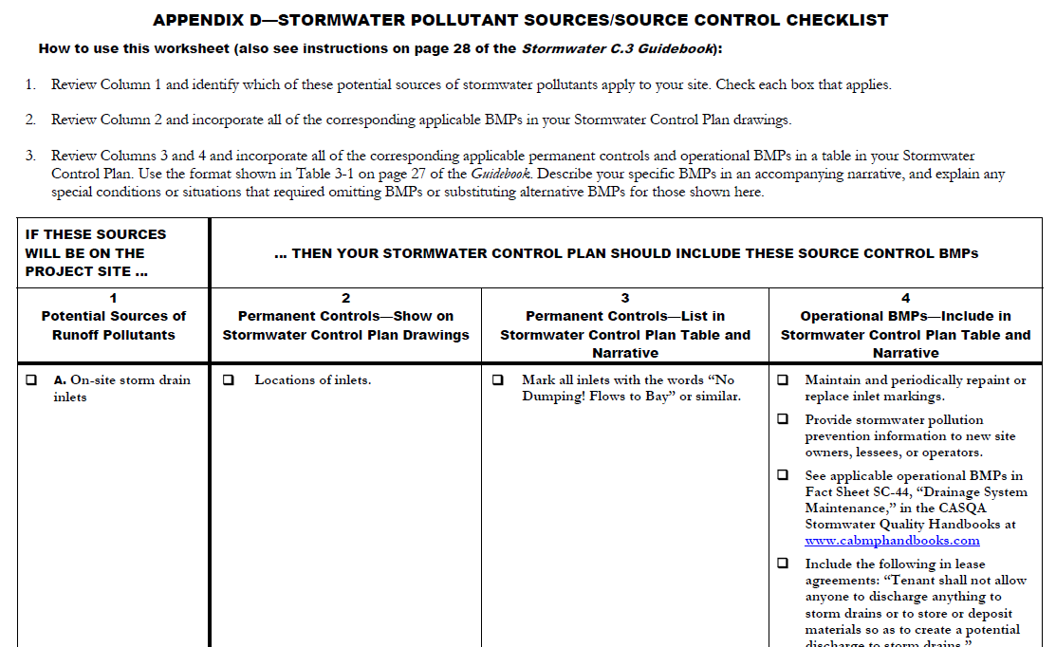
Source Control Measures
Page
28

Slide 67
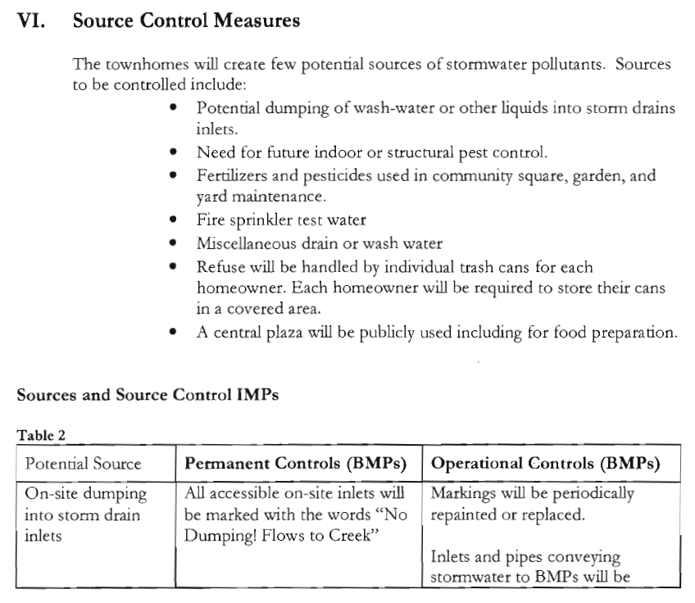
REVIEW PLANS
Page
29

Slide 68
Stormwater Facility Maintenance
Page
29
Ownership and responsibility
  Commitment to execute agreements
  Accept O&M until formally transferred
Maintenance requirements
  Fact sheets on website
REVIEW PLANS

Slide 69
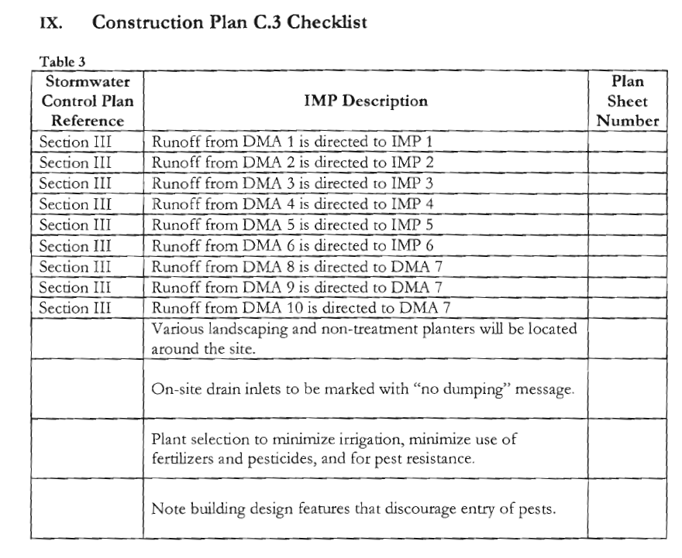
Construction C.3 Checklist
Page
32
REVIEW PLANS

Slide 70
Certification
“The selection, size, and preliminary design of treatment BMPs and other control measures in this plan meet the requirements of Regional Water Quality Board Order R2-2009-0074.”

Slide 71
Reporting

Slide 72
Small Projects
Stormwater NPDES Compliance for New Developments

Slide 73
Provision C.3.i.
Started December 1, 2012
Small Projects
  All projects requiring approvals or permits
  2,500 SF ≥ impervious area ≤10,000 SF
  Single family homes ≥ 2,500 SF
Site Design Measures
  Rain barrels or cisterns
  Direct runoff to vegetated areas
  Permeable pavement
Develop standard specifications
Reporting: Discuss implementation
SMALL

Slide 74
SMALL

Slide 75
Bioretention Design
Stormwater NPDES Compliance for New Developments

Slide 76
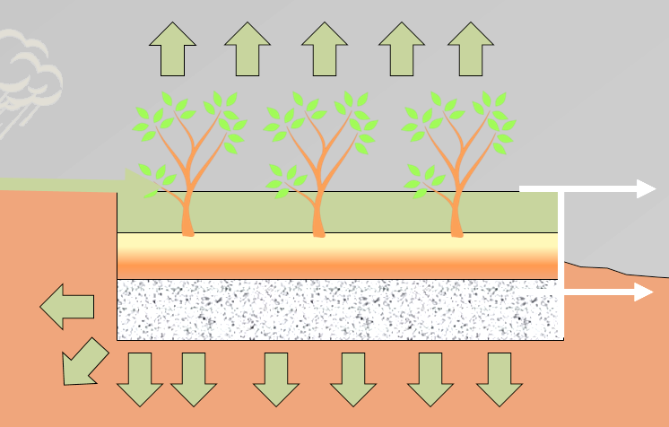
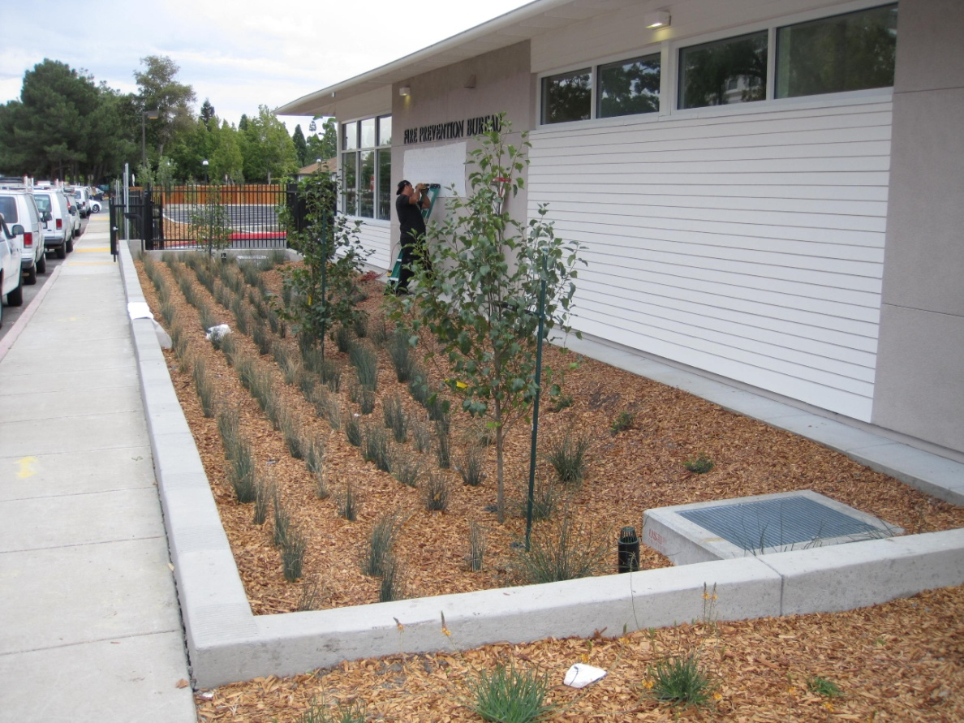
Make This Happen
Bioretention facilities are level so they “fill up like a bathtub.”
BIORETENTION

Slide 77
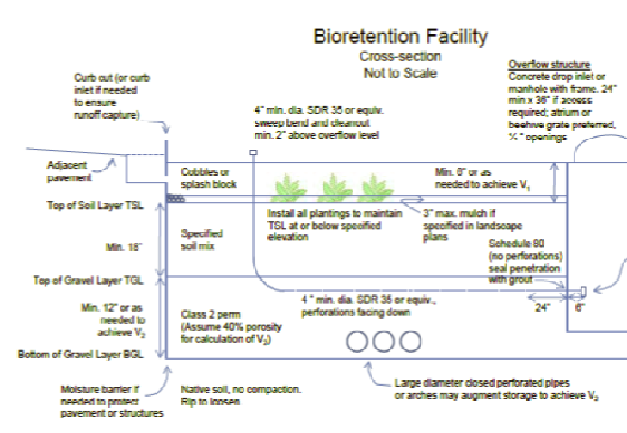
Page
76

Slide 78
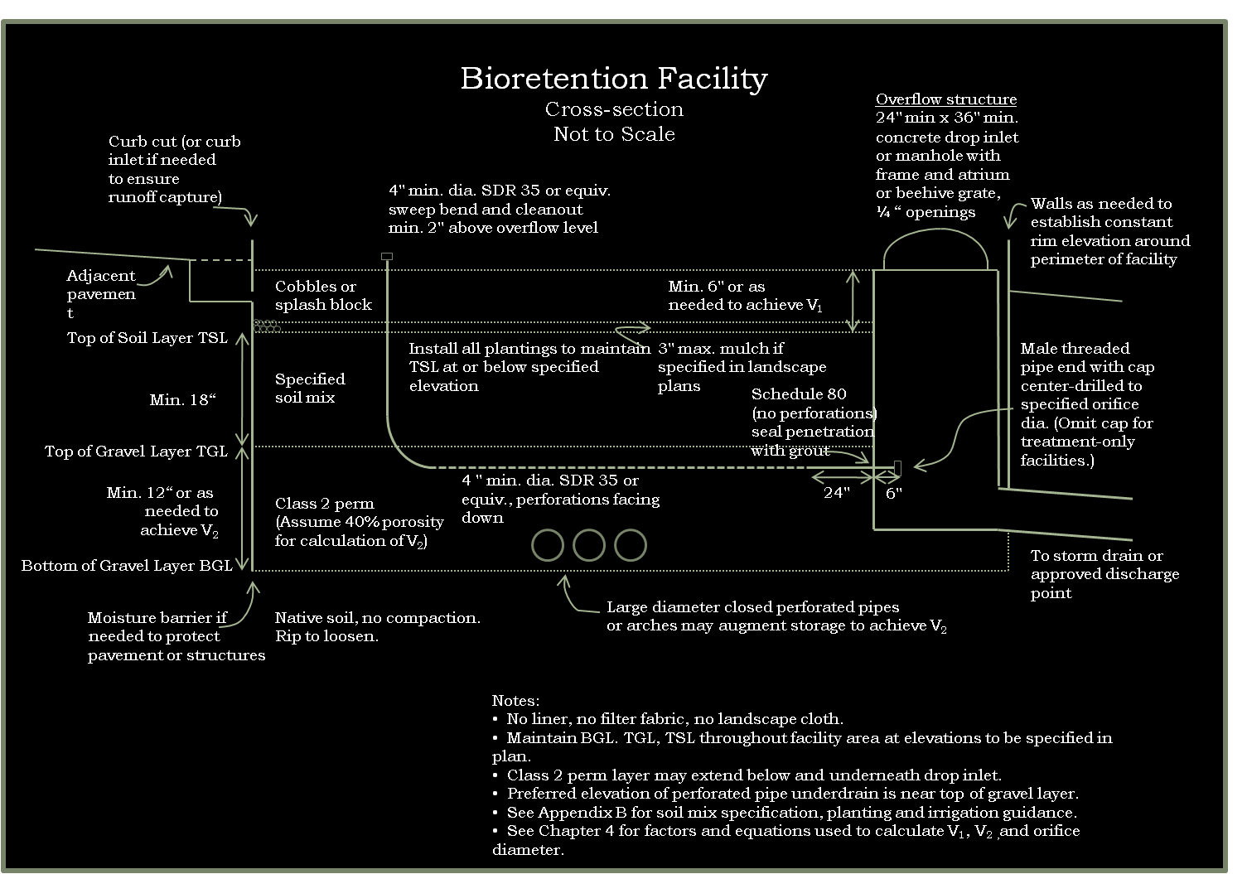
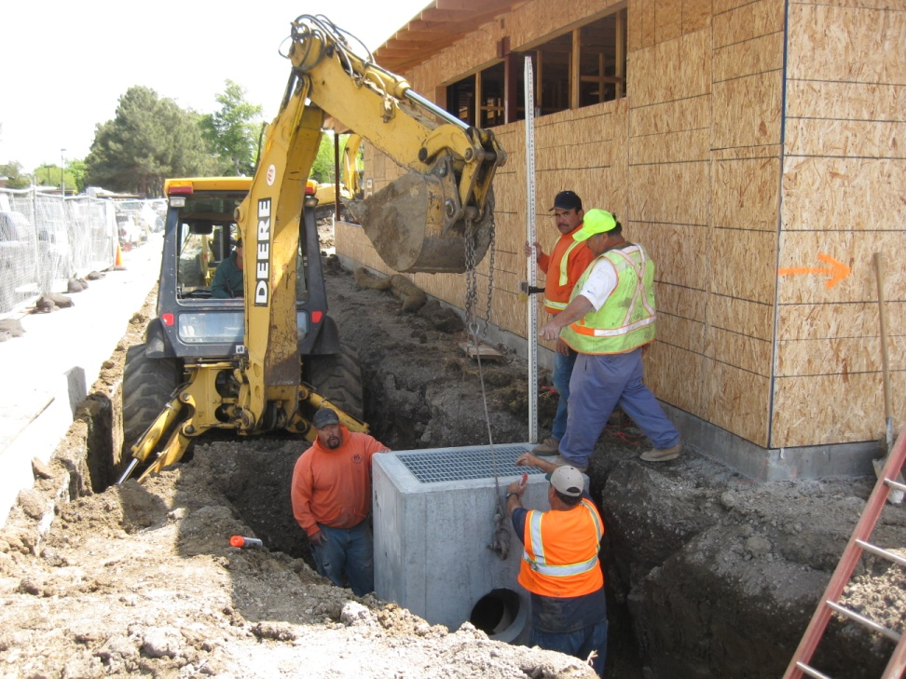
Outlets
Page
76
BIORETENTION
Overflow
elevation

Slide 79
Bioretention Edges
Page
77
BIORETENTION

Slide 80
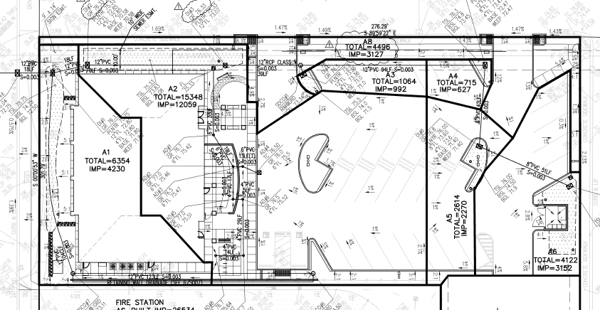
DMAs with Grading Shaded
BIORETENTION

Slide 81
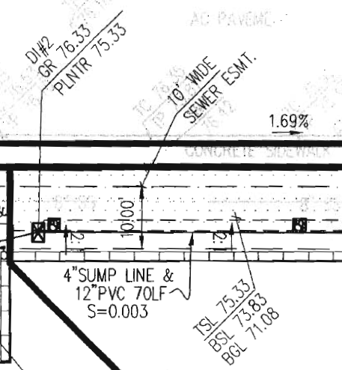
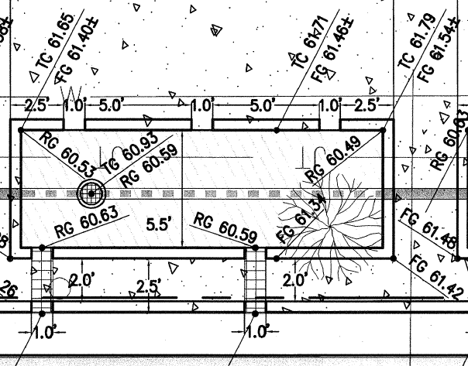
Call out elevations
    Outlet structure
  Top of overflow grate
  Underdrain connection
    Inlet
  Flow line at inlet
  Top of curb
  Top of adjacent paving
    Soil layers
  Top of soil layer
  Bottom of gravel layer
  Bottom of soil layer
BIORETENTION

Slide 82
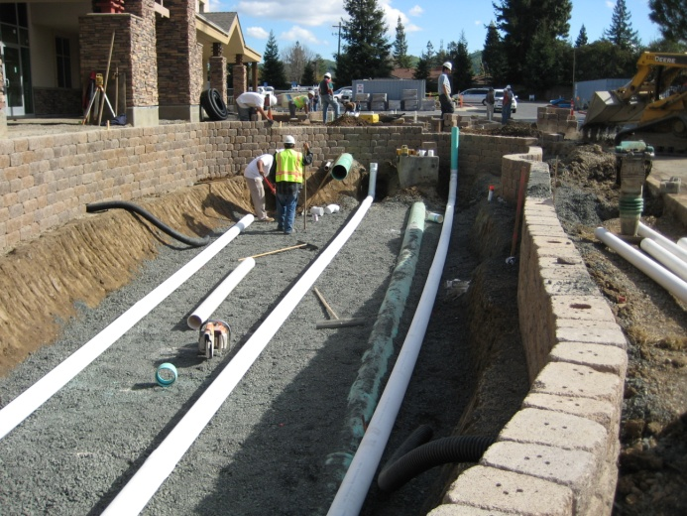
Gravel and Underdrain
    Class 2 permeable
  Caltrans spec 68-1.025
  Typical to be slightly off
  gradation spec on delivery
    No filter fabric
    Underdrain
  Near top of gravel layer
  PVC SDR 35 or equivalent; holes facing down
  Solid pipe for 2' closest to outlet structure
  Cleanout
BIORETENTION

Slide 83
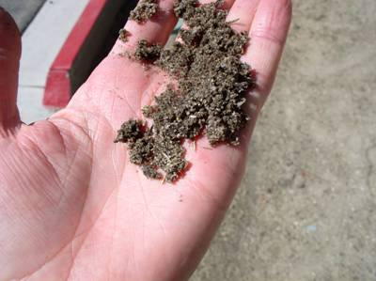
Soil Specification
    60-70% Sand
  ASTM C33 for fine aggregate
    30-40% Compost
  Certified through US Composting Council
  Seal of Testing Assurance Program
    Submittal per Guidebook
    Option to accept test results for a “brand-name” mix if volume is less than 100 cubic yards
    Install in 8"-12" lifts
    Do not compact
    Do not overfill
    Leave room for mulch
BIORETENTION

Slide 84
Bioretention Construction
Page
95
Runoff flow from the intended tributary drainage management area must flow into the facility.
The surface reservoir must fill to its intended volume during high inflows.
Runoff must filter rapidly through the layer of imported soil mix.
Filtered runoff must infiltrate into the native soil to the extent possible (or allowable).
Remaining runoff must be captured and drained to a storm drain or other approved location.
BIORETENTION

Slide 85
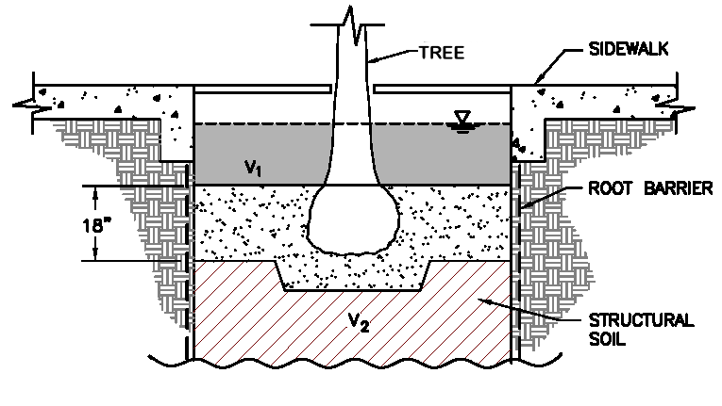
Plantings
    Maintain design top of soil elevation
    Trees
  Incorporate into bioretention facility
  Account for surface roots
BIORETENTION

Slide 86
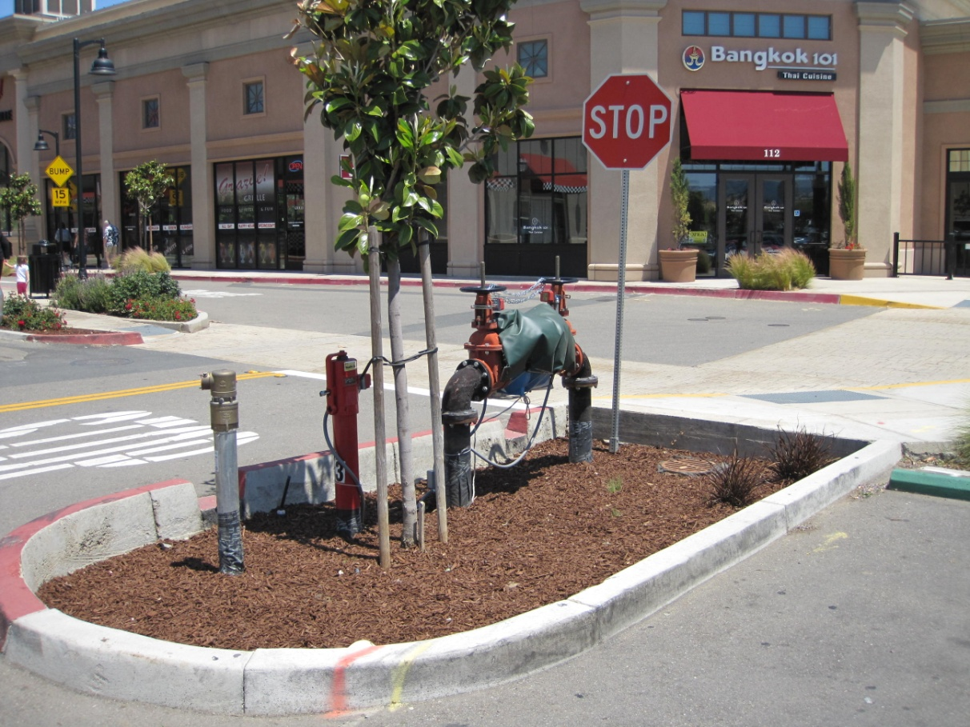
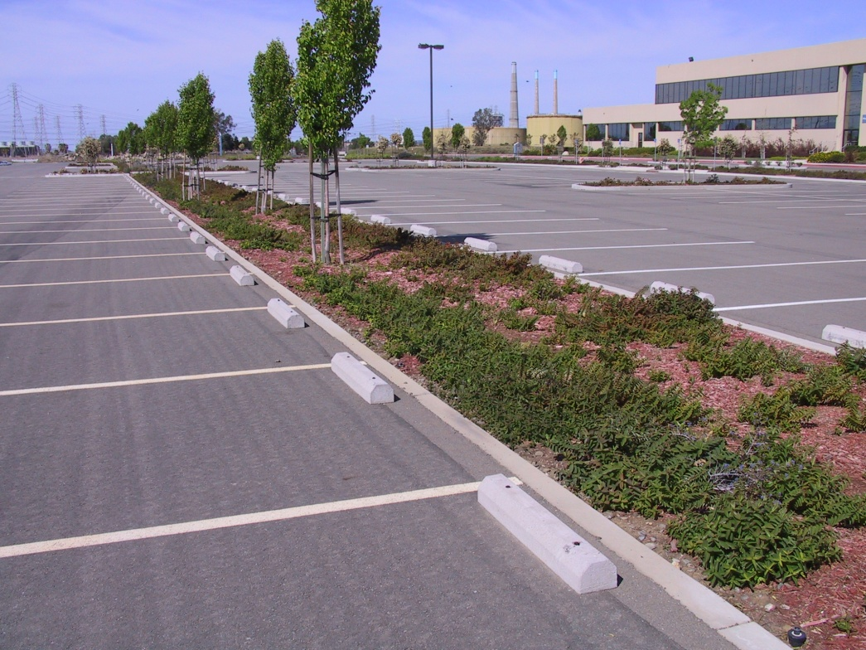
Pedestrian Access, Utilities
BIORETENTION

Slide 87
Operation & Maintenance
Stormwater NPDES Compliance for New Developments

Slide 88
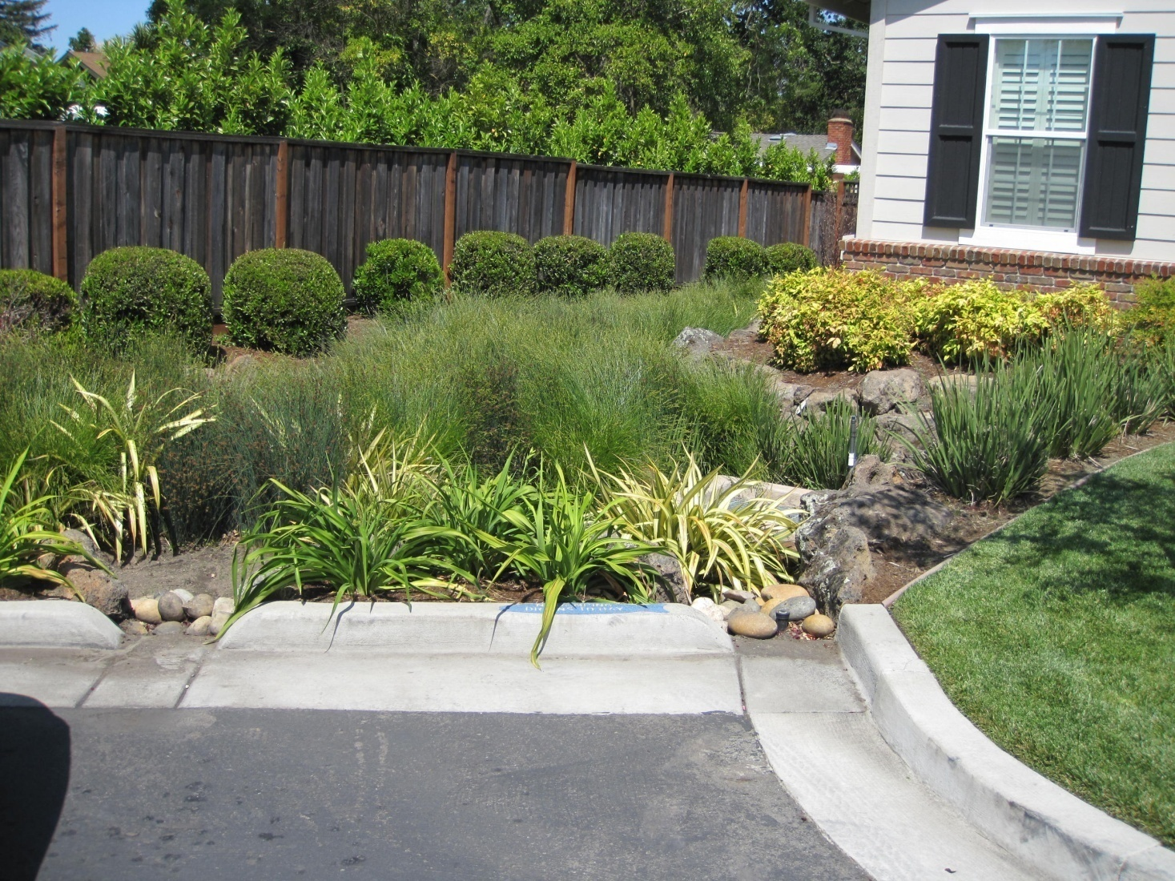
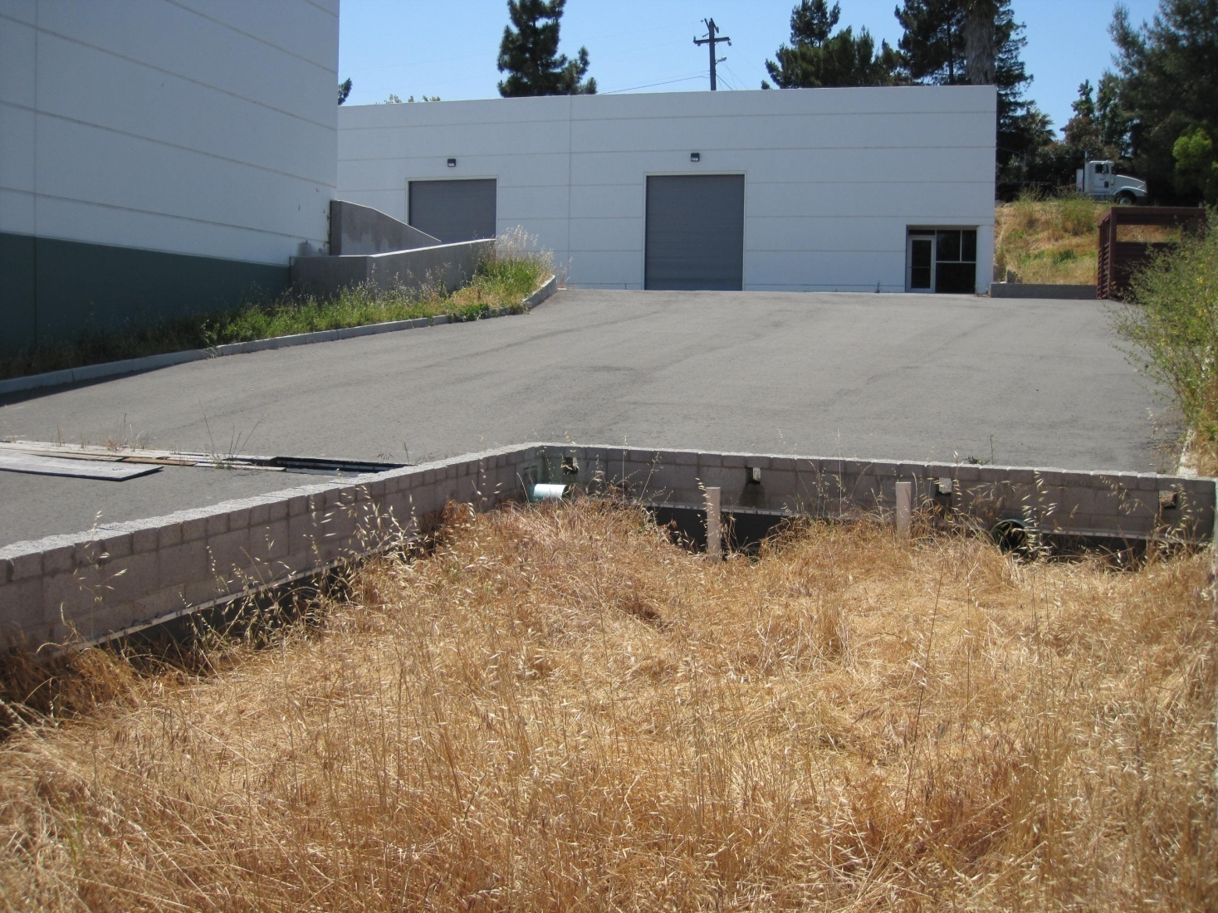
Ensure Operation & Maintenance
Initial inspection within 45 days
Inspect 20% of facilities each year
Inspect every facility once every 5 years
O&M

Slide 89
What to look for
Properly designed and constructed bioretention facilities are nearly maintenance-free…
…Unless facilities are treated as ordinary landscaping.
  Additions of topsoil or mulch
  Re-grading
  Additional plantings
Also…
  Plants may grow so dense that runoff can’t enter
O&M

Slide 90
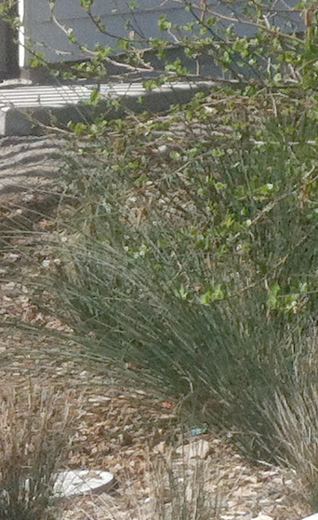
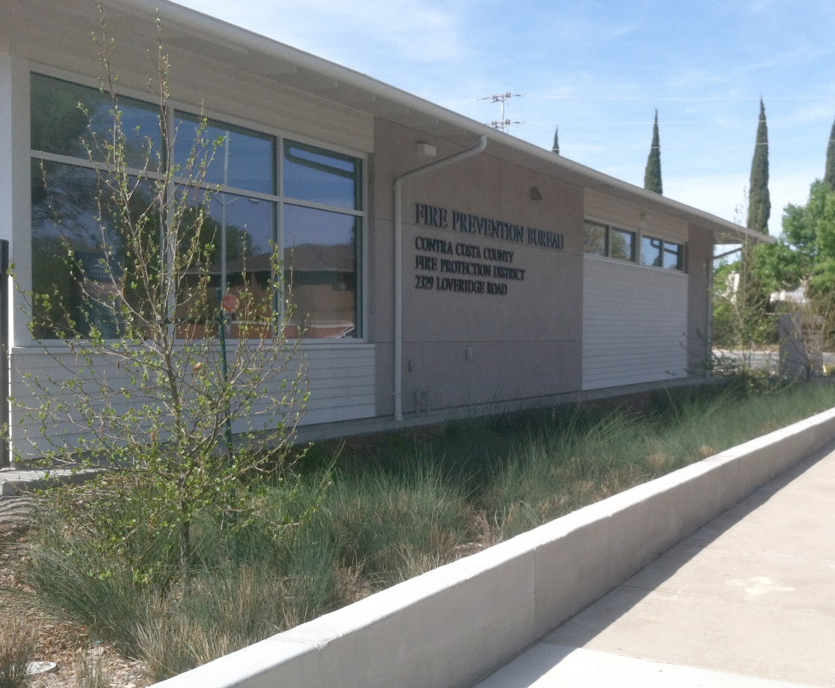
Addition of material

Slide 91
Resources for O&M Inspections
Forms
  Designation of Responsible Individuals
  Operation and Maintenance Log
O&M Fact Sheets
Example O&M Plans
  Example Contents of Inspector’s Report
O&M

Slide 93
Discussion

