Slide 1
Debris Removal and Weeding
Trash, sediment, weeding, and Pruning
Megan W. Stromberg Consulting

Slide 2
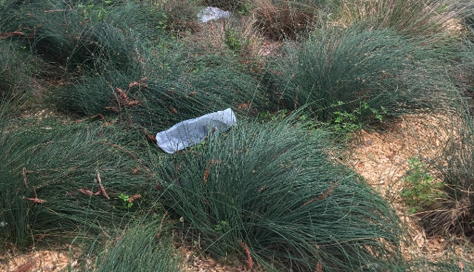
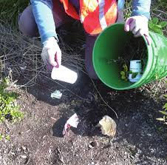
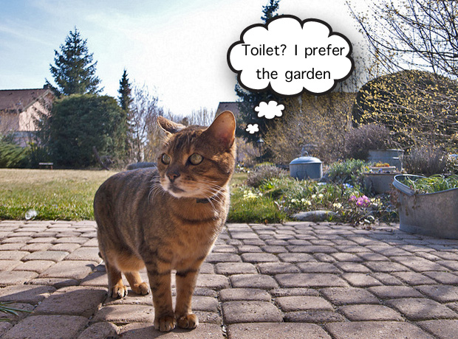
Trash
Problematic in parking lots
Remove regularly before enters drain or breaks down into smaller bits
Sharps - Use grabbers or puncture-safe gloves
Notes:
Trash
Be sure to use gloves and grabbers to remove dangerous trash
(needles, animal carcasses, etc.) and dispose of safely.

Slide 3
True or False:
Used motor oil is the number one pollutant found in surface water.
Notes:
FALSE - sediment is the #1 source of pollution to our rivers and streams

Slide 4
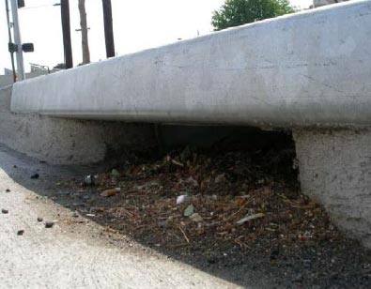
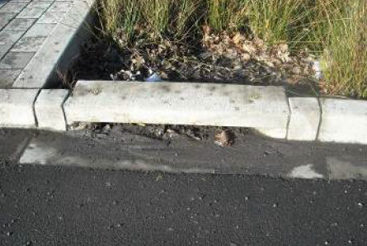
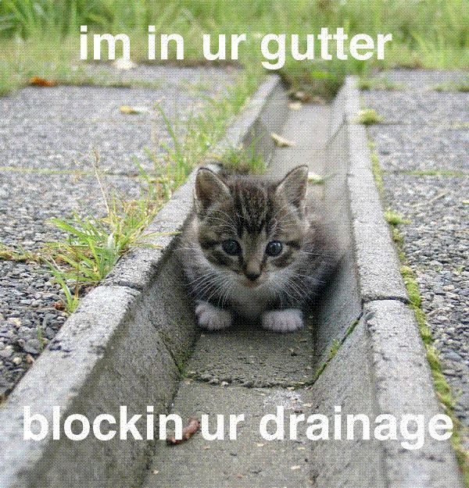
Sediment
Sediment & leaves accumulate at inlets and low-points
Prevents runoff from entering a facility or slows infiltration
Water is required to soak into soil within 48 hours
Regularly remove sediment to make sure runoff can get in via inlets
Keeps sediment out of the piped system, prevents clogging
Remove during dry season, when possible
Remove when sediment is blocking inlet or accumulates to a depth of 2+ inches.

Slide 5
Put sediment in a bucket/wheel barrow and dispose in regular trash (not yard waste)
Scrape sediment manually from the bottom of facility
Loosen soil surface with a rake
Sediment removal should occur during the dry season. If sediment is wet it needs to be dewatered before disposal. Do not drain wet sediment outside the facility (pollutants will enter the SD!)

Slide 6
When to remove Plants
Blocking inlets
Dead
Invasive weeds
Otherwise weeding is an aesthetic issue not a functional problem

Slide 7
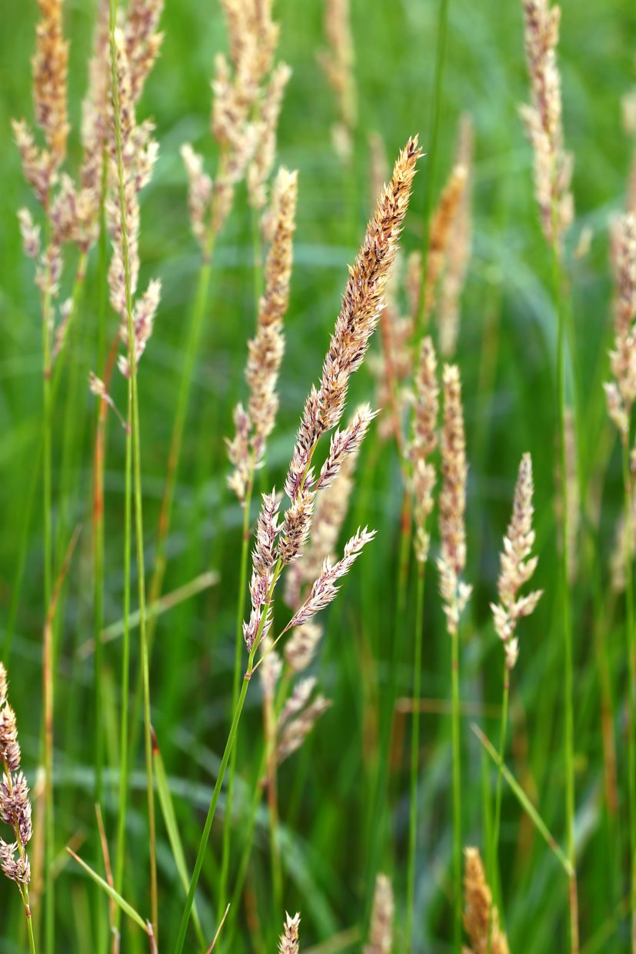
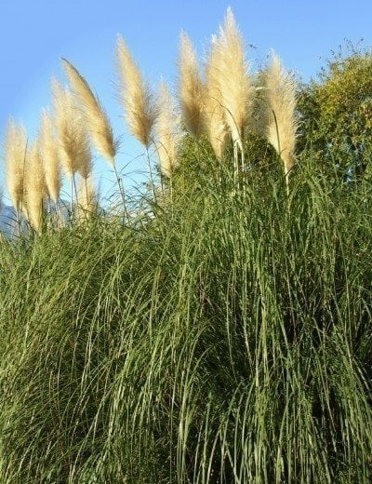
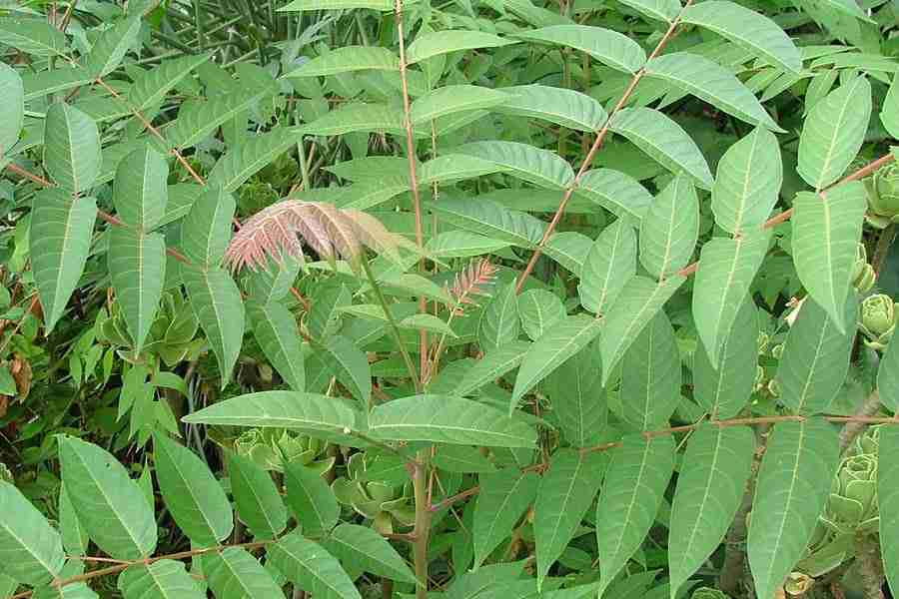
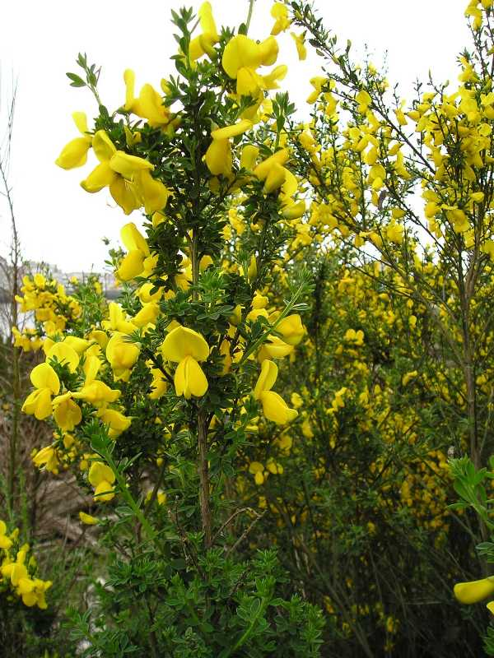
Bioretention weeding
Use rock mulch to suppress (no plastic)
Use Integrated Pest Management (IPM) techniques
Do not use herbicide/pesticide
Remove entire plant by hand/digging
Dispose in greenwaste or facility that is composting on industrial scale

Slide 8
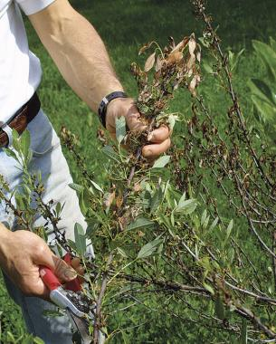
Bioretention pruning
Maintain lines of sight
Allow sunlight in to kill pathogens
Facilitate trash pick-up
Safety issues
Dispose in green waste bins

