Slide 1
Grading & Drainage Design
for Bioretention Facilities
Dan Cloak Environmental Consulting May 23, 2011

Slide 2
Overview
Consider drainage early in the design process
Find suitable sites for bioretention
Use roof plans and grading/paving plans to analyze and display drainage management areas
Distribute bioretention through the site
Grade to distribute drainage to among inlets
Use the head from roof leaders to move roof runoff
Avoid utility conflicts

Slide 3
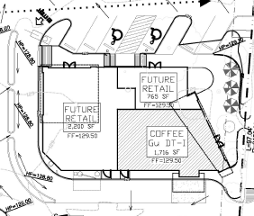
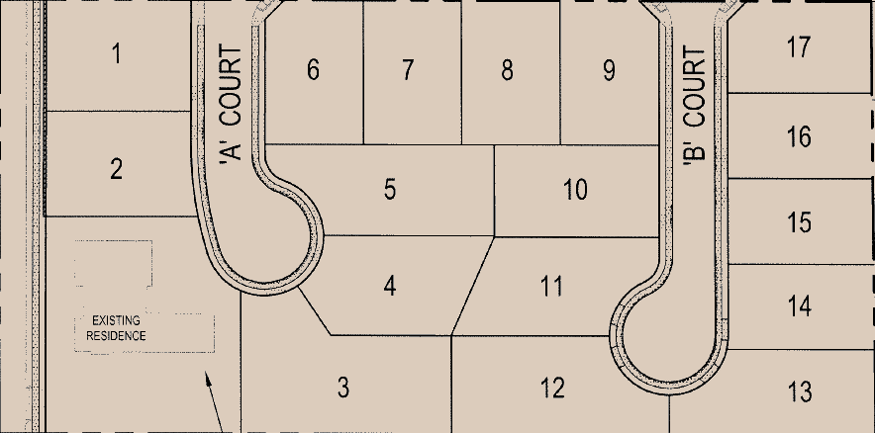
Consider Drainage Early

Slide 4
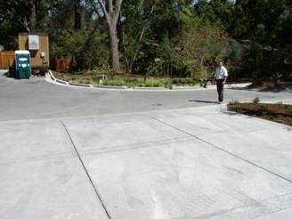
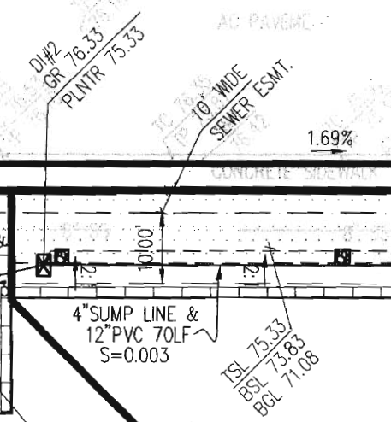
Suitable Sites
Find suitable sites for bioretention
Downgradient
Unbuildable
Aesthetic

Slide 5
Roof and Grading Plans
Drainage area includes portions of roof and of parking lot

Slide 6
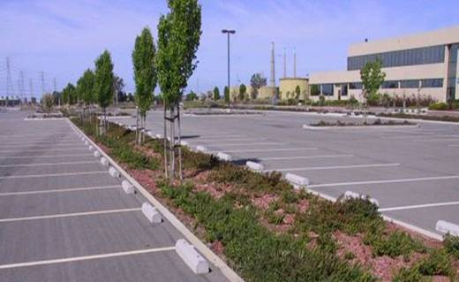
Distribute through the site
Facilitates mimicking pre-development hydrology of site
Keeps drainage runs short and shallow
Avoid creating barriers to circulation

Slide 7
Distribute throughout site

Slide 8
Distribute throughout site
On steep sites consider:
Integrating bioretention facilities with terracing
Collecting runoff in the conventional way and piping to bioretention facilities at the base of the slope

Slide 9
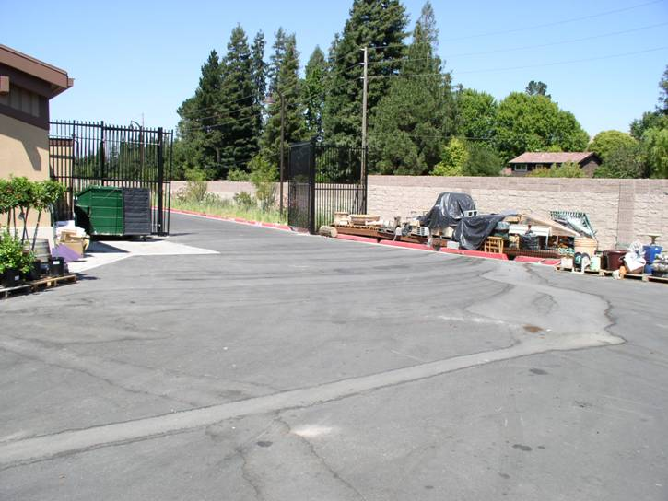
Distribute runoff
Avoid conventionally swaled pavement

Slide 10
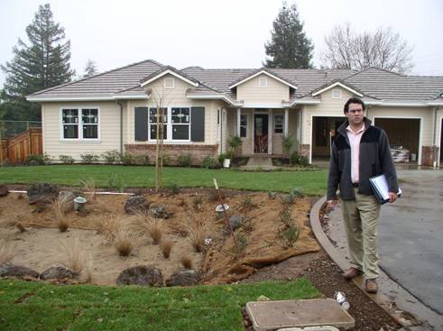
Tightline Roof Leaders
Use the head from roof leaders to move roof runoff

Slide 11
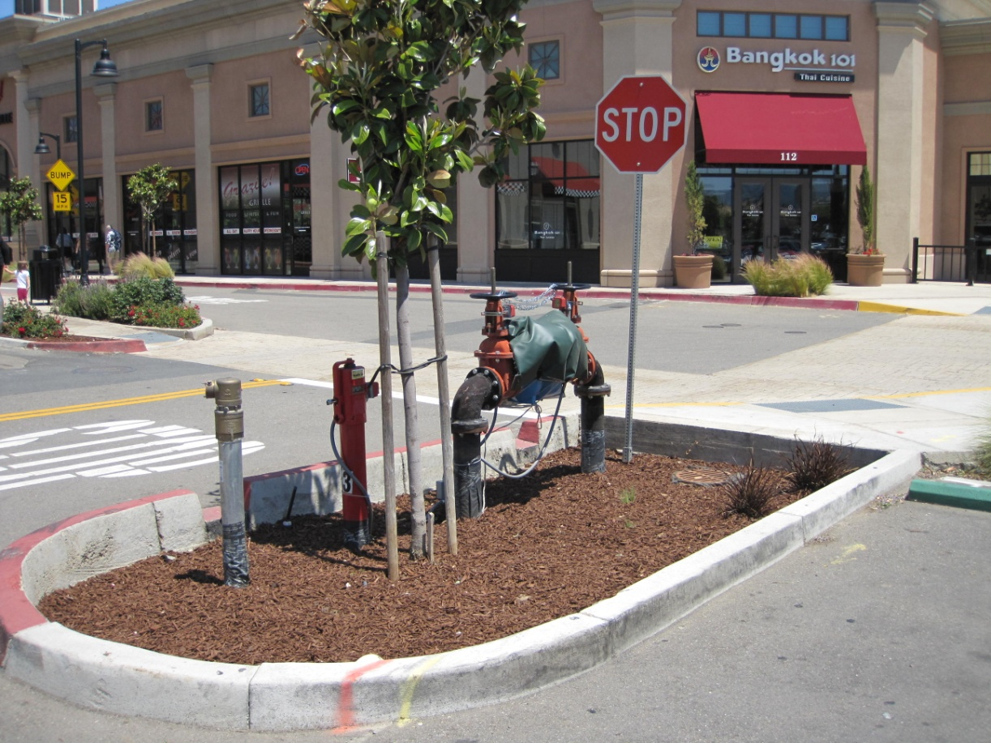
Utility Conflicts
Avoid conflicts with existing underground utilities
Avoid conflicts with newly installed utilities

