Slide 1
Plants and Irrigation in Bioretention
Megan W. Stromberg Consulting

Slide 2
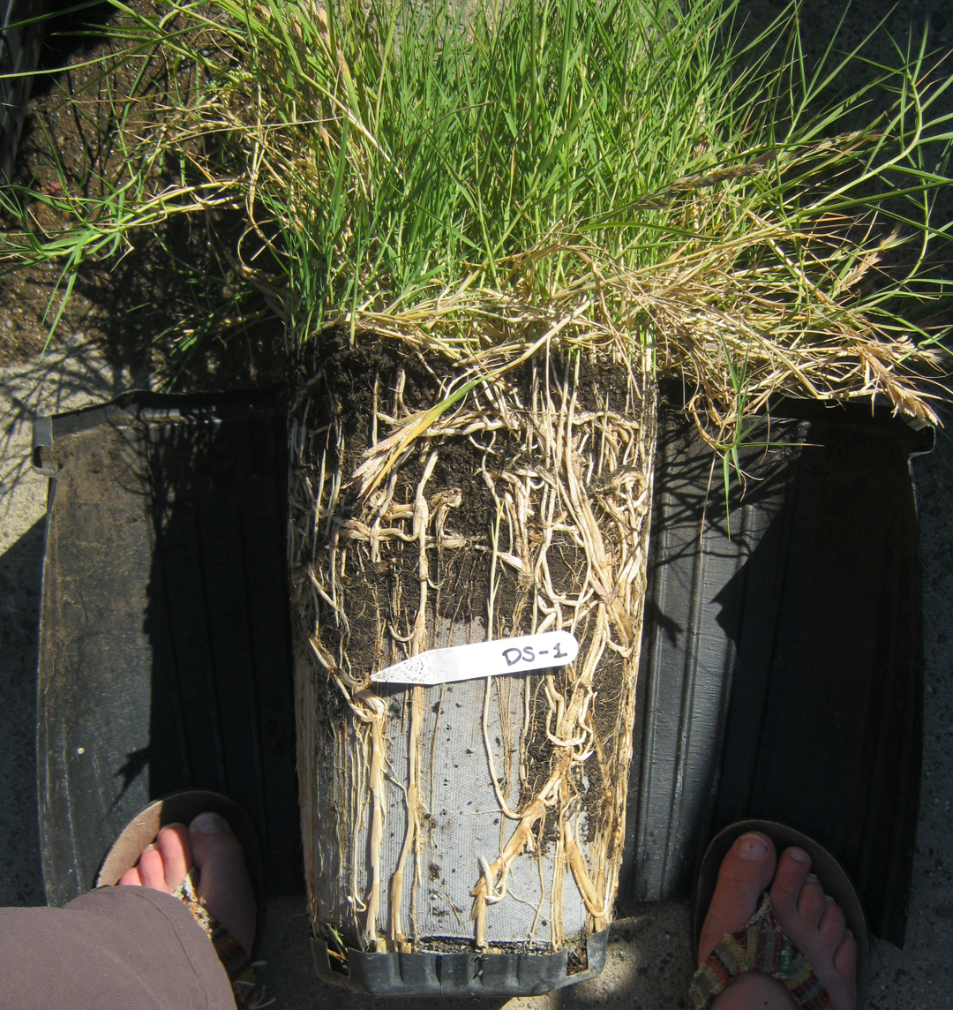
Role of plants
Plant roots penetrate soil creating flow paths
Maintain infiltration rate
Exude saccharides and dead material that feed organisms
Create soil aggregates
Nutrient uptake
Metal uptake
Volatilization
Drawback: Short-circuiting
Notes:
Plants influence water quality directly (uptake/volatilization) and indirectly (physical and chemical changes in soil)

Slide 3
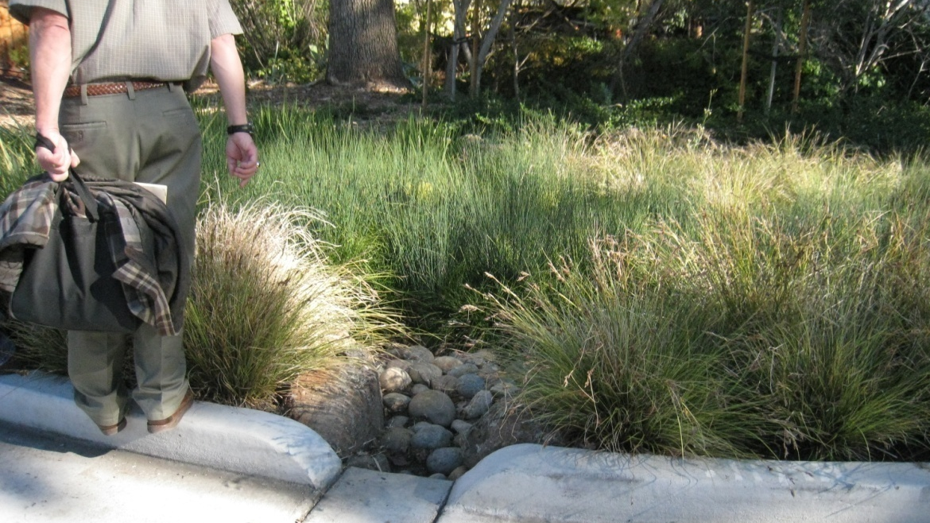
Selection of plants
Must tolerate poor shallow well-drained soils AND flooding
Native species preferred
Provide dense cover and fibrous root structure
No fertilizer
Tolerate drip irrigation
Grasses perform best

Slide 4
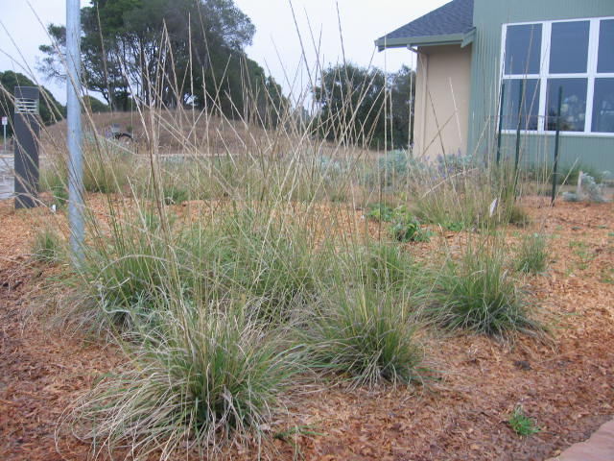
Top picks
Native Grasses:
Juncus patens or Juncus effuses (rushes)
Carex barbarae, Carex pansa (sedges)
Muhlenbergia rigens (Deer Grass)
Non-native Grasses:
Chondropetalum tectorum (Small Cape Rush)
Carex divulsa (Berkeley sedge)

Slide 5
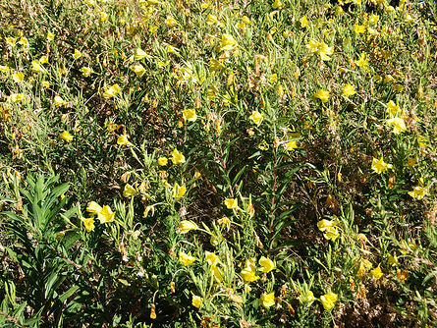
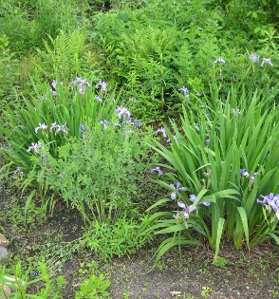
Top picks
Perennials:
Iris douglasiana (Douglas iris)
Achillea millefolium (Yarrow)
Frageria chiloensis (strawberry)
Oenethera hookeri (Hooker’s primrose)

Slide 6
Top picks
Shrubs:
Baccharis pilularis (dwarf or upright coyote brush)
Artemisia ludoviciana (white sagebrush)
Mahonia nervosa (dwarf Oregon grape)
Rosa californica (California rose)

Slide 7
TOP Picks
Trees:
Trees struggle in bioretention
Work with your local jurisdiction – street tree criteria
Choose small trees that are good for containers: Redbud, Olive, Southern Magnolia, Japanese Maple

Slide 8
Warning signs
Unhealthy Vegetation
Sign of drainage problems (too fast)
Reduced filtration
Irrigation failure or schedule adjustment
High infiltration rate = stress
Add mulch to improve water retention and adjust irrigation
Replant with more drought tolerant plants

Slide 9
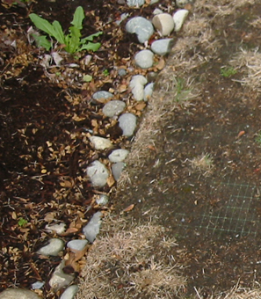
Warning Signs: Bare spots
< 60% cover
Replant
Mulch with compost during dry season
Compost tea, no fertilizer
Investigate drainage issues, clogging

Slide 10
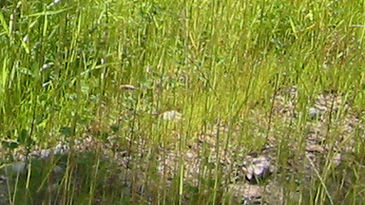
Warning signs
Dead Vegetation & Weeds
Remove thatch when more than 10% cover
Remove weeds, invasive versus unwanted
Remove plants blocking inlets/outlets
Replant if weeds more than 25%
Dead vs. dormant

Slide 11
Weeding
Address invasive plants early
Remove weeds by hand. Pull and dig out roots.
Remove all weeds and vegetative debris from the facility and dispose of properly (greenwaste)
Consult UC Davis IPM Guides
No herbicides allowed

Slide 12
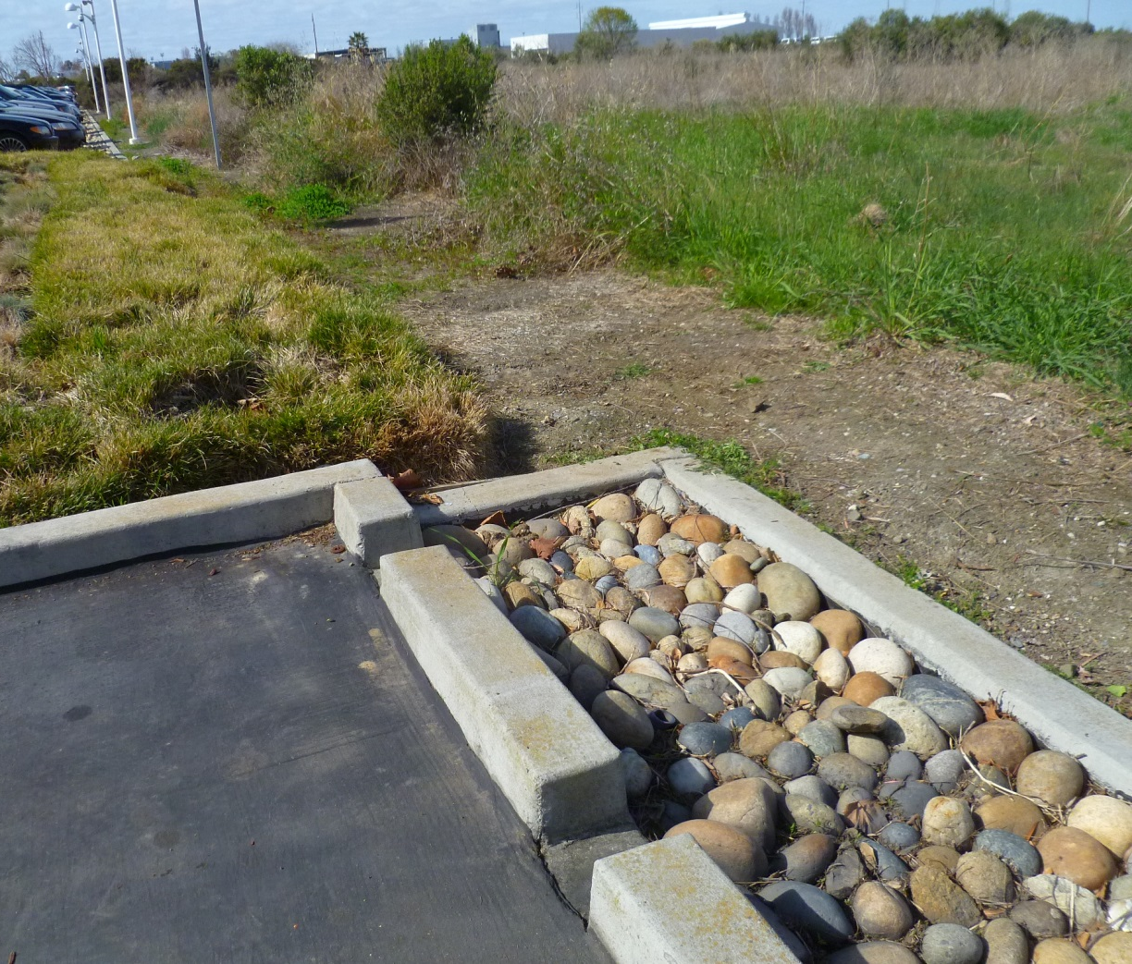
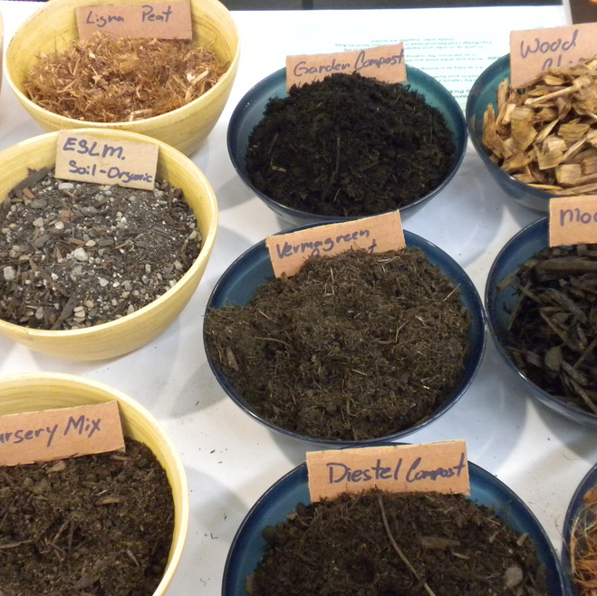
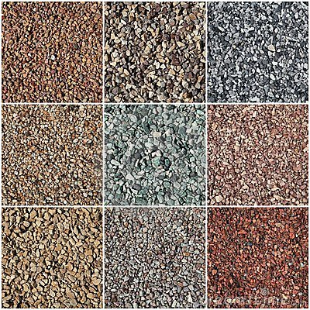
Mulch!!!!
Reduces weeds
Regulate soil temperature and moisture
Add organic matter (?)
Attenuate heavy metals

Slide 13
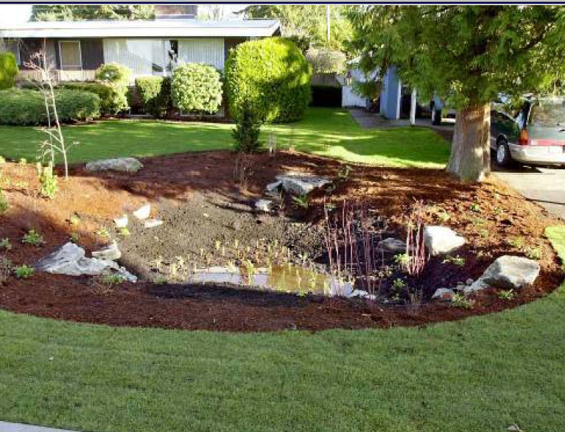
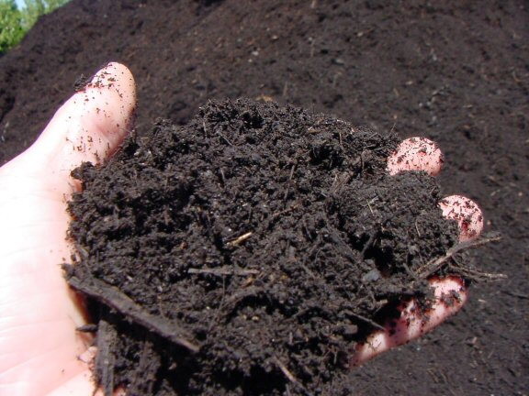
Mulch!!!!
Below waterline: Compost (“aged” coarse mulch) pea gravel, rock, cobble
Above waterline: Wood chip mulch (chipped hardwood or softwood)
Depth: 3-4” max depth
Micro-bark or gorilla hair not recommended (fire)
Add compost each Spring so it can bind with soil
For compost below waterline: press into soil with boots

Slide 14
Prohibited Materials
Bioretention is directly connected to streams and the Bay
Bioretention cannot remove herbicides or pesticides
Excessive nutrients are a pollutant leading to algal blooms, reduces oxygen in water
Herbicides
Pesticides
Fertilizer

Slide 15
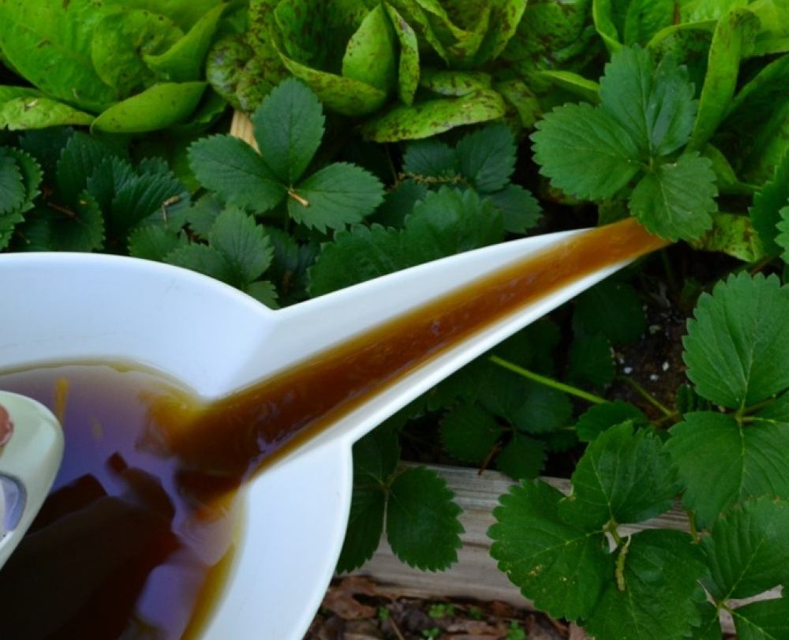
Compost tea
5 gallons compost tea mixed with 15 gallons water per acre
Once a year max
Apply between March – June
Mild temperatures (between 50 – 90)
No rain for 48 hours in forecast
Notes:
1 ¾ cups tea + 5 ¼ cups water for 10’ x 10’ facility

Slide 16
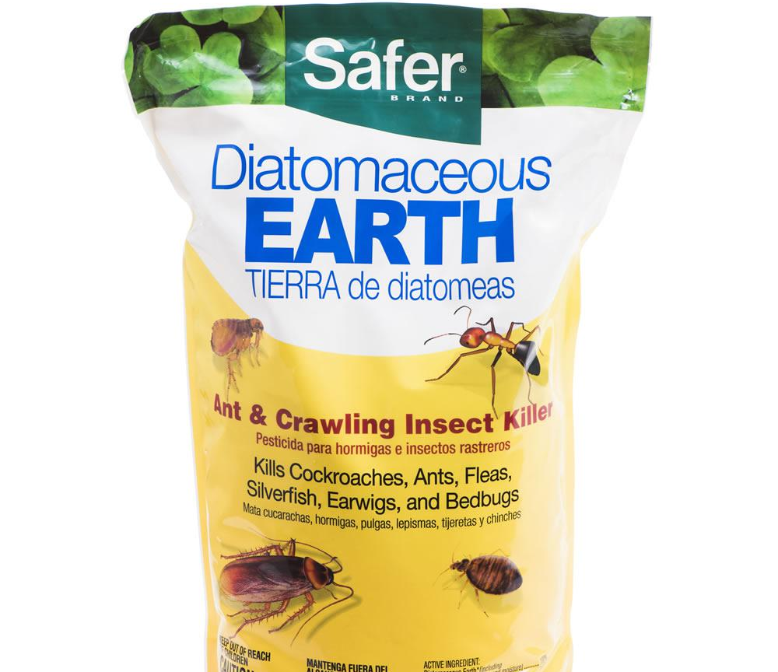
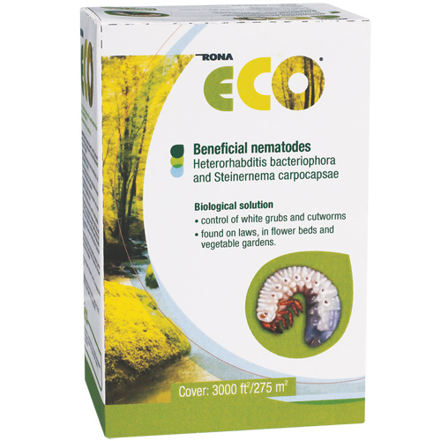
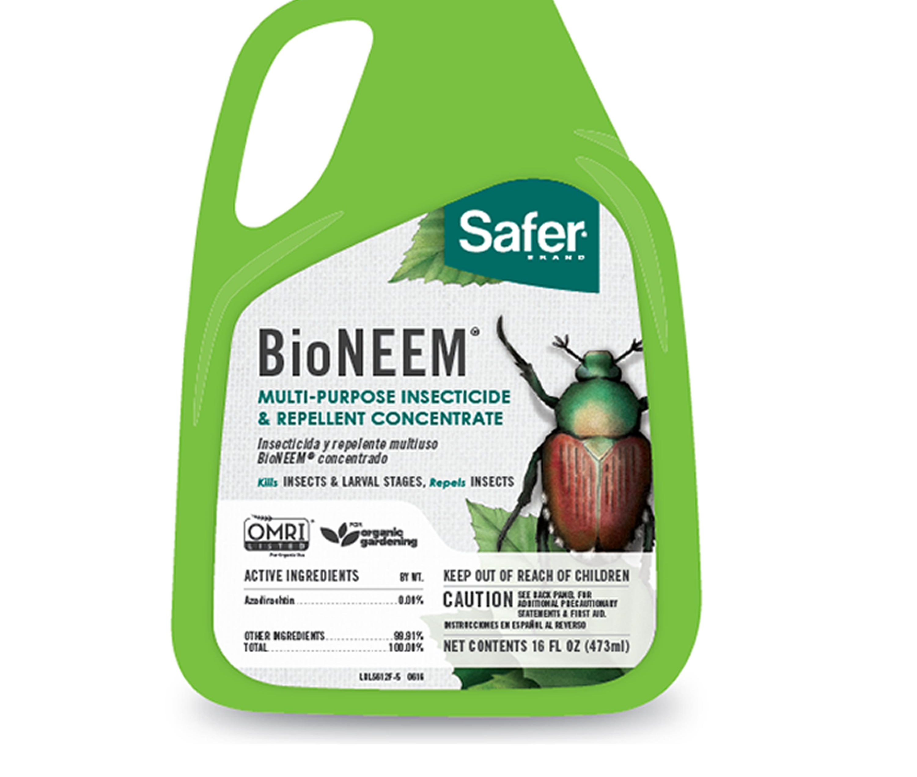
Pest Control Options:
The following may be applied for pest control if needed:
Beneficial nematodes
“Safer” Products
Neem Oil
Check UCIPM database

Slide 17
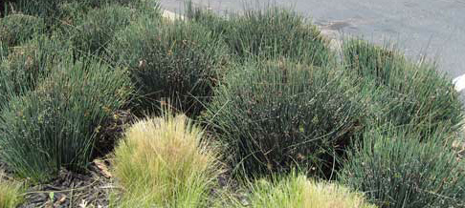
Maintaining plant health: Juncus (Rushes)
Does not benefit from cutting back regularly
If pruning: comb through, clip at base.
Do not prune to a ball. Impenetrable to new growth.
Every 3-4 years, prune to 1” in Fall/winter only, vulnerable to heat when pruned

Slide 18
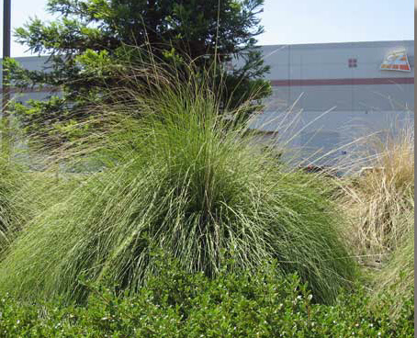
Maintaining Plants: Deer Grass
Thrives on minimal care
2-3 years thatch builds up
Cut back only slumping plants in late winter to 6” height
Other smaller species of bunch grasses can be cut to 3”

Slide 19
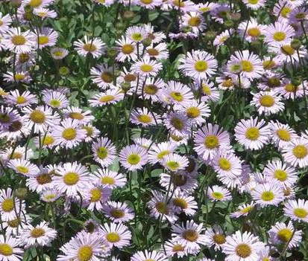
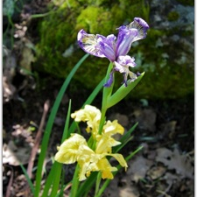
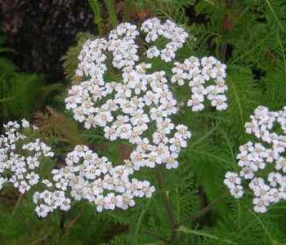
Maintaining plant health: perennials
More sensitive to flooding than grasses
Deadheading or cut off spent flower stocks at base after blooming cycle or early fall
Divide roots to refresh during winter every 3-5 years
Winter pruning: Many species can be cut to 2-3” every 2-3 years to refresh
Google it to find out if it can be refreshed before giving up

Slide 20
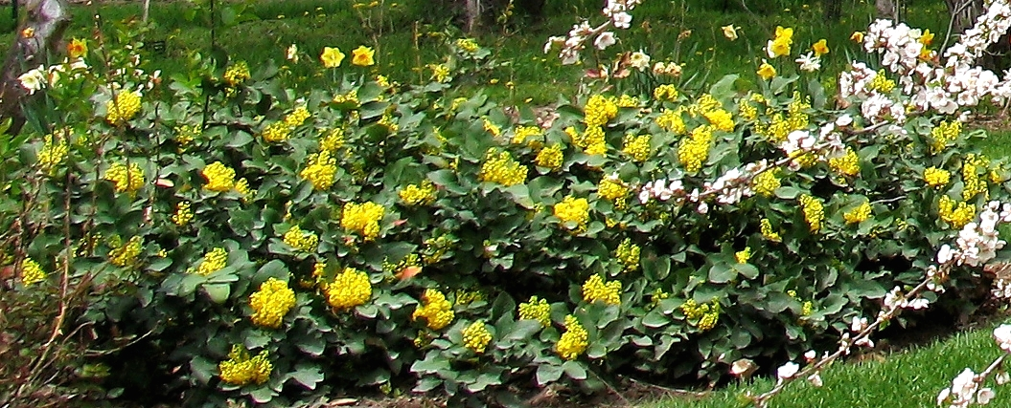
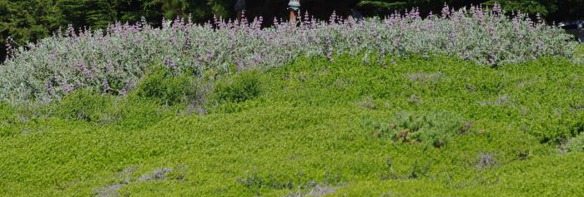
Maintaining plant health: Shrubs/Trees
Ideally shrubs are not too large for basin
Pruning: Use sharp clean tools
Remove dead wood first, crossing branches
Work slowly, selective pruning is best
Remove whole branch where it meets another major branch
Shearing is generally bad for most natives
Notes:
When in doubt google it!
Coyote brush (prostrate varieties like twin peaks or pidgeon point), upright varieties can be cut to ground
Dwarf Oregon grape – minimal pruning
Prunus ilicifolia (holly leaf cherry) – can be sheared
Cercis occidentalis (red bud) – can be cut down to near the ground and will come back

Slide 21
Irrigation
Little difference in maintenance from regular landscapes.
Avoid overwatering – potable water is not good for streams.
Many systems are subsurface drip
Inspect the system components for breaks, leaks and blockages and repair them as needed
Inspect while system is running
Adjust the system to prevent overspray outside the facility.

Slide 22
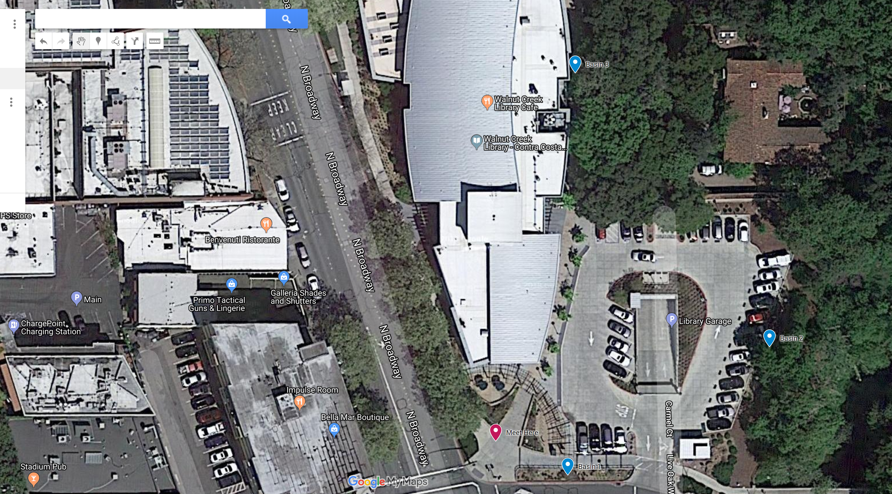
Field Walk

