Slide 1

Bioretention Design
Getting the Details Right

Slide 2
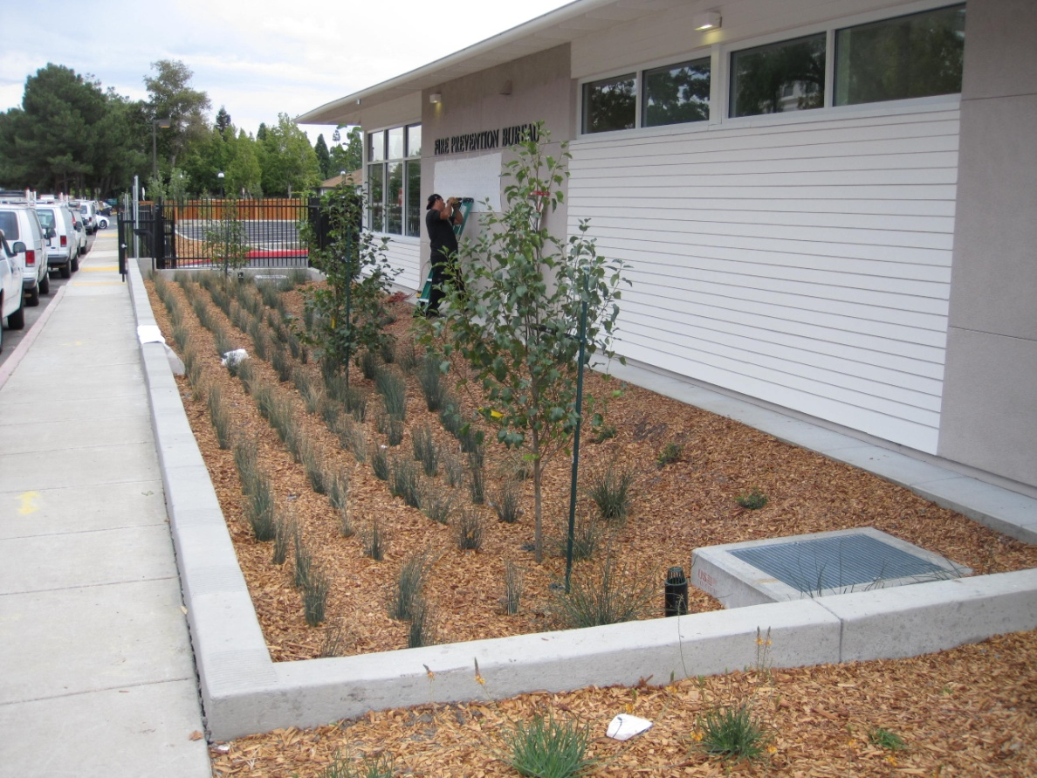
Coordination of Plans
Page
30
Curb elevations, grade breaks, architectural plans consistent with delineation of DMAs
Harvesting and Reuse
  Drainage to Cisterns
  Cisterns
  Distribution piping
Bioretention facilities are level so they “fill up like a bathtub.”

Slide 3
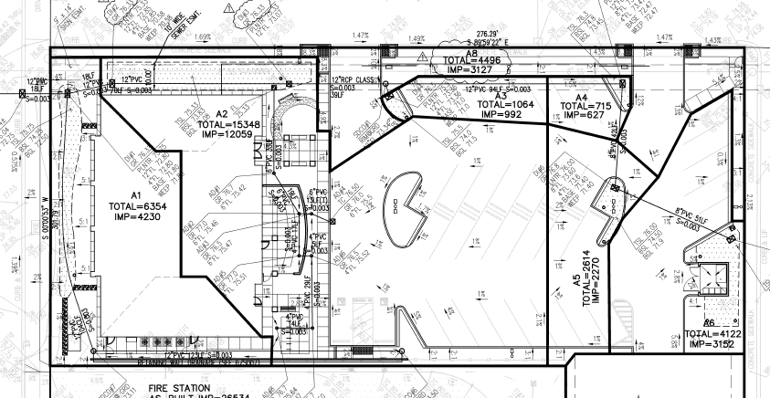
DMAs with Grading Shaded

Slide 4
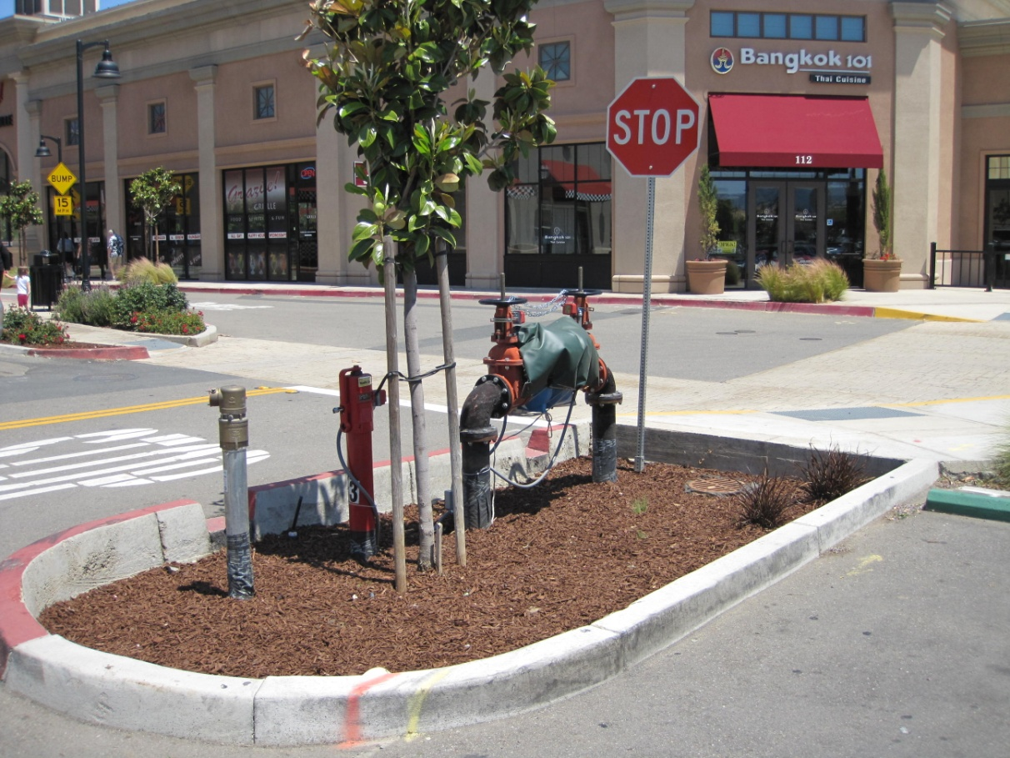
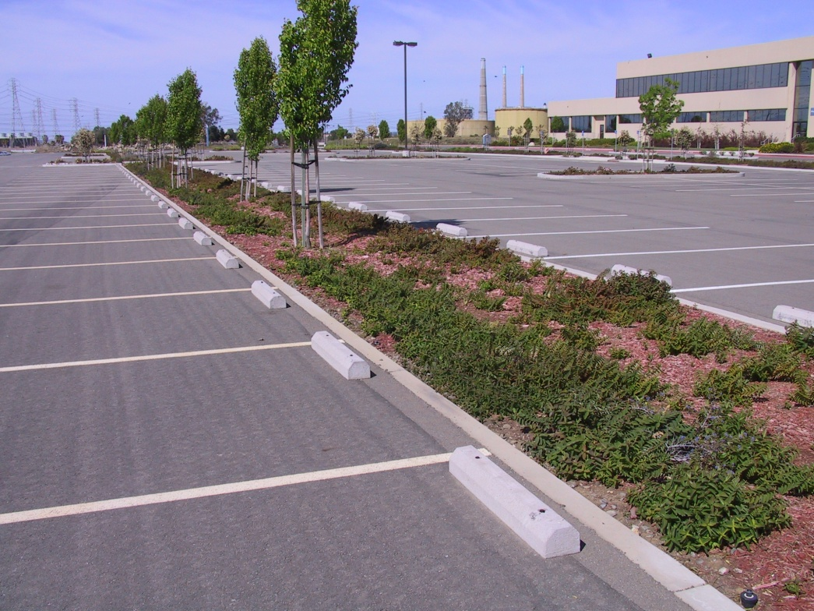
Pedestrian Access, Utilities

Slide 5
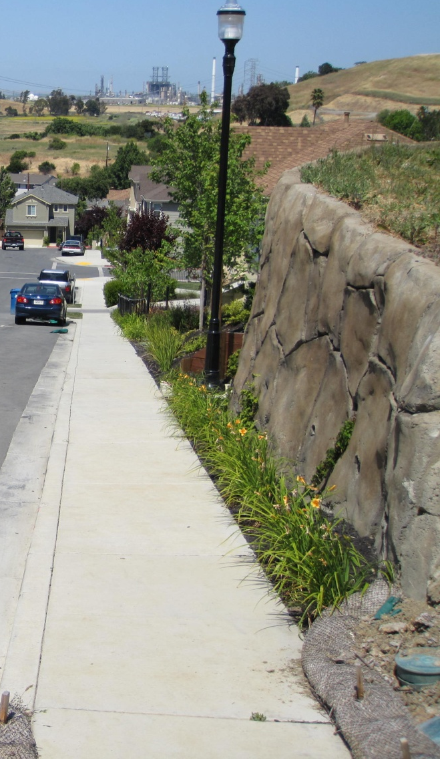
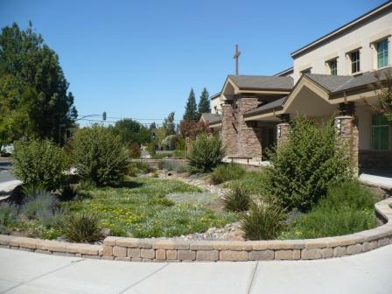
Visual Impacts, planting plans

Slide 6
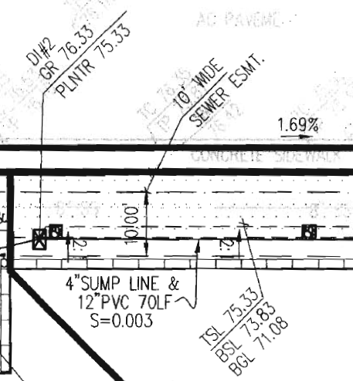
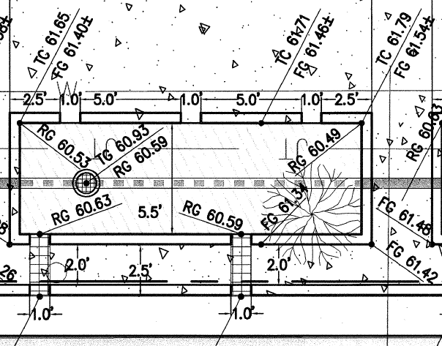
Call out elevations
    Outlet structure
  Top of overflow grate
  Underdrain connection
    Inlet
  Flow line at inlet
  Top of curb
  Top of adjacent paving
    Soil layers
  Top of soil layer
  Bottom of gravel layer
  Bottom of soil layer

Slide 7
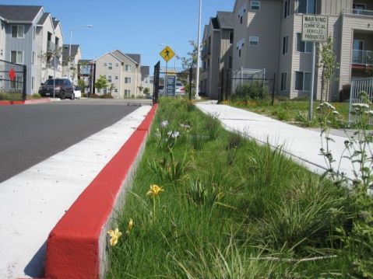
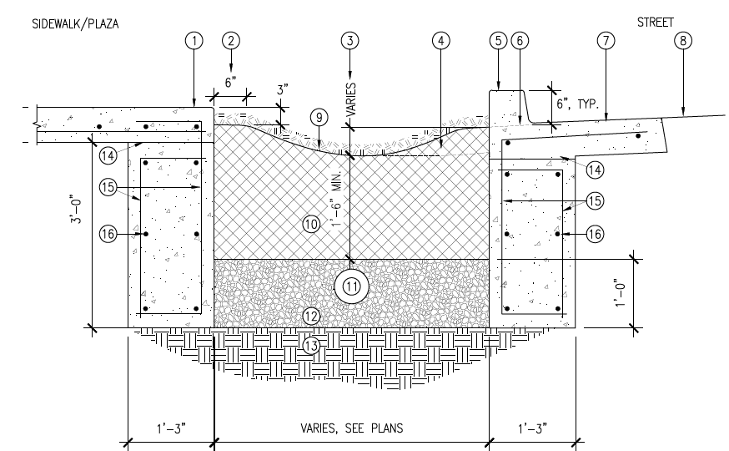
Structural
15"

Slide 8
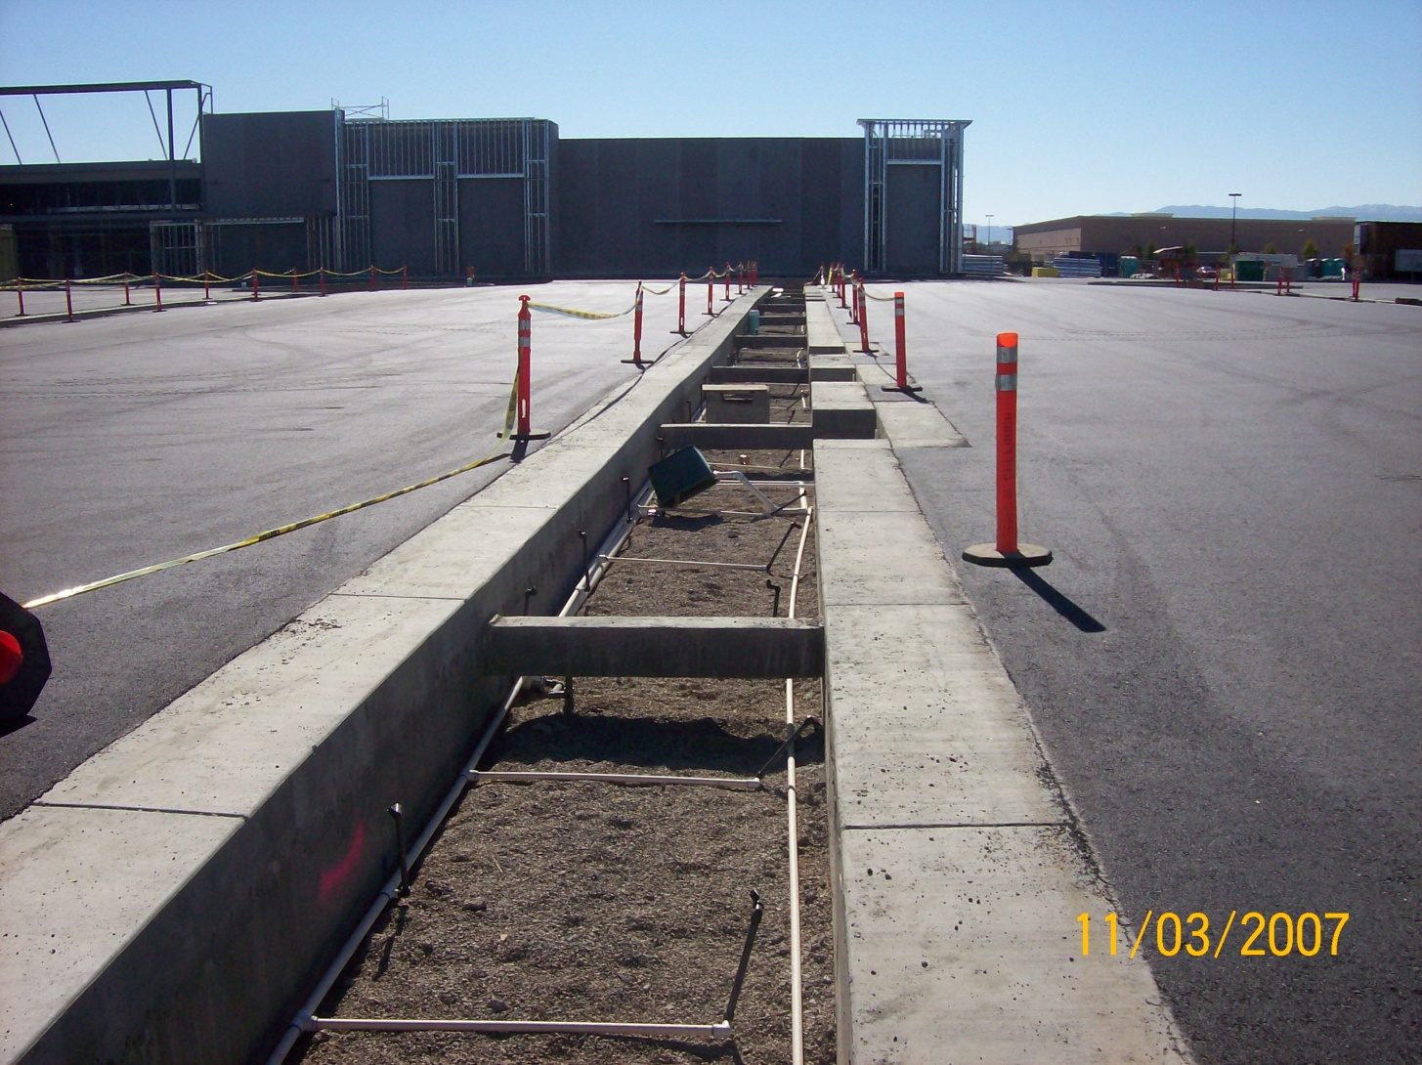
Structural

Slide 9
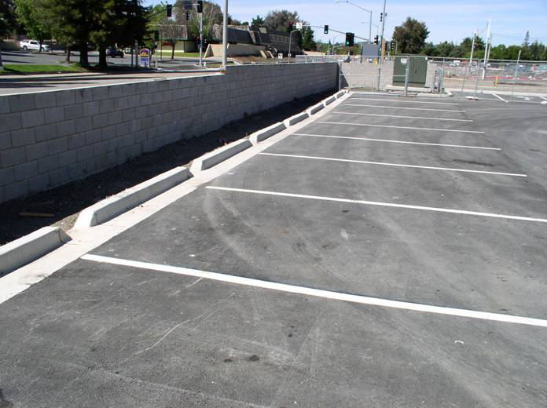
Grading and Paving

Slide 10
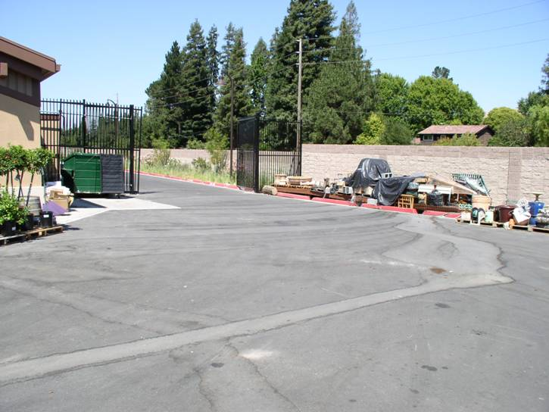
Grading

Slide 11
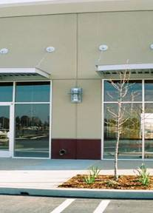
Roof leaders

Slide 12
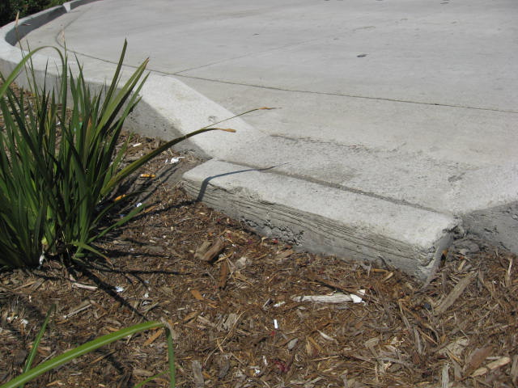
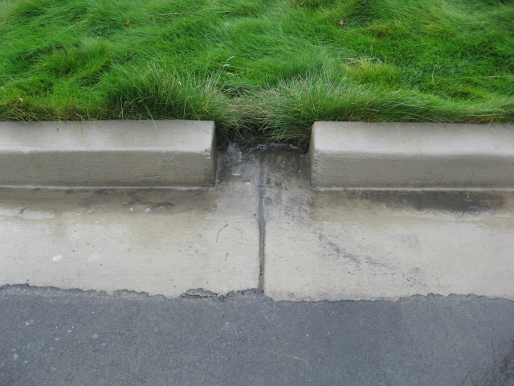
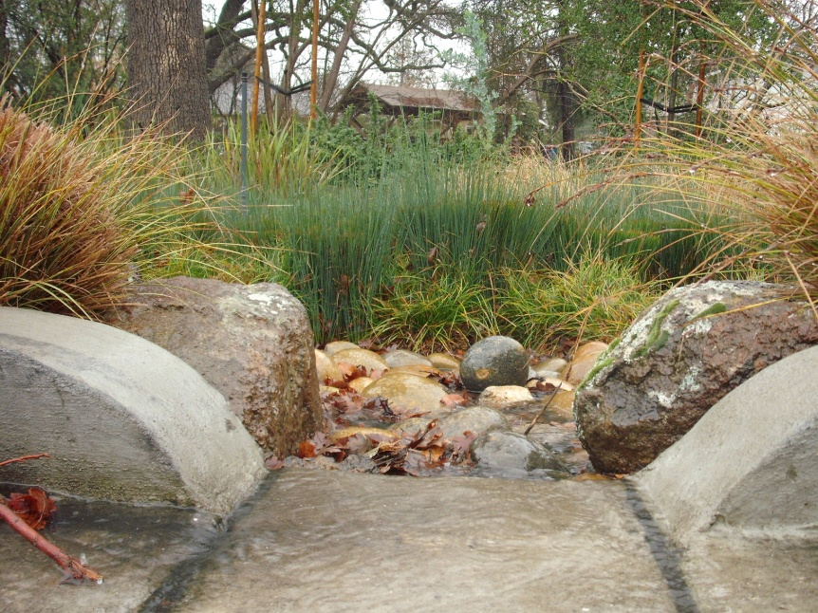
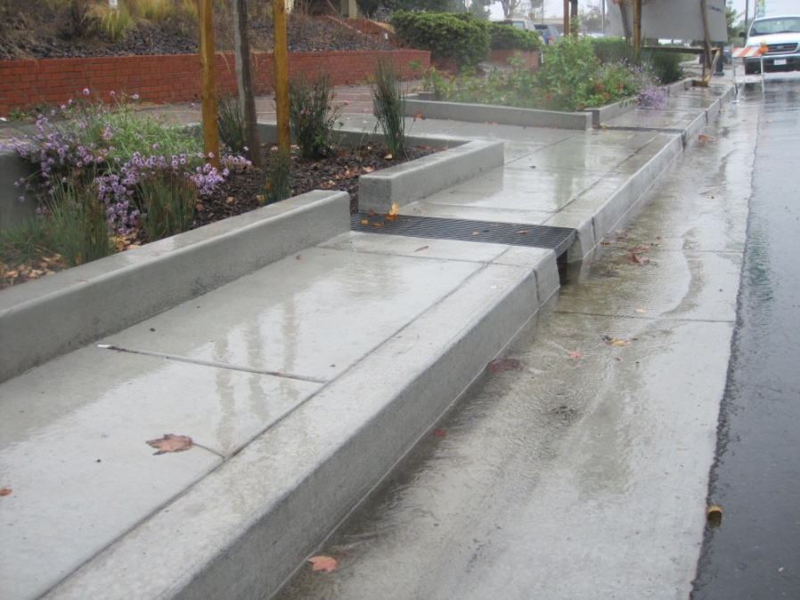
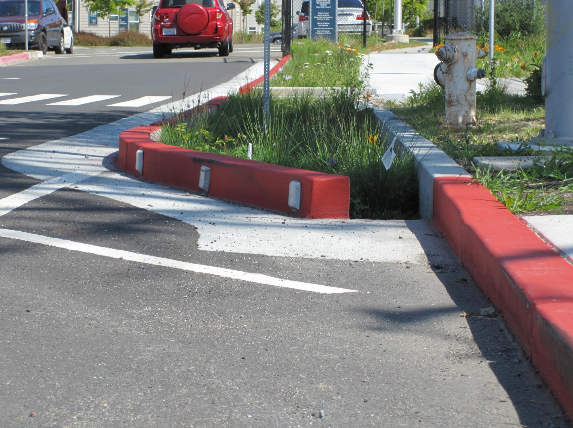
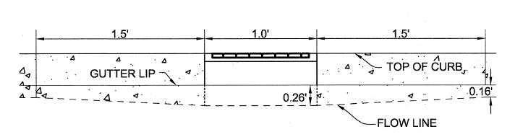
Inlets

Slide 13
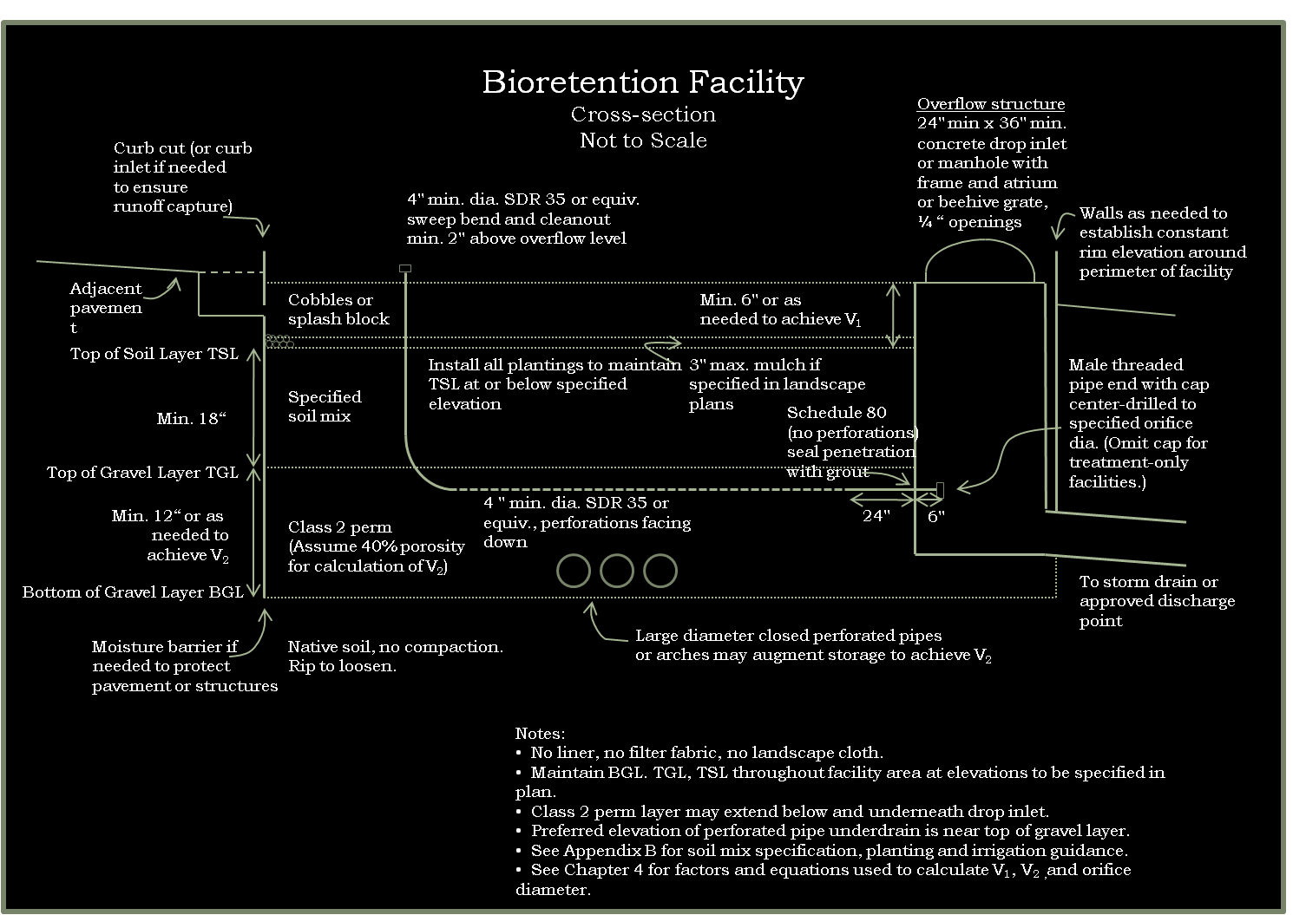
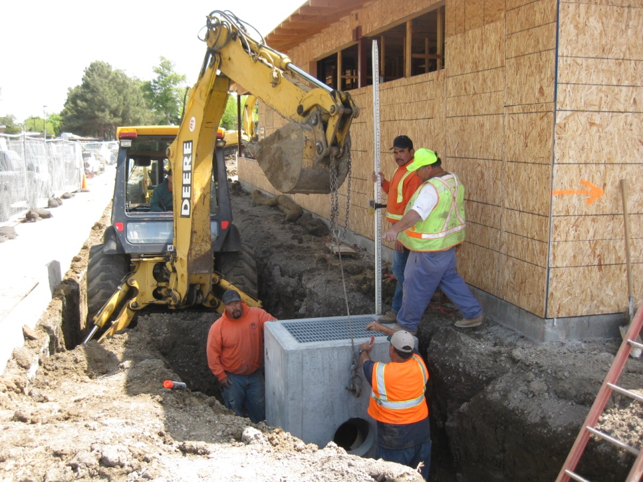
Outlets
Page
76
Overflow
elevation

Slide 14
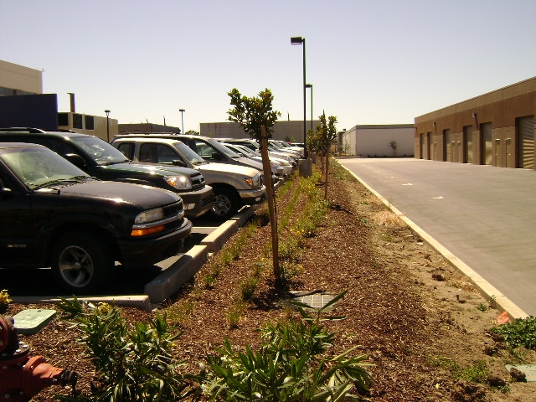
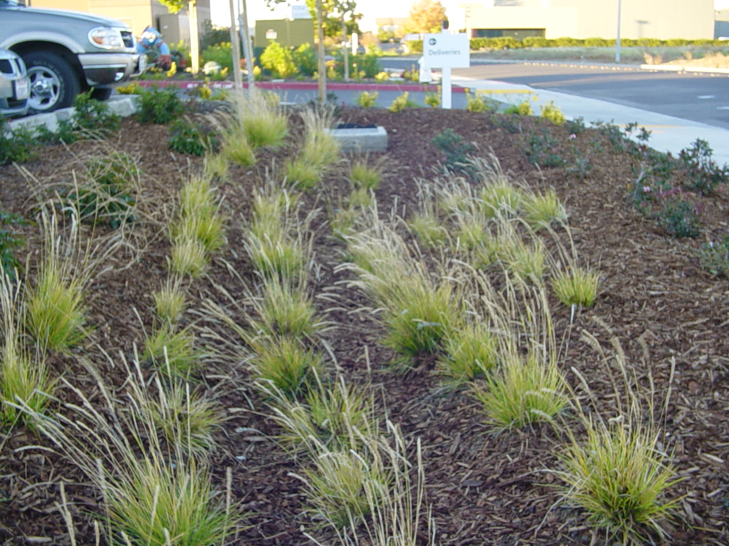
Fixing a low outlet grate

Slide 15
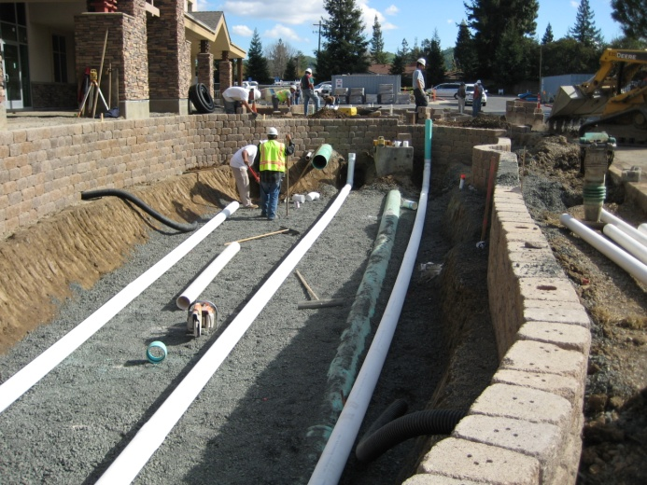
Gravel and Underdrain
    Class 2 permeable
  Caltrans spec 68-1.025
  Typical to be slightly off
  gradation spec on delivery
    No filter fabric
    Underdrain
  Near top of gravel layer
  PVC SDR 35 or equivalent; holes facing down
  Solid pipe for 2' closest to outlet structure
  Cleanout

Slide 16
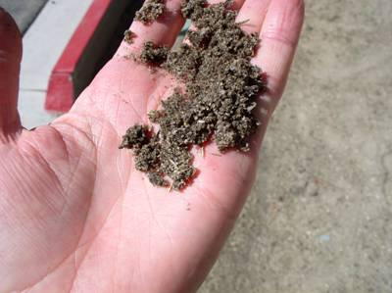
Soil Specification
    60-70% Sand
  ASTM C33 for fine aggregate
    30-40% Compost
  Certified through US Composting Council
  Seal of Testing Assurance Program
    Submittal per Guidebook
    Option to accept test results for a “brand-name” mix if volume is less than 100 cubic yards
    Install in 8"-12" lifts
    Do not compact
    Do not overfill
    Leave room for mulch

Slide 17
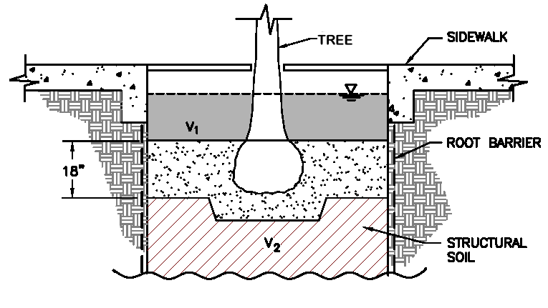
Plantings
    Maintain design top of soil elevation
    Trees
  Incorporate into bioretention facility
  Account for surface roots

