Slide 1
C.3 in MRP 2.0
What to Expect (as of March 17, 2015)
Dan Cloak

Slide 2
What’s Unlikely to Change
Threshold for Regulated Projects
Requirements for Small Projects
Exclusions, including those for roads
50% Rule
Alternative compliance
Ambiguities related to applicability
Organization of permit provision
Reporting (except for Special Projects)

Slide 3
MRP 2.0: What’s Likely to Change
Design specs for pervious pavement
Operation and maintenance verification
  Apply to pervious pavements
  Enforcement response plan required
Green Infrastructure Plan

Slide 4
Still under discussion (as of 3/17)
Grandfathering
Infiltration and Harvest/Reuse Feasibility
Soil Specification (Attachment L)
Hydromodification Management
Special Projects
  Intention to eliminate in next permit term
  Tweaks to definitions of density required
  More explicit analysis of bioretention feasibility

Slide 5
Stormwater Control Plans
What to Look for During Your Review
Dan Cloak

Slide 6
Four Questions for SCP Review
Does it meet Provision C.3 requirements?
  All impervious areas accounted for?
  Features and facilities adequately sized?
  Facilities properly designed?
Is it congruent with the project design?
  Site Plan
  Grading and Drainage Plan
  Landscaping Plan

Slide 7
Four Questions for SCP Review
Is it buildable?
  Slopes
  Soils
  Setbacks and allowable uses
  Other project requirements
Is it the best design for this project?
  Most effective stormwater treatment
  Cost effective and maintainable
  Best for municipality and community

Slide 8
Exhibit
Entire site divided into DMAs
Locations and sizes of LID facilities

Slide 9
Drainage Management Areas

Slide 10
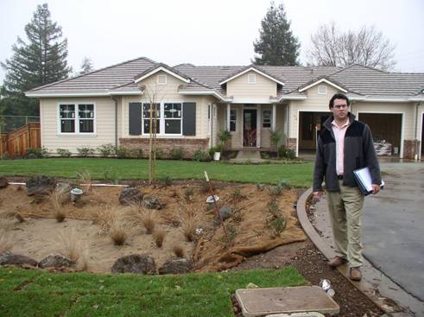
Surface Drainage

Slide 11
Before Entitlements
Delineation of DMAs is consistent with preliminary grading and drainage design
Each bioretention facility is level and flat
Facilities are shown in artist renderings
Facilities do not create conflicts with vehicle and pedestrian circulation
Landscaping plans show bioretention facilities with appropriate plant palette

Slide 12
Bioretention Facilities
What to Look for During Plan Check
Dan Cloak

Slide 13
Revisions to Preliminary Plans
Site Plan
Grading and Drainage Plan
Landscaping Plan

Slide 14
Page
76
Bioretention Design Specs

Slide 15

Bioretention Functions
evapotranspiration
losses
infiltration
Discharge
(biotreatment)

Slide 16
Flat with raised underdrain
Not this
Or this

Slide 17
Elevations

Slide 18
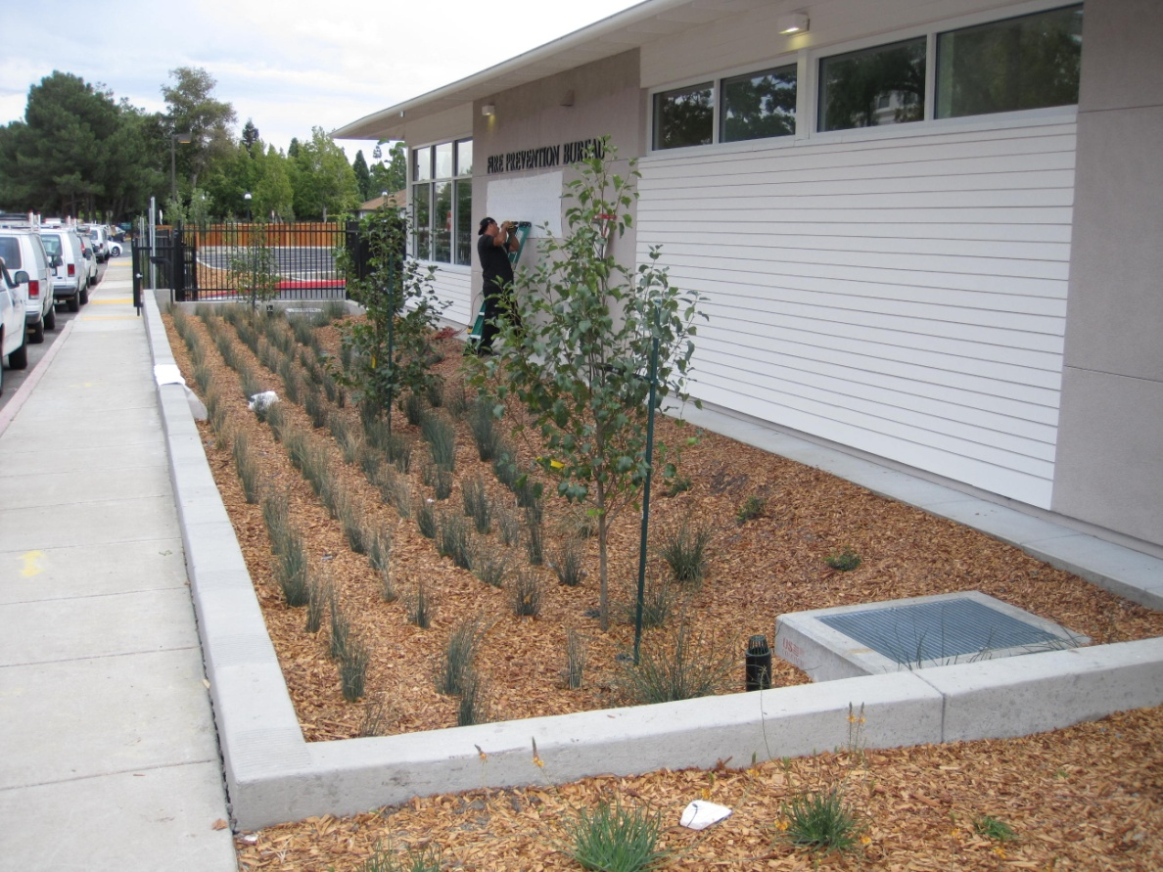
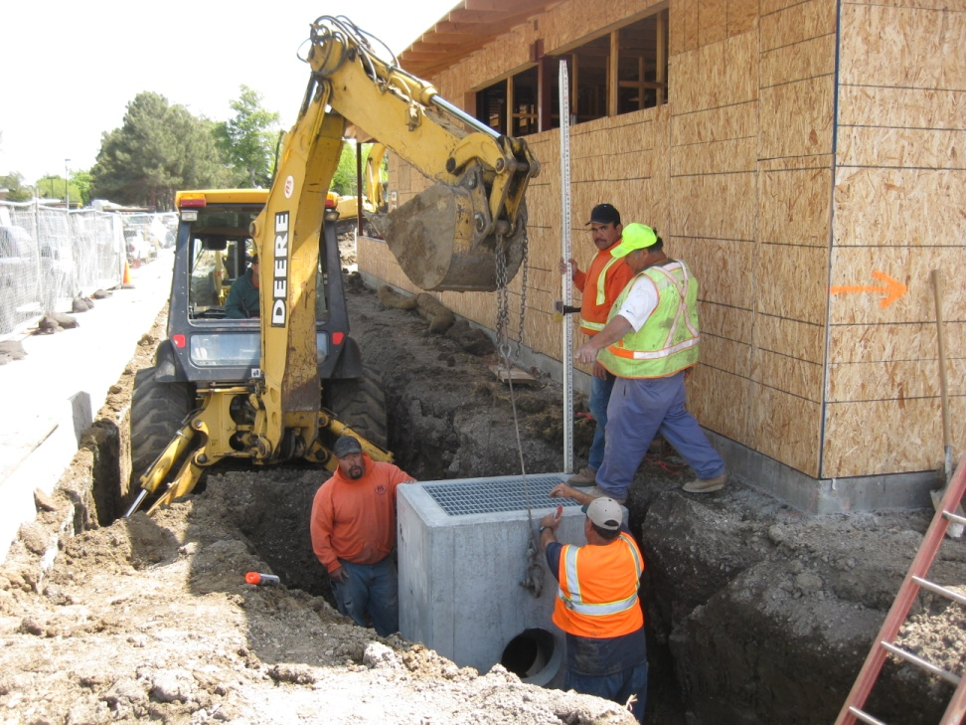
Overflow Elevation
Overflow
elevation

Slide 19
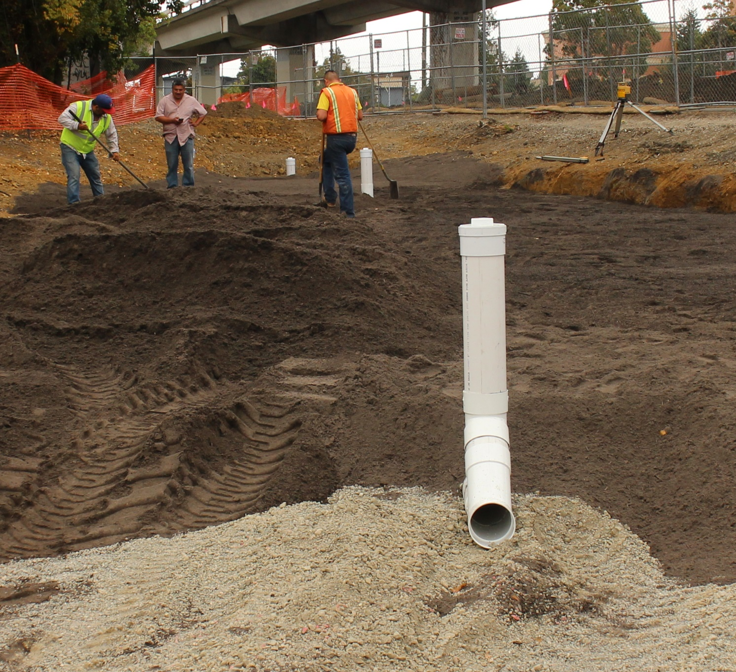
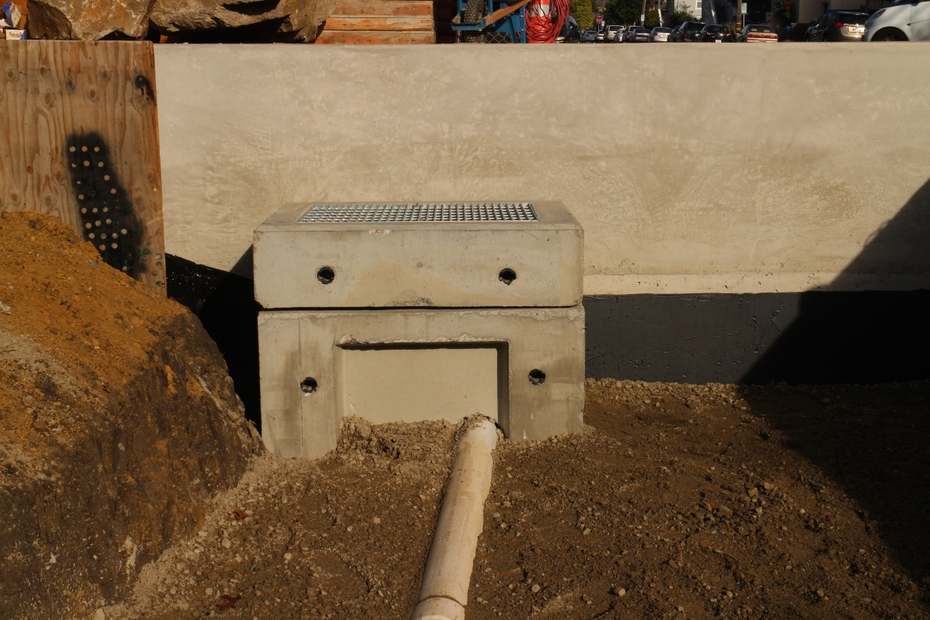
Underdrain Elevation

Slide 20
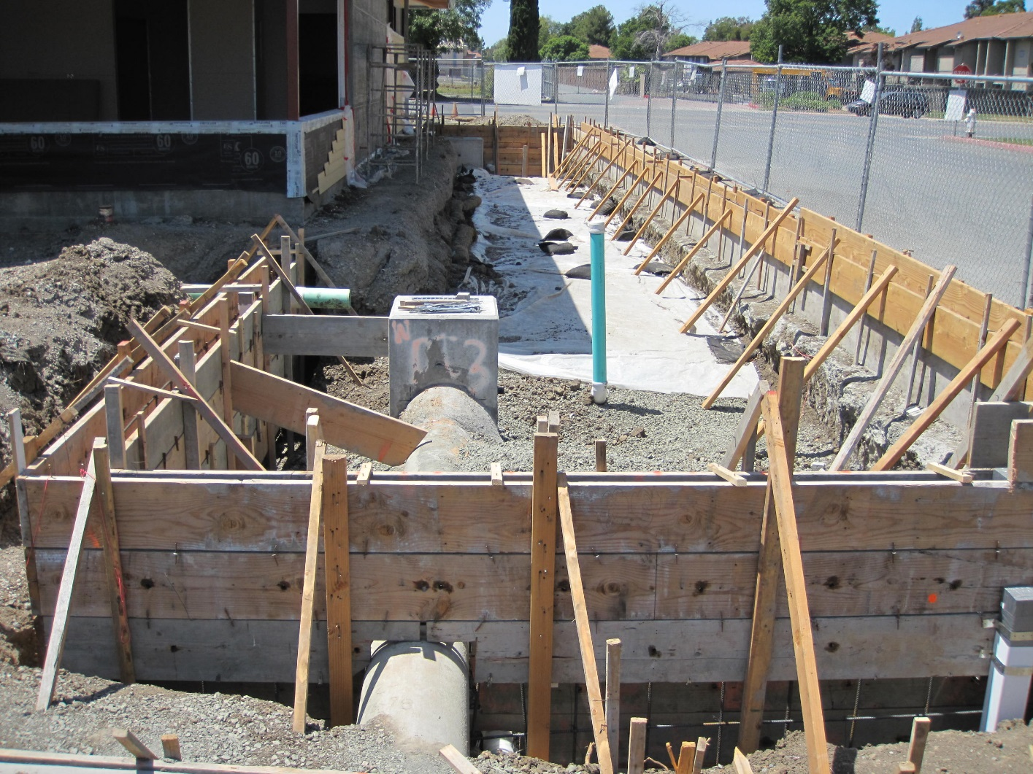
Protection of Adjacent Structures

Slide 21
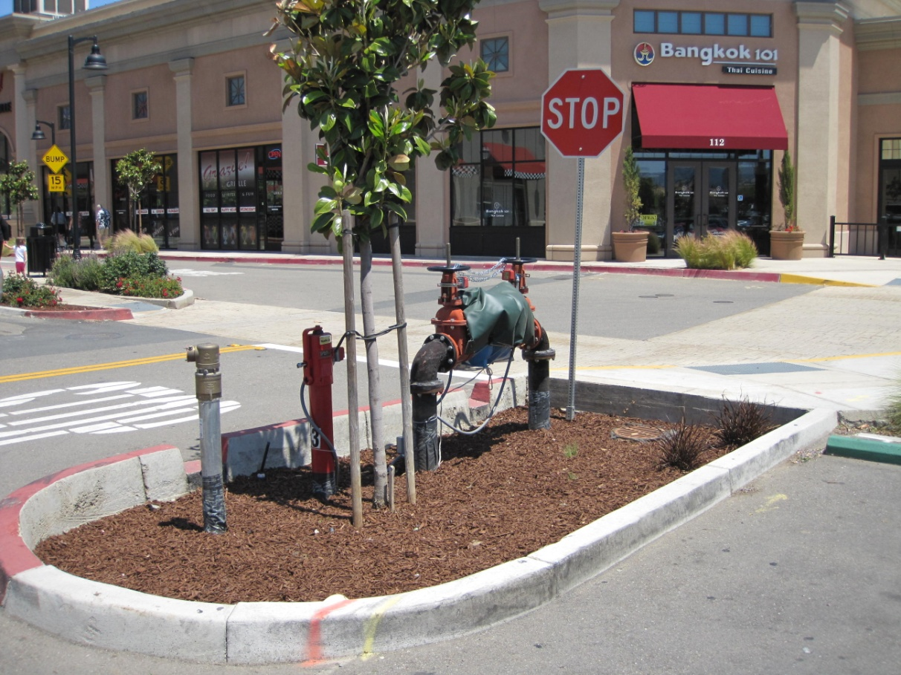
Utilities

Slide 22
Discussion

Slide 23
Inspecting Construction of Bioretention Facilities
Carlton Thompson and Jeff Cowling

Slide 24
Reviewing Bioretention
Soil Submittals
Dan Cloak, Carlton Thompson, and Jeff Cowling

Slide 25
Background
On the bioretention soil specification
Dan Cloak

Slide 26
Soil Specifications Milestones
Early bioretention specifications called for “sandy loam” with a minimum infiltration rate of 5"/hr.
Municipal staff developed a “bucket test” and then the “dirt bong” to check the infiltration rate
Staff encountered difficulty obtaining consistent and repeatable results from test

Slide 27
Soil Specifications Milestones
More consistent results could be obtained by an engineered soil (sand/compost mix)
Contra Costa developed and refined a specification (2008)
MRP 1.0 (2009) required development of a soil specification for all Permittees
Regional roundtable recommended
Contra Costa’s mix
Specification added to permit (2011)

Slide 28
Soil Specifications Milestones
Permit Attachment L allows municipalities to accept a “brand-name” mix in lieu of site-specific testing
CCCWP invited soil suppliers to submit samples and lab results for “brand name” mixes and be listed on website
Some municipalities are using the bucket test or dirt bong to field-test delivered mix

