Slide 1
Building and Testing
Rain Gardens
To Meet NPDES Retention and Hydromodification Management Requirements
Tom Dalziel Program Manager, Contra Costa Clean Water Program
Dan Cloak Dan Cloak Environmental Consulting
CASQA Conference, September 27, 2011

Slide 2

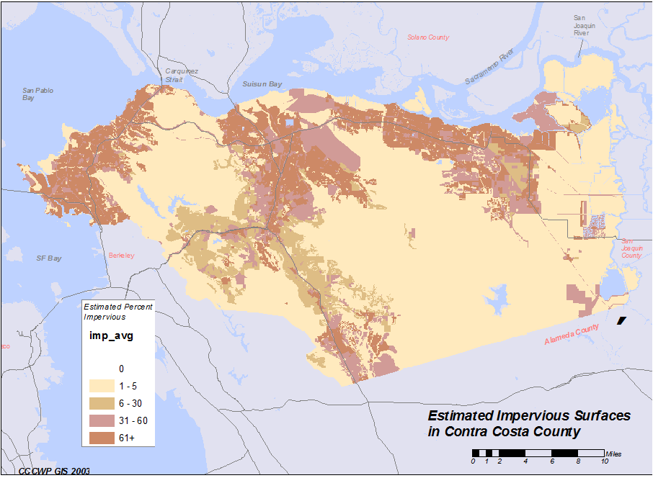
21 Copermittees
One million residents
Oldest city incorporated 1876; newest incorporated in 1999
Annual rainfall from 12" to 30"
Mostly clay soils

Slide 3
LID in Contra Costa
Stormwater C.3 Guidebook published 2005
    LID approach to treatment
    Well received and widely implemented
    Continuously improved under direction
    of municipal staff
    Fifth Edition published 10/20/2010
Hydrograph Modification Management Plan (HMP) approved 2006
    Uses LID to control flow peaks and durations
    Based on computer-modeled performance of bioretention and other LID facilities
HMP requires monitoring 5 locations to validate model

Slide 4
Topics
Bioretention:
    What we don’t know
    Why we need to know it
Model of Bioretention Performance
    Rate and duration of underdrain discharge
Design of Our Experiment
to Validate Model
Design and Construction of Bioretention Facilities and Monitoring Instrumentation
    Office Building
    Residential Townhouse Development

Slide 5


Bioretention
evapotranspiration
biotreatment
infiltration
What proportion of runoff goes where?
Notes:
Bioretention advantages: Provides infiltration, evapotranspiration and treatment to the extent feasible at the site. Underdrain is a “backup” in case infiltration rate is not sufficient to drain facility before the next storm arrives. Otherwise, there is the potential that runoff from a follow-up storm would overflow the facility.
Regulatory disadvantage: not really feasible to quantify precisely how much water goes where.
Advocates of duration control basins argue there isn’t precise control of discharge volumes and rates
Advocates of harvest and reuse (NRDC, USEPA IX – south) argue amount of treated discharge is unknown. Re-labeled bioretention as “biotreatment” and now specifically disallow it as a mode of runoff management unless harvest and reuse is shown to be infeasible (Bay Area MRP).

Slide 6
Hydromod: What’s it mean?

Slide 7
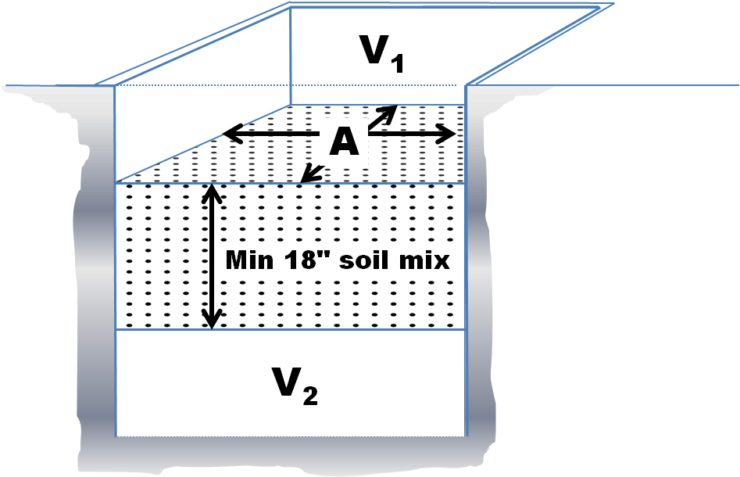
Modeling Bioretention
evapotranspiration
One Acre
inflow
underdrain
infiltration

Slide 8
About the Model
A watershed model (HSPF) was adapted to characterize bioretention performance.
    Stage-storage discharge relationships for each layer represented within FTABLEs in HSPF.
    At each time step, moisture content of the bioretention soil media, matric head within soil pores, and hydraulic conductivity of the soil media are recalculated.
    Watershed models are typically calibrated using stream gage data. This model is uncalibrated.

Slide 9
Limitations of the model
Pan evaporation was used to calculate evapotranspiration.
Single, textbook values were used for hydraulic conductivity of underlying soils.
Lateral movement of moisture from the bioretention media and gravel layer into the surrounding soil was not accounted for.
The effects of head above the underlying soil surface were not accounted for.

Slide 10
Model output: hourly flow
Hour # | Flow (cfs)
1 | 0.0
2 | 0.0
3 | 0.1
4 | 0.1
5 | 0.0
6 | 0.2
7 | 1.5
8 | 0.6
Etc.

Slide 11
250,000 hours: Sort by flow
Hour # | Flow (cfs) | Hours exceeded
115241 | 10.3 | 0
4598 | 10.3 | 1
3672 | 10.2 | 2
115242 | 10.0 | 3
243581 | 10.0 | 4
66058 | 9.9 | 5
75291 | 9.8 | 6
186540 | 9.7 | 7
Etc.
This flow was exceeded during 2 hours/250,000 hours (0.0008%)
This flow was exceeded during 7 hours/250,000 hours (0.0028%)

Slide 12
Plot Results: Compliance

Slide 13
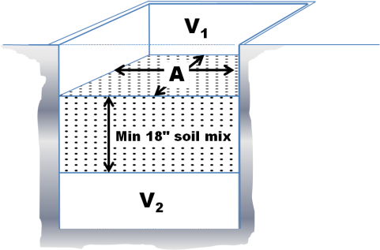
Sizing Factors
Facility Design | Soil Group | Area A (ft²/ft²) | Volume V₁ (ft³/ft²) | Volume V₂ (ft³/ft²) | Rainfall Adjustment for Surface Area | Rainfall Adjustment for Storage Volume | Maximum Release Rate
Bioretention Facility | A | 0.07 | 0.058 | No min. | Eq. 4-6 | Eq. 4-6 | No orifice
 | B | 0.11 | 0.092 | No min. | Eq. 4-7 | Eq. 4-7 | No orifice
 | C | 0.06 | 0.050 | 0.066 | Eq. 4-8 | Eq. 4-8 | Eq. 4-10
 | D | 0.05 | 0.042 | 0.055 | Eq. 4-9* | Eq. 4-9 | Eq. 4-11
Flow-through Planter | A | Not permitted in “A” soils
 | B | Not permitted in “B” soils
 | C | 0.06 | 0.050 | 0.066 | Eq. 4-8 | Eq. 4-8 | Eq. 4-10
 | D | 0.05 | 0.042 | 0.055 | Eq. 4-9* | Eq. 4-9 | Eq. 4-11
Dry Well | A | 0.05 | 0.130 | N/A | Eq. 4-6 | Eq. 4-6 | No release
 | B | 0.06 | 0.204 | N/A | Eq. 4-7 | Eq. 4-7 | No release
 | C | Not permitted in “C” soils
 | D | Not permitted in “D” soils
Cistern + Bioretention | A | 0.020 | 0.193 | N/A | Eq. 4-13 | Eq. 4-6 | Eq. 4-17
 | B | 0.009 | 0.210 | N/A | Eq. 4-14 | Eq. 4-7 | Eq. 4-12
 | C | 0.013 | 0.105 | N/A | Eq. 4-15 | Eq. 4-8 | Eq. 4-10
 | D | 0.017 | 0.063 | N/A | Eq. 4-16 | Eq. 4-9 | Eq. 4-11
Bioretention + Vault | A | 0.04 | N/A | 0.096 | N/A | Eq. 4-6 | No release
 | B | 0.04 | N/A | 0.220 | N/A | Eq. 4-7 | Eq. 4-12
 | C | 0.04 | N/A | 0.152 | N/A | Eq. 4-8 | Eq. 4-10
 | D | 0.04 | N/A | 0.064 | N/A | Eq. 4-9 | Eq. 4-11

Slide 14
Now, for a real installation:
❶ Collect on-site rain gage data.
Calculate
hourly inflow for the real tributary
area
❸ Use the model to predict hourly ET, infiltration, and underdrain flow
❹ Measure actual underdrain flow.
Notes:
Bioretention advantages: Provides infiltration, evapotranspiration and treatment to the extent feasible at the site. Underdrain is a “backup” in case infiltration rate is not sufficient to drain facility before the next storm arrives. Otherwise, there is the potential that runoff from a follow-up storm would overflow the facility.
Regulatory disadvantage: not really feasible to quantify precisely how much water goes where.
Advocates of duration control basins argue there isn’t precise control of discharge volumes and rates
Advocates of harvest and reuse (NRDC, USEPA IX – south) argue amount of treated discharge is unknown. Re-labeled bioretention as “biotreatment” and now specifically disallow it as a mode of runoff management unless harvest and reuse is shown to be infeasible (Bay Area MRP).

Slide 15
Model Validation/Tweaking
Compare predicted to actual outflow rates (hour by hour).
Tweak the model inputs so that model output more accurately represents actual underdrain discharge (hour-by-hour and storm-by-storm).
Then, use those new model inputs to recalculate sizing factors for bioretention minimum area (A), surface storage volume (V₁) and subsurface storage volume (V₂).

Slide 16
Bonus
We can then input 30+ years of rainfall data and use our validated/tweaked model to predict the percent infiltrated + evapotranspirated (annual average).
Notes:
Bioretention advantages: Provides infiltration, evapotranspiration and treatment to the extent feasible at the site. Underdrain is a “backup” in case infiltration rate is not sufficient to drain facility before the next storm arrives. Otherwise, there is the potential that runoff from a follow-up storm would overflow the facility.
Regulatory disadvantage: not really feasible to quantify precisely how much water goes where.
Advocates of duration control basins argue there isn’t precise control of discharge volumes and rates
Advocates of harvest and reuse (NRDC, USEPA IX – south) argue amount of treated discharge is unknown. Re-labeled bioretention as “biotreatment” and now specifically disallow it as a mode of runoff management unless harvest and reuse is shown to be infeasible (Bay Area MRP).

Slide 17
Insight
Within some of the facilities,
we will also track saturation level.
Notes:
Bioretention advantages: Provides infiltration, evapotranspiration and treatment to the extent feasible at the site. Underdrain is a “backup” in case infiltration rate is not sufficient to drain facility before the next storm arrives. Otherwise, there is the potential that runoff from a follow-up storm would overflow the facility.
Regulatory disadvantage: not really feasible to quantify precisely how much water goes where.
Advocates of duration control basins argue there isn’t precise control of discharge volumes and rates
Advocates of harvest and reuse (NRDC, USEPA IX – south) argue amount of treated discharge is unknown. Re-labeled bioretention as “biotreatment” and now specifically disallow it as a mode of runoff management unless harvest and reuse is shown to be infeasible (Bay Area MRP).

Slide 18
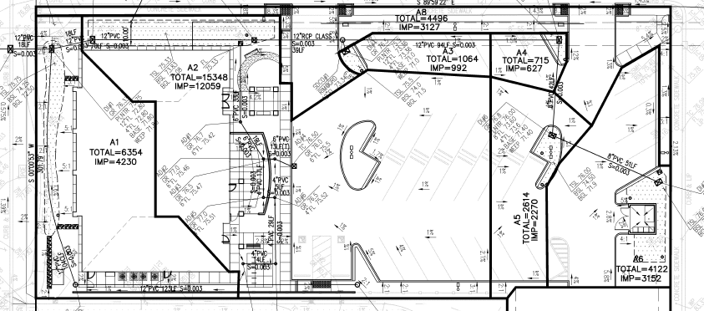
Fire Protection Building

Slide 19
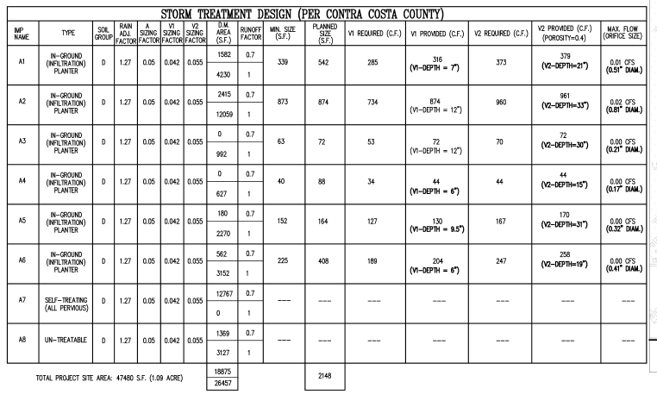
Sizing per Guidebook

Slide 20
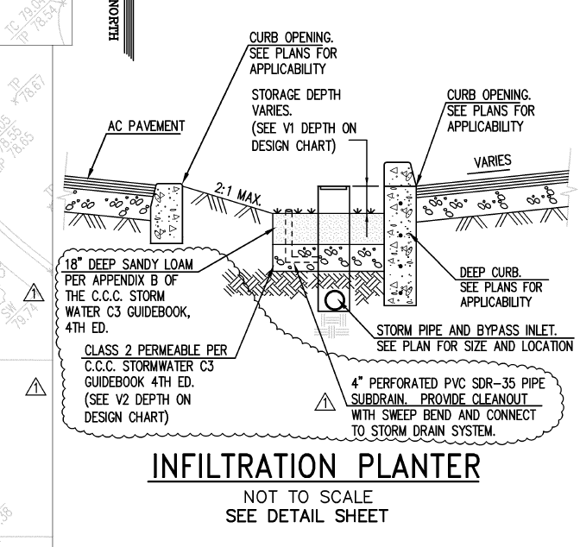
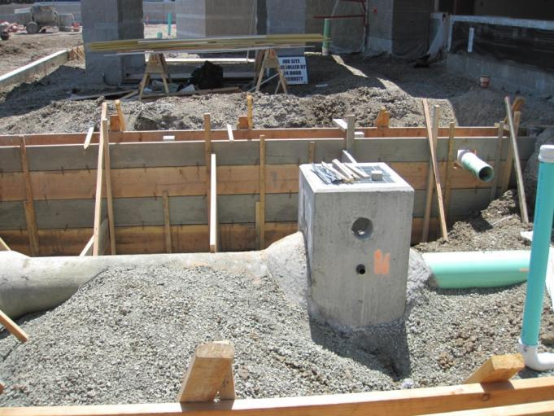
Design and Construction

Slide 21
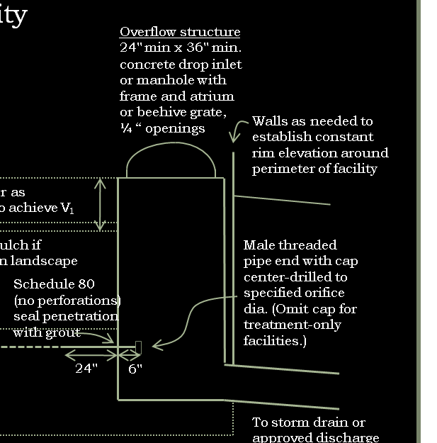
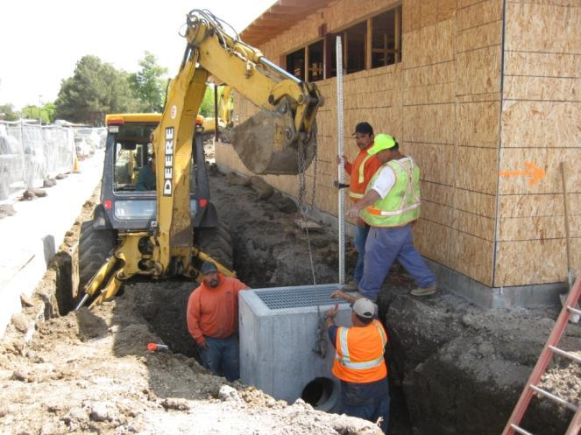
Outlet Design
Overflow
elevation

Slide 22
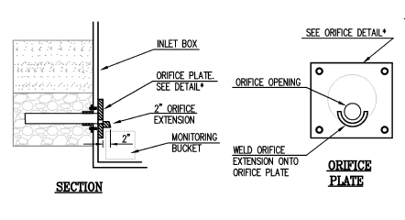
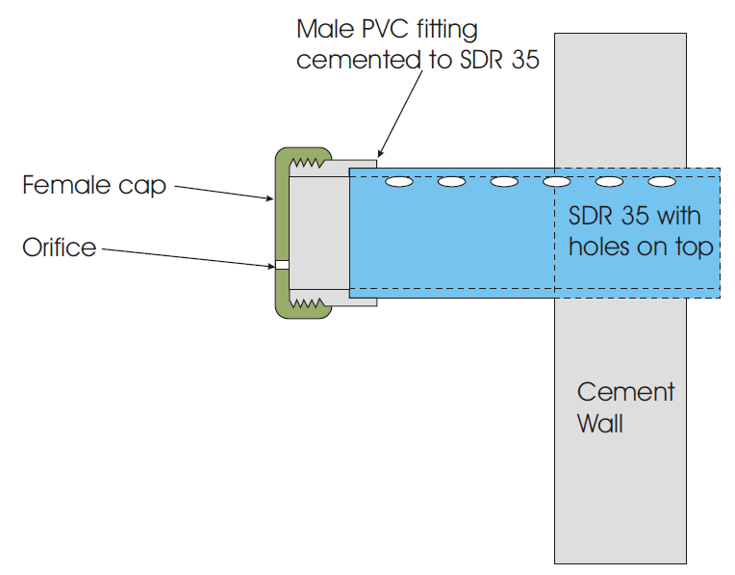
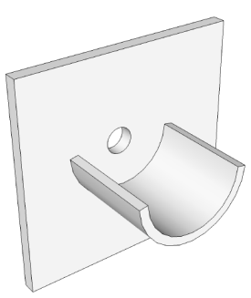
Orifice Design

Slide 23
Bioretention Facility
Cross-section
Not to Scale
Overflow structure
24" min x 36" min.
concrete drop inlet
or manhole with frame and atrium or beehive grate,
¼ “ openings
Curb cut (or curb
inlet if needed
to ensure
runoff capture)
4" min. dia. SDR 35 or equiv.
sweep bend and cleanout
min. 2" above overflow level
Walls as needed to
establish constant
rim elevation around
perimeter of facility
Adjacent pavement
Cobbles or
splash block
Min. 6" or as
needed to achieve V₁
Top of Soil Layer TSL
Install all plantings to maintain
TSL at or below specified
elevation
3" max. mulch if
specified in landscape
plans
Male threaded pipe end with cap center-drilled to specified orifice dia. (Omit cap for treatment-only facilities.)
Specified
soil mix
Schedule 80
(no perforations)
seal penetration with grout
Min. 18“
Top of Gravel Layer TGL
4 " min. dia. SDR 35 or equiv., perforations facing down
Min. 12“ or as
needed to
achieve V₂
Class 2 perm
(Assume 40% porosity
for calculation of V₂)
24"
6"
Bottom of Gravel Layer BGL
To storm drain or
approved discharge
point
Moisture barrier if
needed to protect
pavement or structures
Native soil, no compaction.
Rip to loosen.
Large diameter closed perforated pipes
or arches may augment storage to achieve V₂
Notes:
No liner, no filter fabric, no landscape cloth.
Maintain BGL. TGL, TSL throughout facility area at elevations to be specified in plan.
Class 2 perm layer may extend below and underneath drop inlet.
Preferred elevation of perforated pipe underdrain is near top of gravel layer.
See Appendix B for soil mix specification, planting and irrigation guidance.
See Chapter 4 for factors and equations used to calculate V₁, V_{2 ,}and orifice diameter.

Slide 24
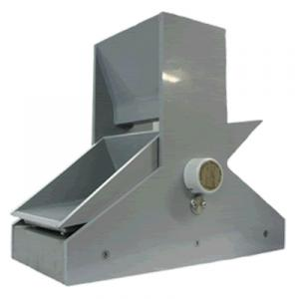
Instrumentation
Hydro Services TV!LT Tipping Bucket
Required 12” clear from orifice to bottom of catch basin
Installed weir and pump system to prevent storm drain backups from flooding instrumentation

Slide 25
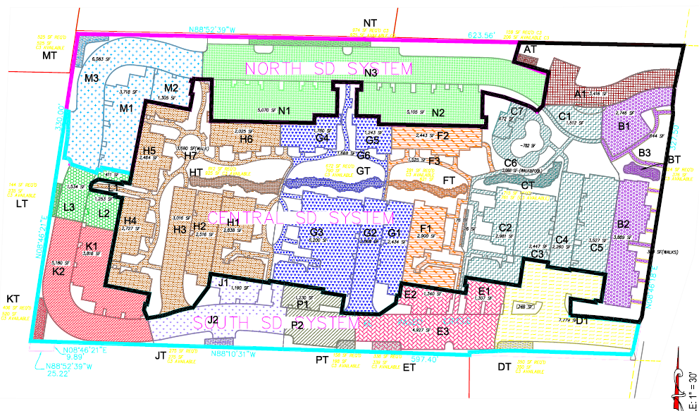
Walden Park Commons

Slide 26
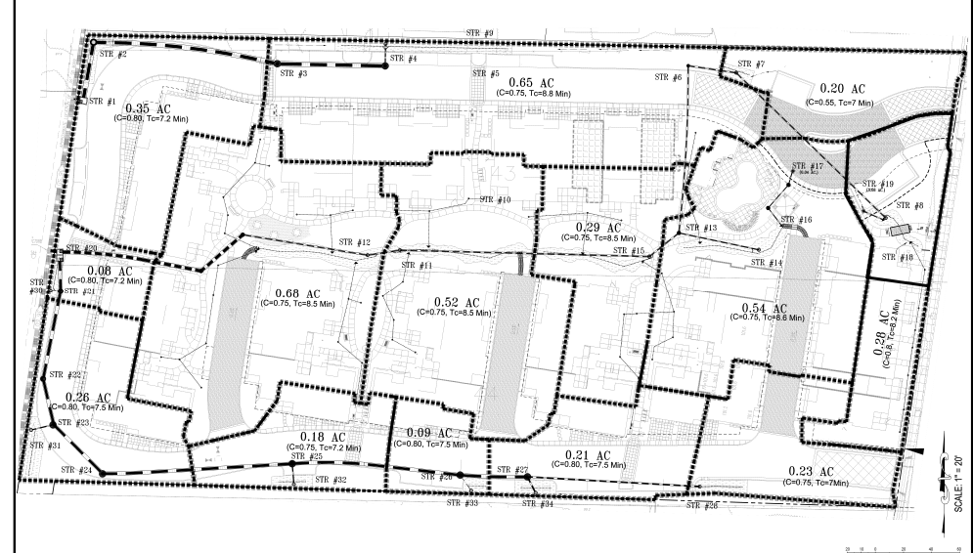
Walden Park Commons

Slide 27
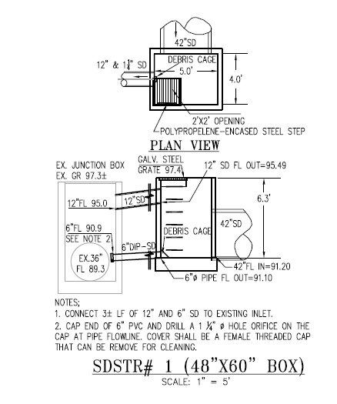
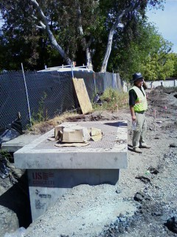
Outlet Design

Slide 28
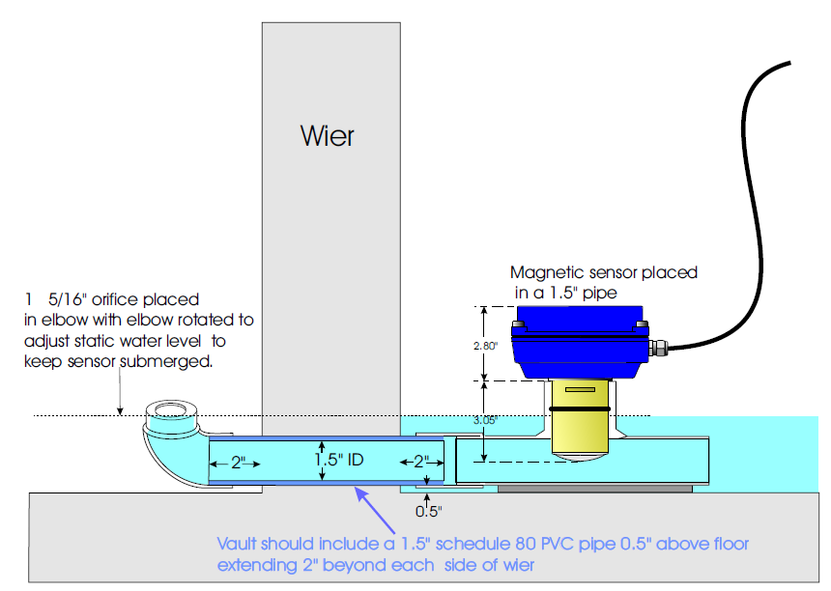
Magmeter Installation

Slide 29
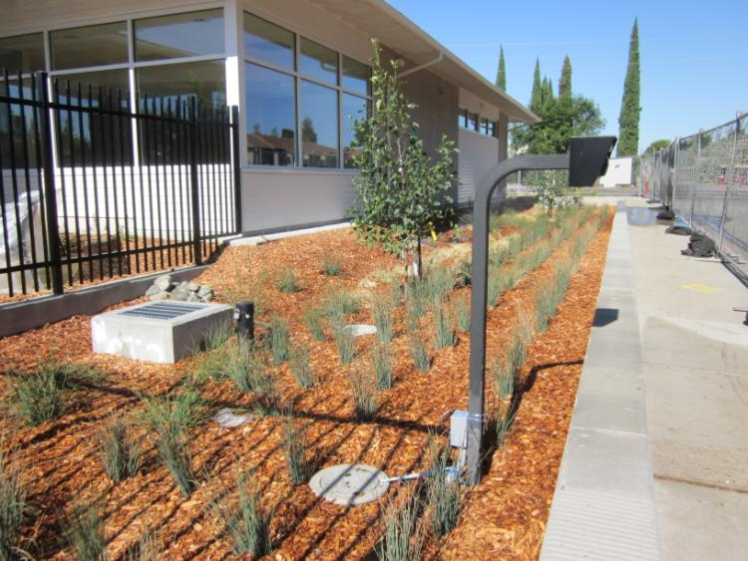
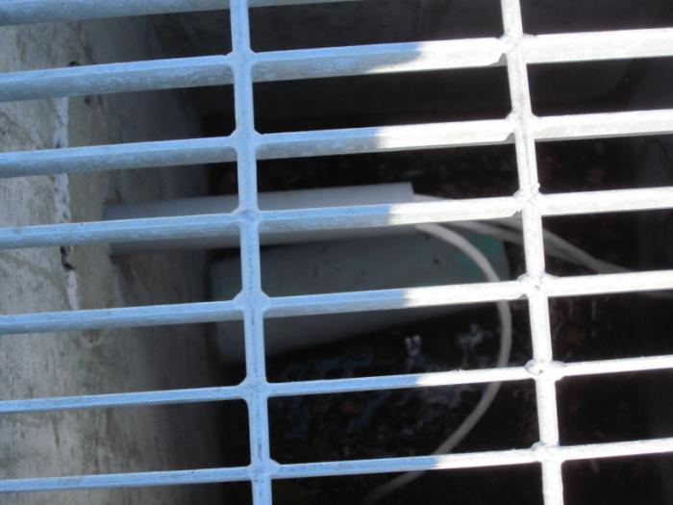
Ready to begin monitoring

Slide 30
Status and Schedule
Development projects completed
summer 2011.
Instrumentation installed
September 2011.
Data collection during 2011-2012
and 2012-2013 rainy seasons.
Analysis of initial data during 2012.
Report due to SF Bay Water Board
April 1, 2014

Slide 31
Credits and Info
Jolan Longway, City of Pittsburg
Carlton Thompson, City of Walnut Creek
Scott McQuarrie and Mark Boucher, Contra Costa Flood Control District
www.cccleanwater.org or search for “Contra Costa Stormwater”

